Slide 1
The Circular Functions (The Unit Circle)
Section 4.3 – Day 1

Slide 2
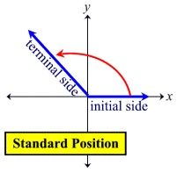
Angle and Angle Measurements
Terms
Image
Initial Side:
Always on the x-axis.
Terminal Side:
Ending point.

Slide 3
Angle Measure
Positive Angle
Negative Angle
Counterclockwise
Clockwise

Slide 4
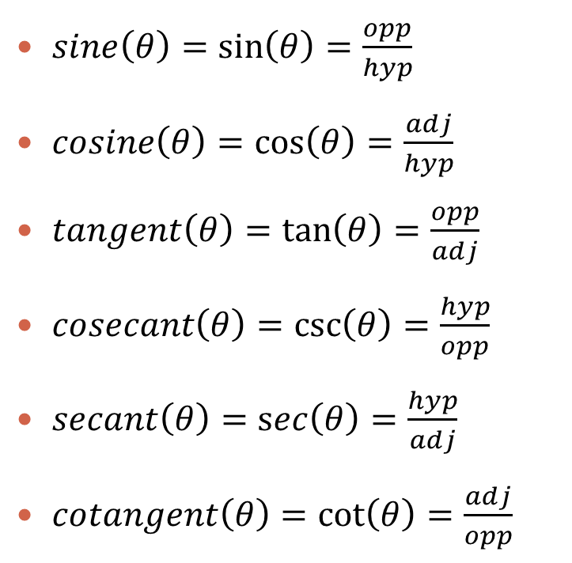
Trigonometric Functions
Reference Triangle
Let $θ$ be an acute angle in the right triangle $∆ABC$. Then,
$sine\left(θ\right)=\sin\left(θ\right)=\frac{opp}{hyp}$
$cosine\left(θ\right)=\cos\left(θ\right)=\frac{adj}{hyp}$
$tangent\left(θ\right)=\tan\left(θ\right)=\frac{opp}{adj}$
$cosecant\left(θ\right)=\csc\left(θ\right)=\frac{hyp}{opp}$
$secant\left(θ\right)=\sec\left(θ\right)=\frac{hyp}{adj}$
$cotangent\left(θ\right)=\cot\left(θ\right)=\frac{adj}{opp}$

Slide 5
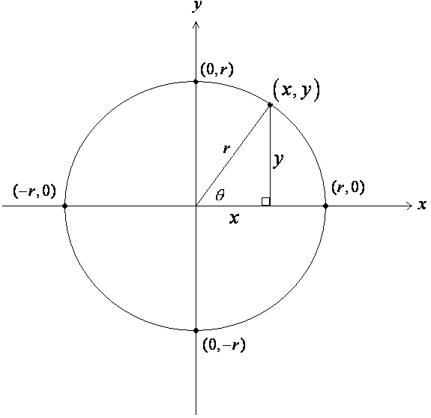
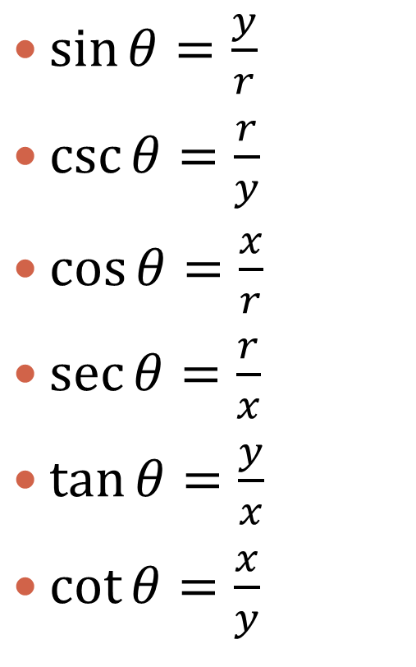
Trig Functions of General Angles
$\sin{θ}=\frac{y}{r}$
$\csc{θ}=\frac{r}{y}$
$\cos{θ}=\frac{x}{r}$
$\sec{θ}=\frac{r}{x}$
$\tan{θ}=\frac{y}{x}$
$\cot{θ}=\frac{x}{y}$

Slide 6
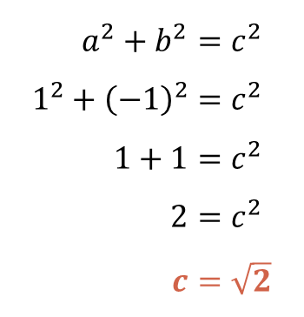
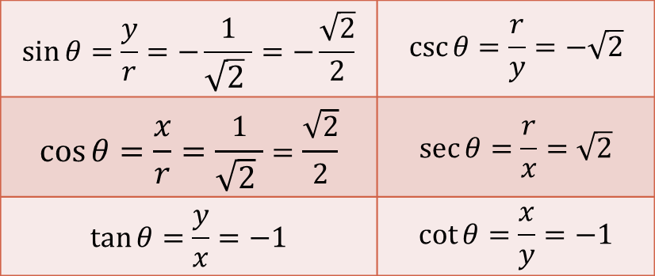
Exercises: #1 – #4
Directions: Evaluate the six trigonometric functions of $θ$.
$$1$$
$$a^{2}+b^{2}=c^{2} \\ 1^{2}+{\left(−1\right)}^{2}=c^{2} \\ 1+1=c^{2} \\ 2=c^{2} \\ c=\sqrt{2}$$
$$θ$$
$$−1$$
$$\sqrt{2}$$
$$θ$$
$$P(1,−1)$$
$$\sin{θ}=\frac{y}{r}=−\frac{1}{\sqrt{2} }=−\frac{\sqrt{2}}{2}$$ | $$\csc{θ}=\frac{r}{y}=−\sqrt{2}$$
$$\cos{θ}=\frac{x}{r}=\frac{1}{\sqrt{2} }=\frac{\sqrt{2}}{2}$$ | $$\sec{θ}=\frac{r}{x}=\sqrt{2}$$
$$\tan{θ}=\frac{y}{x}=−1$$ | $$\cot{θ}=\frac{x}{y}=−1$$

Slide 7




Exercises: #5 – #10
Directions: Point P is on the terminal side of $θ$. Evaluate the six trigonometric functions of $θ$.
$P (3, 4)$
$P (−2, 0)$
$$x=−2 \\ y=0 \\ r=2$$
$$a^{2}+b^{2}=c^{2} \\ 3^{2}+4^{2}=c^{2} \\ 9+16=c^{2} \\ 25=c^{2} \\ c=5$$
$$(3, 4)$$
$$(−2, 0)$$
$$5$$
$$4$$
$$θ$$
$$\sin{θ}=\frac{y}{r}=\frac{0}{2}=0$$ | $\csc{θ}=\frac{r}{y}=\frac{2}{0}=$ UND
$$\cos{θ}=\frac{x}{r}=−\frac{2}{2}=−1$$ | $$\sec{θ}=\frac{r}{x}=−\frac{2}{2}=−1$$
$$\tan{θ}=\frac{y}{x}=−\frac{0}{−2}=0$$ | $\cot{θ}=\frac{x}{y}=−\frac{2}{0}=$ UND
$$3$$

Slide 8
HOMEWORK
P. 365: #1 – #10

Slide 9
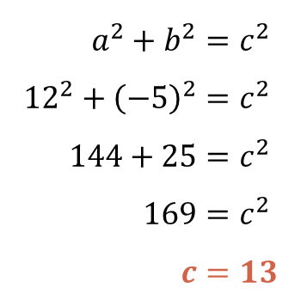
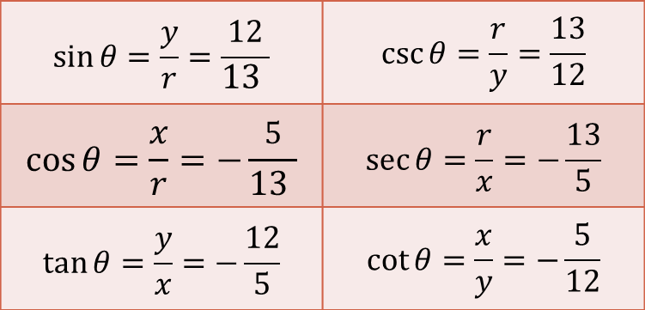
Exit Slip
Directions: Evaluate the six trigonometric functions of $θ$.
$$a^{2}+b^{2}=c^{2} \\ {12}^{2}+{\left(−5\right)}^{2}=c^{2} \\ 144+25=c^{2} \\ 169=c^{2} \\ c=13$$
$$13$$
$$12$$
$$θ$$
$$P(−5, 12)$$
$$θ$$
$$−5$$
$$\sin{θ}=\frac{y}{r}=\frac{12}{13 }$$ | $$\csc{θ}=\frac{r}{y}=\frac{13}{12}$$
$$\cos{θ}=\frac{x}{r}=−\frac{5}{13 }$$ | $$\sec{θ}=\frac{r}{x}=−\frac{13}{5}$$
$$\tan{θ}=\frac{y}{x}=−\frac{12}{5}$$ | $$\cot{θ}=\frac{x}{y}=−\frac{5}{12}$$

Slide 10
The Circular Functions (The Unit Circle)
Section 4.3 – Day 2

Slide 11
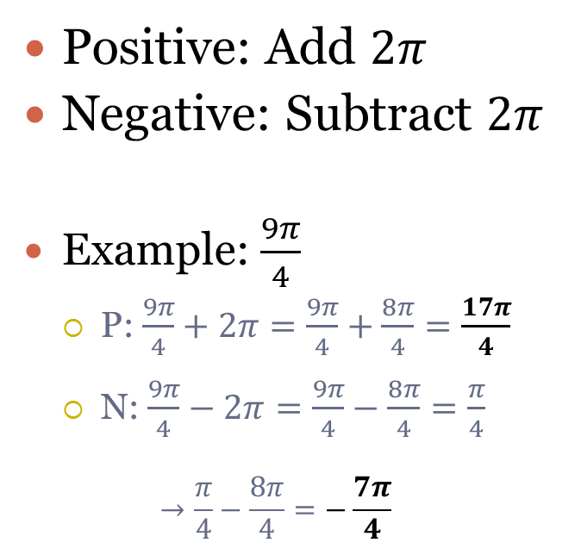
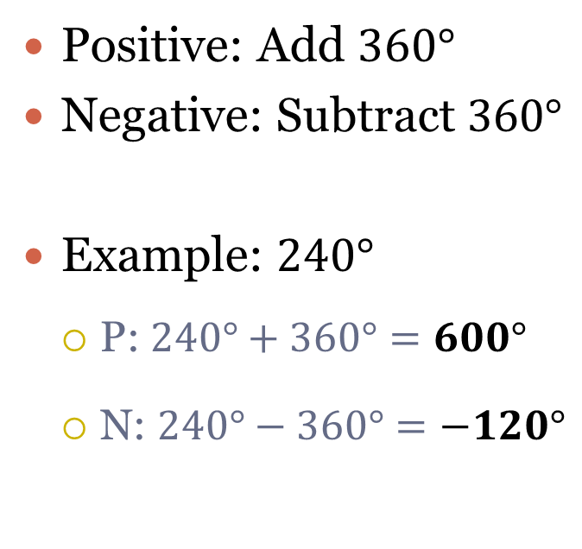
Coterminal Angles
(Have the same terminal side).
Degrees
Radians
Positive: Add $360°$
Negative: Subtract $360°$
Example: $240°$
P: $240°+360°=600°$
N: $240°−360°=−120°$
Positive: Add $2π$
Negative: Subtract $2π$
Example: $\frac{9π}{4}$
P: $\frac{9π}{4}+2π=\frac{9π}{4}+\frac{8π}{4}=\frac{17π}{4}$
N: $\frac{9π}{4}−2π=\frac{9π}{4}−\frac{8π}{4}=\frac{π}{4}$ $→\frac{π}{4}−\frac{8π}{4}=−\frac{7π}{4}$

Slide 12
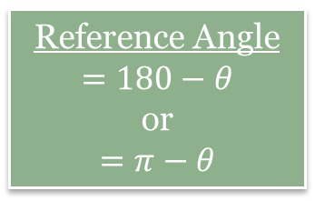
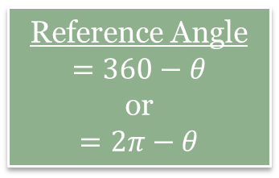
Reference Angles
Quadrant I
Quadrant II
$$θ$$
Reference Angle
$$=180−θ$$
or $$=π−θ$$
$$θ$$
Reference Angle
$$=θ$$
$$\frac{9π}{4}$$
Quadrant III
Quadrant IV
Reference Angle
$$=θ−180$$
or
$$=θ−π$$
Reference Angle
$$=360−θ$$
or
$$=2π−θ$$
$$θ$$
$$θ$$

Slide 13
The Circular Functions (The Unit Circle)
Section 4.3 – Day 3

Slide 14
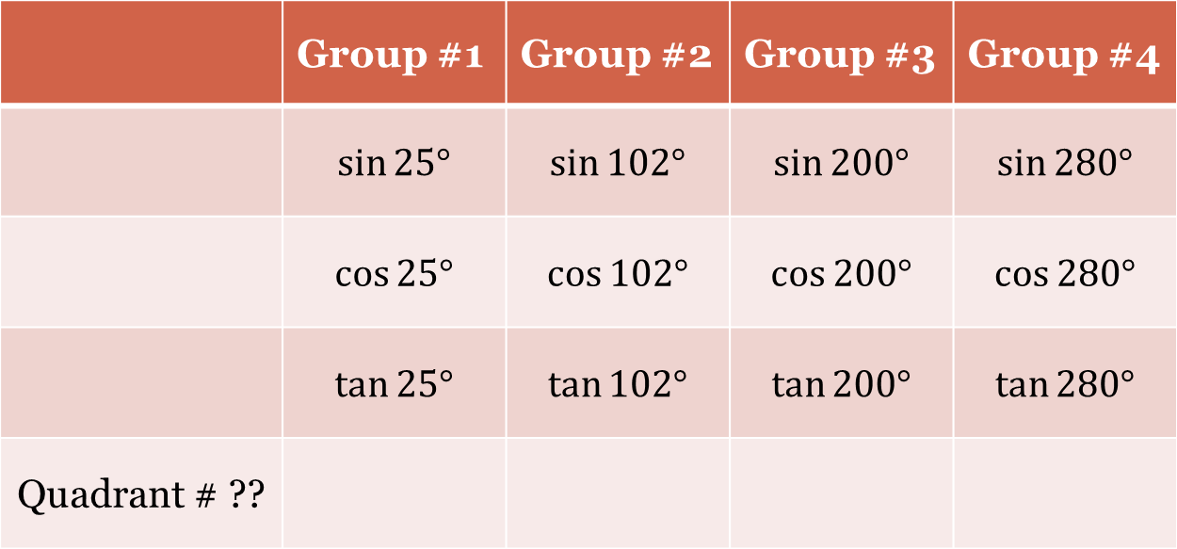
Warm up: Calculator Experiment
Use you calculator to determine the sign $(+,−)$of the following: (Make sure your calculator is in degrees)
 | Group #1 | Group #2 | Group #3 | Group #4
 | $$\sin{25°}$$ | $$\sin{102°}$$ | $$\sin{200°}$$ | $$\sin{280°}$$
 | $$\cos{25°}$$ | $$\cos{102°}$$ | $$\cos{200°}$$ | $$\cos{280°}$$
 | $$\tan{25°}$$ | $$\tan{102°}$$ | $$\tan{200°}$$ | $$\tan{280°}$$
Quadrant # ??

Slide 15
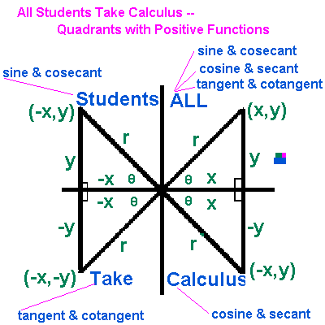
Quadrants with Positive Functions
(x,-y)

Slide 16
Two Helpful Hints to Remember Quadrants with Positive Functions
All Students Take Calculus
All Silly Turtles Crawl
Or make you own!!

Slide 17
Example (Exercises #11 – #14)
Directions: State the sign ($+,−)$ of (a) $\sin{t, }$(b) $\cos{t,}$ and (c) $\tan{t}$ for values of $t$ in the interval given.
$$\left(π,\frac{3π}{2}\right)$$
What Quadrant is this?
III
What trig functions are positive here?
Tan and Cot
$\sin{t=−}$
$\cos{t=−}$
$\tan{t=+}$

Slide 18
Example 2 (Exercises #15-#20)
Determine the sign ($+,−)$ of the given value without the use of a calculator.
$\tan{153°}$
$\cos{\frac{−π}{ 6}}$

Slide 19
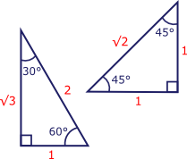
Two Special Triangles

Slide 20
Trigonometric Functions
Reference Triangle
Let $θ$ be an acute angle in the right triangle $∆ABC$. Then,
$sine\left(θ\right)=\sin\left(θ\right)=\frac{opp}{hyp}$
$cosine\left(θ\right)=\cos\left(θ\right)=\frac{adj}{hyp}$
$tangent\left(θ\right)=\tan\left(θ\right)=\frac{opp}{adj}$
$cosecant\left(θ\right)=\csc\left(θ\right)=\frac{hyp}{opp}$
$secant\left(θ\right)=\sec\left(θ\right)=\frac{hyp}{adj}$
$cotangent\left(θ\right)=\cot\left(θ\right)=\frac{adj}{opp}$

Slide 21
Reference Angles
Quadrant I
Quadrant II
$$θ$$
Reference Angle
$$=180−θ$$
or $$=π−θ$$
$$θ$$
Reference Angle
$$=θ$$
Quadrant III
Quadrant IV
Reference Angle
$$=θ−180$$
or
$$=θ−π$$
Reference Angle
$$=360−θ$$
or
$$=2π−θ$$
$$θ$$
$$θ$$

Slide 22
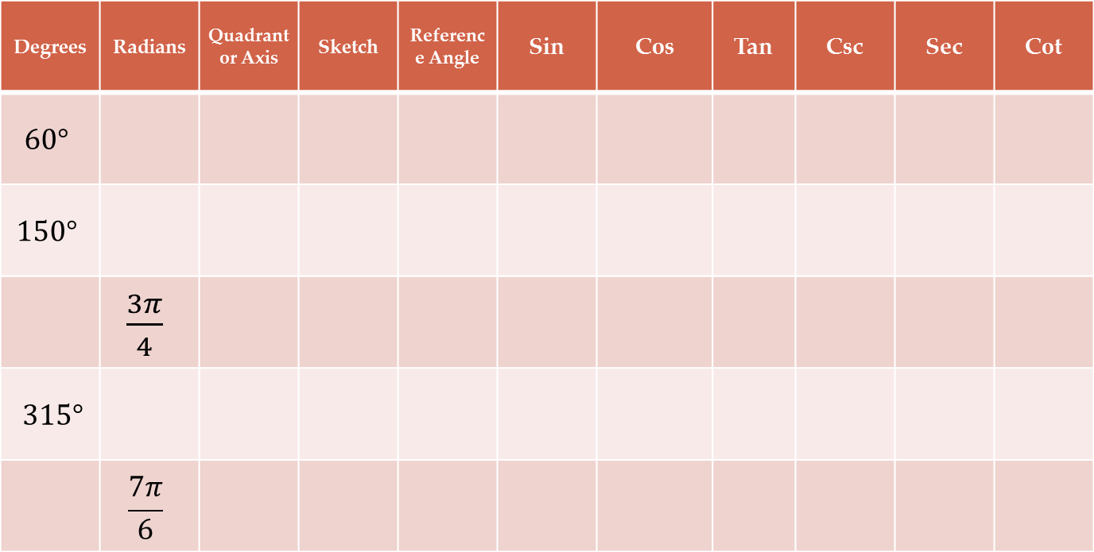
Trigonometric Ratio worksheet
Use your two special triangles and “All Students Take Calculus” to fill in the following chart. No calculators are allowed.
Degrees | Radians | Quadrant or Axis | Sketch | Reference Angle | Sin | Cos | Tan | Csc | Sec | Cot
$$60°$$
$$150°$$
 | $\frac{3π}{4}$
$315°$
 | $$\frac{7π}{6}$$

Slide 23
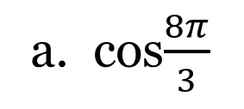
Example 3 (Exercises #31 – #42)
Directions: Evaluate without using a calculator by using ratios in a reference triangle.
a. cos$\frac{8π}{3}$
$$=cos⁡(480°)=−\frac{1}{2}$$
b. $tan\frac{−15π}{4}$
$$=tan⁡(−675°)=1$$

Slide 24
HOMEWORK
Due MONDAY:
Worksheet “Trigonometric Special Angles (Multiples of 30 and 45 degrees)”
Worth: 40 points
Do not wait to the last minute. You are able to do all rows except the quadrant angles i.e.. $90°$.
P. 365: #11 – #20 AND #31 – #42

Slide 25
The Circular Functions (The Unit Circle)
Section 4.3 – Day 4

Slide 26
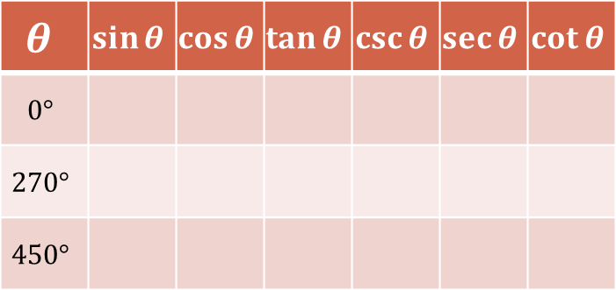
Quadrant Angles
The Unit Circle
Examples
We know points are always:
$$(x,y)$$
In the unit circle, our points are:
$$(\cos{θ}, \sin{θ})$$
$$(0,1)$$
$$(−1,0)$$
$$(1,0)$$
$$θ$$ | $$\sin{θ}$$ | $$\cos{θ}$$ | $$\tan{θ}$$ | $$\csc{θ}$$ | $$\sec{θ}$$ | $$\cot{θ}$$
$$0°$$
$$270°$$
$$450°$$
$$(0,−1)$$

Slide 27
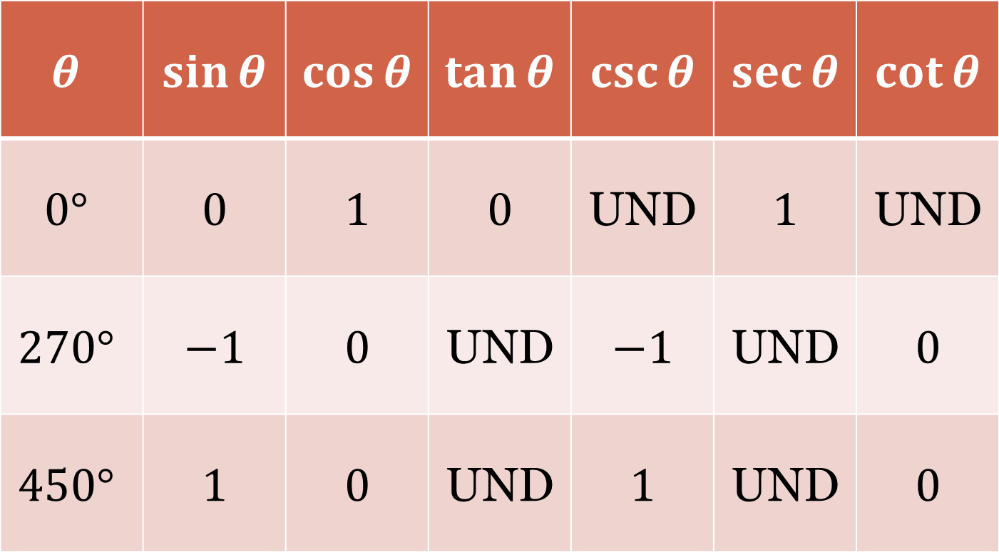
Quadrant Angles – Solutions
$$θ$$ | $$\sin{θ}$$ | $$\cos{θ}$$ | $$\tan{θ}$$ | $$\csc{θ}$$ | $$\sec{θ}$$ | $$\cot{θ}$$
$$0°$$ | $$0$$ | $$1$$ | $$0$$ | UND | $$1$$ | UND
$$270°$$ | $$−1$$ | $$0$$ | UND | $$−1$$ | UND | $$0$$
$$450°$$ | $$1$$ | $$0$$ | UND | $$1$$ | UND | $$0$$

