Slide 1
Warm – Up: 1/29
What do degrees mean?
Provide an example.
What do radians mean?
Provide an example.

Slide 2
Angles and Their Measure
Section 4.1 – Day 1

Slide 3
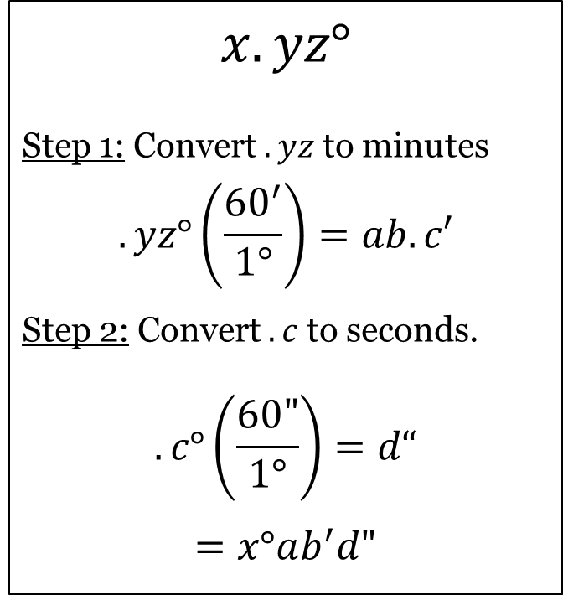
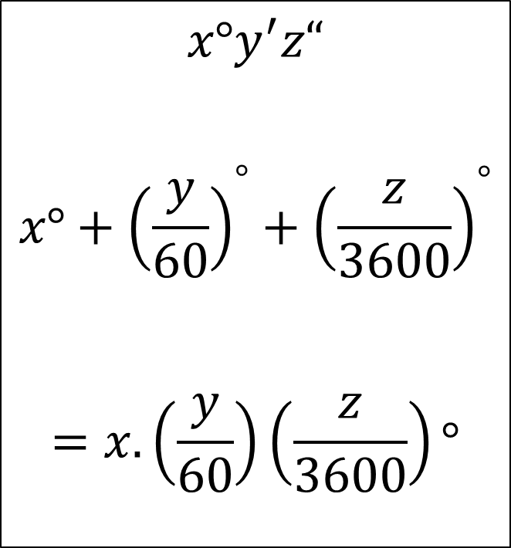
DMS $↔$ Degrees
DMS $→$ Degrees
Degrees $→$ DMS
$$x°y^{′}z“$$
$$x°+{\left(\frac{y}{60}\right)}^{°}+{\left(\frac{z}{3600}\right)}^{°}$$
$$=x.\left(\frac{y}{60}\right)\left(\frac{z}{3600}\right)°$$
$$x.yz°$$
Step 1: Convert $.yz$ to minutes
$$.yz°\left(\frac{{60}^{′}}{1°}\right)=ab.c′$$
Step 2: Convert $.c$ to seconds.
$$.c°\left(\frac{60"}{1°}\right)=d“$$
$$=x°ab^{′}d"$$

Slide 4
Exercises: 1 – 3:
Directions: Convert from DMS to decimal form.
$35°{24}^{′}$
$$35°+{\left(\frac{24}{60}\right)}^{°}=35.4°$$
$48°{30}^{′}36"$
$$48°+{\left(\frac{30}{60}\right)}^{°}+{\left(\frac{36}{3600}\right)}^{°}=48.51°$$

Slide 5
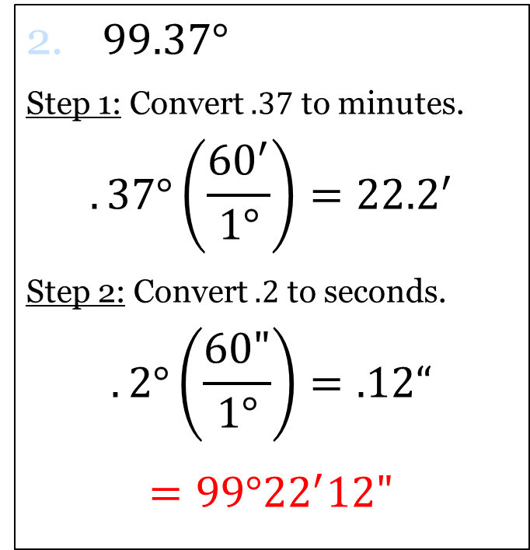
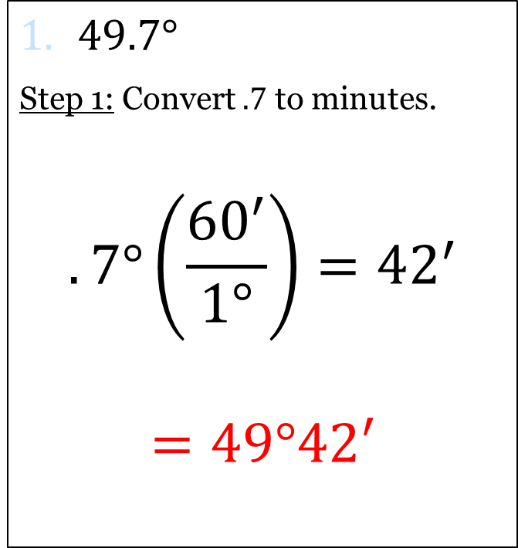
Exercises: 5 – 7:
Directions: Convert from degrees to degrees, minutes, seconds (DMS).
$49.7°$
Step 1: Convert $.7$ to minutes.
$$.7°\left(\frac{{60}^{′}}{1°}\right)={42}^{′}$$
$=49°42′$
$99.37°$
Step 1: Convert $.37$ to minutes.
$$.37°\left(\frac{{60}^{′}}{1°}\right)={22.2}^{′}$$
Step 2: Convert $.2$ to seconds.
$$.2°\left(\frac{60"}{1°}\right)=.12“$$
$=99°{22}^{′}12"$

Slide 6
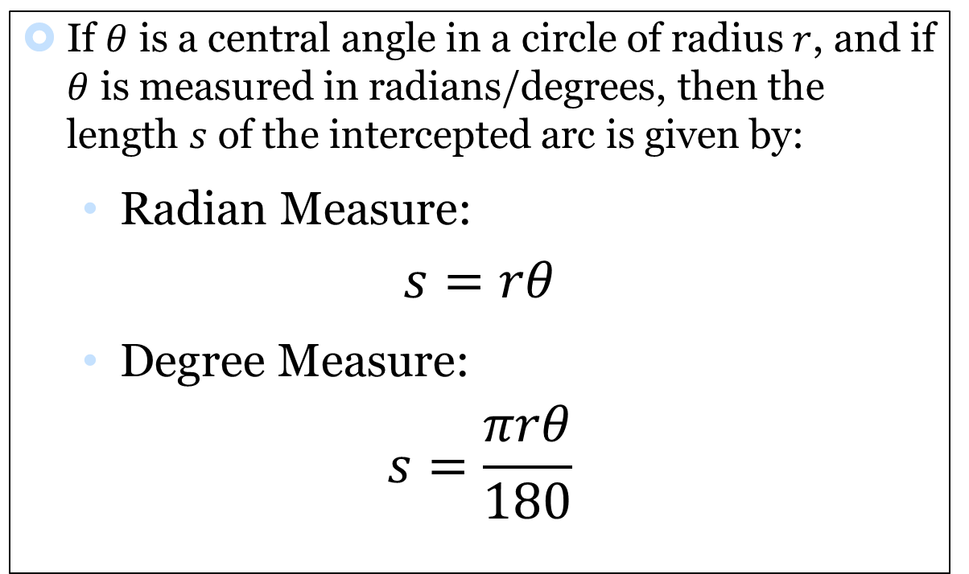
Arc Length Formula
If $θ$ is a central angle in a circle of radius $r$, and if $θ$ is measured in radians/degrees, then the length $s$ of the intercepted arc is given by:
Radian Measure:
$$s=rθ$$
Degree Measure:
$$s=\frac{πrθ}{180}$$

Slide 7
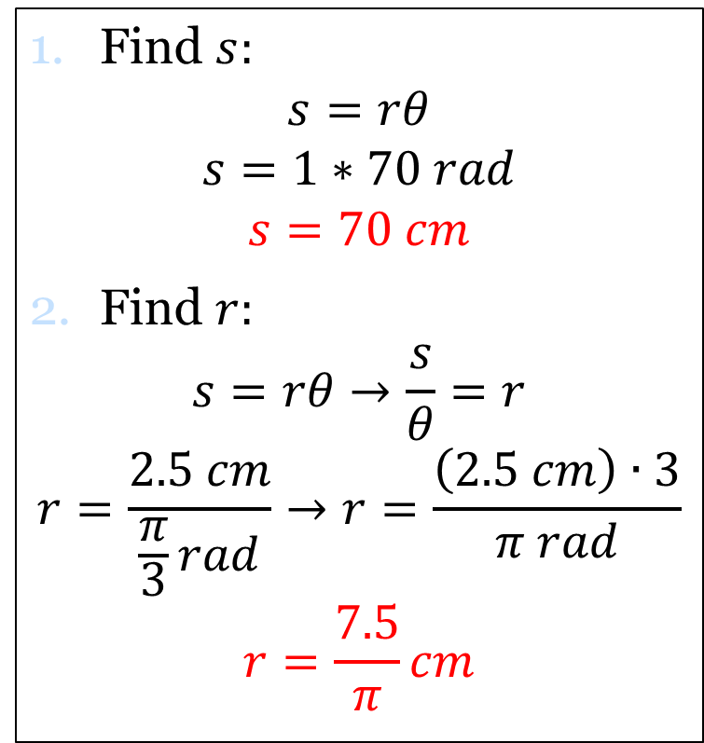
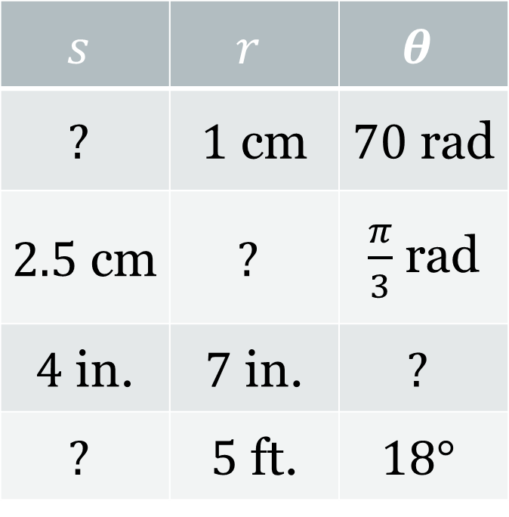

Exercises: 9 – 15:
Directions: Use the appropriate arc length formula to find the missing information.
Find $s:$
$$s=rθ$$
$$s=1∗70 rad$$
$$s=70 cm$$
Find $r:$
$$s=rθ→\frac{s}{θ}=r$$
$$r=\frac{2.5 cm}{\frac{π}{3}rad}→r=\frac{\left(2.5 cm\right)∙3}{π rad}$$
$$r=\frac{7.5}{π}cm$$
$$s$$ | $$r$$ | $$θ$$
$$?$$ | $1$ cm | $70$ rad
$2.5$ cm | $$?$$ | $\frac{π}{3}$ rad
$4$ in. | $7$ in. | $$?$$
$$?$$ | $5$ ft. | $$18°$$
$70$ cm
$\frac{7.5}{π}$cm

Slide 8
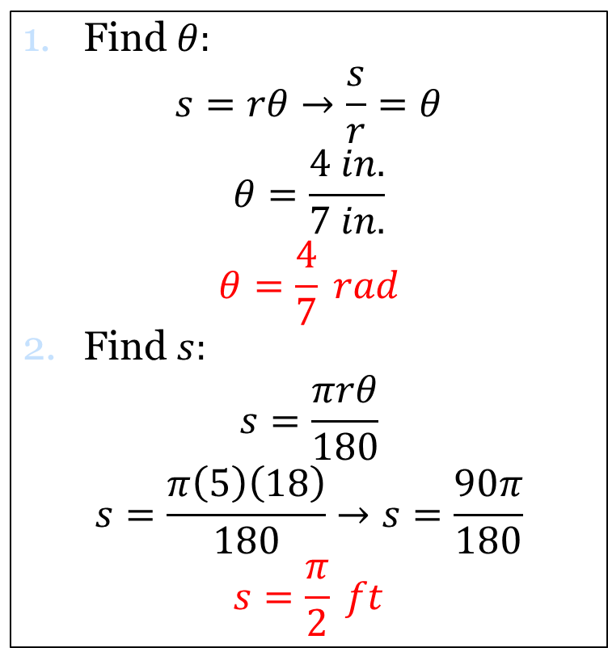
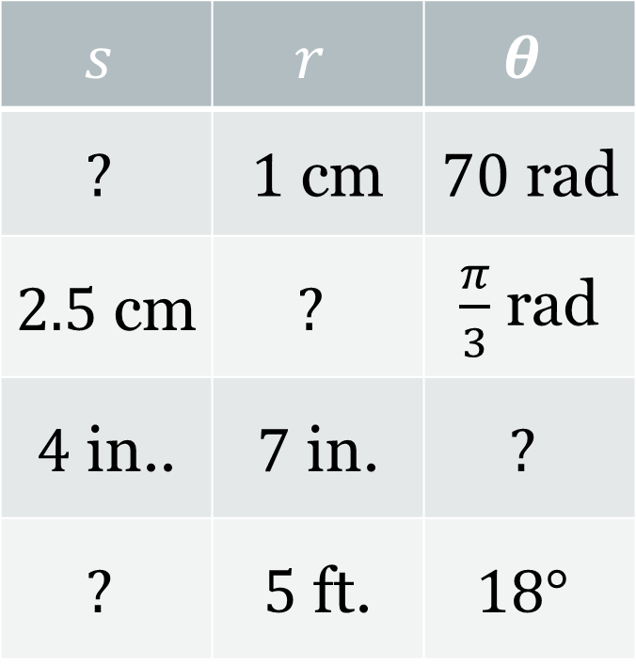
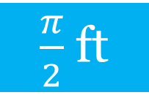

Exercises: 9 – 15:
Directions: Use the appropriate arc length formula to find the missing information.
Find $θ:$
$$s=rθ→\frac{s}{r}=θ$$
$$θ=\frac{4 in.}{7 in.}$$
$$θ=\frac{4}{7} rad$$
Find $s:$
$$s=\frac{πrθ}{180}$$
$$s=\frac{π\left(5\right)\left(18\right)}{180}→s=\frac{90π}{180}$$
$$s=\frac{π}{2} ft$$
$$s$$ | $$r$$ | $$θ$$
$$?$$ | $1$ cm | $70$ rad
$2.5$ cm | $$?$$ | $\frac{π}{3}$ rad
$4$ in.. | $7$ in. | $$?$$
$$?$$ | $5$ ft. | $$18°$$
$70$ cm
$\frac{7.5}{π}$cm
$\frac{4}{7}$ rad
$\frac{π}{2}$ ft

Slide 9
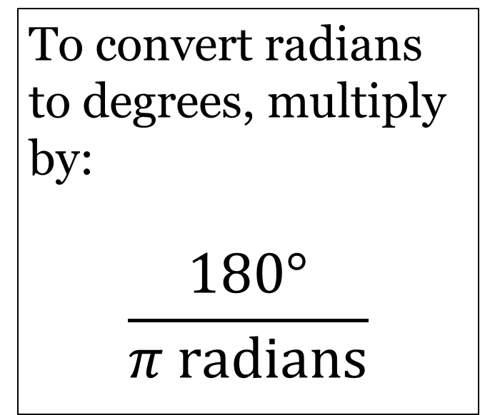
Radians $↔$ Degrees
Degrees $→$ Radians
Radians $→$ Degrees
To convert degrees to radians, multiply by:
$$\frac{π radians}{180°}$$
To convert radians to degrees, multiply by:
$$\frac{180°}{π radians}$$

Slide 10
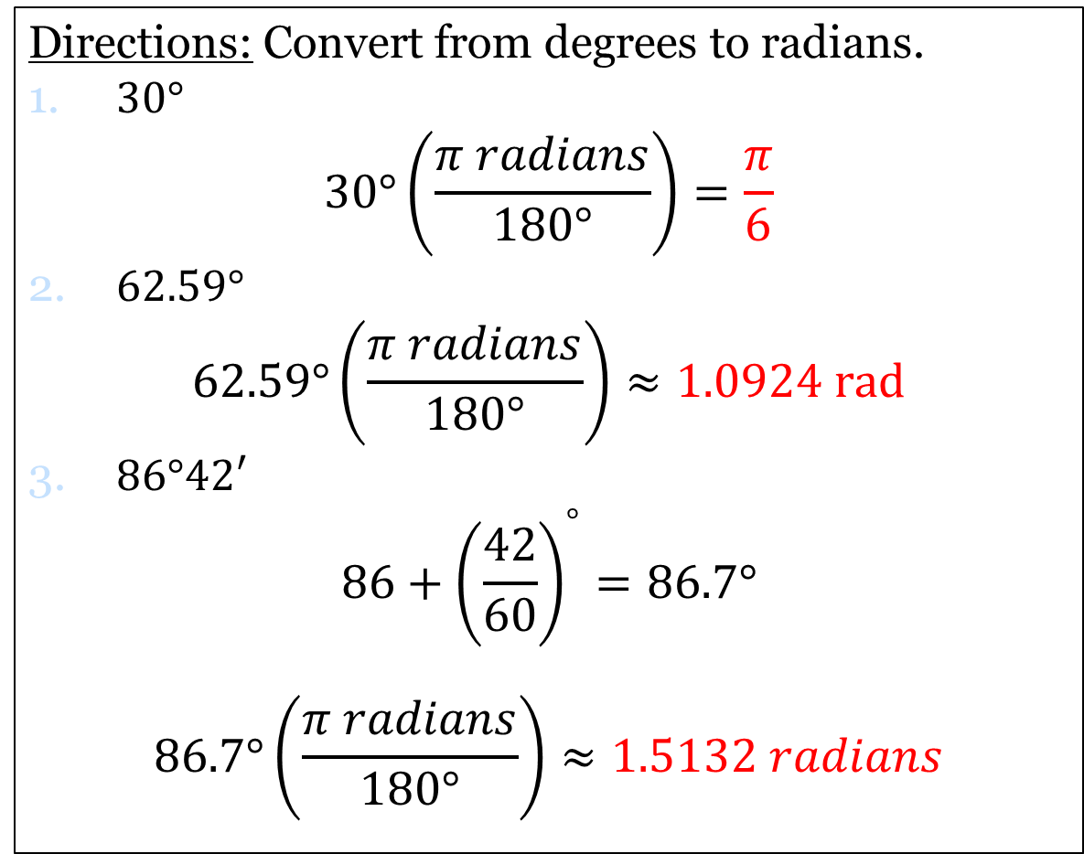
Exercises: 19 – 26:
Directions: Convert from degrees to radians.
$30°$
$$30°\left(\frac{π radians}{180°}\right)=\frac{π}{6}$$
$62.59°$
$$62.59°\left(\frac{π radians}{180°}\right)≈1.0924 rad$$
$86°42′$
$$86+{\left(\frac{42}{60}\right)}^{°}=86.7°$$
$$86.7°\left(\frac{π radians}{180°}\right)≈1.5132 radians$$

Slide 11
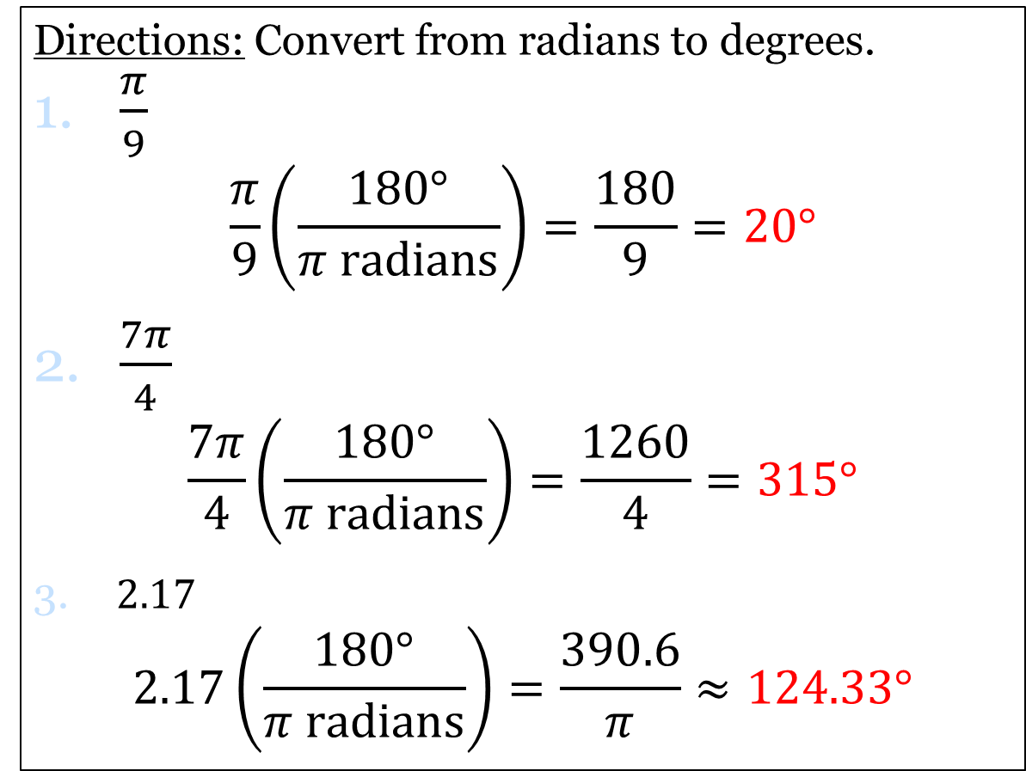
Exercises: 27 – 34:
Directions: Convert from radians to degrees.
$\frac{π}{9}$
$$\frac{π}{9}\left(\frac{180°}{π radians}\right)=\frac{180}{9}=20°$$
$\frac{7π}{4}$
$$\frac{7π}{4}\left(\frac{180°}{π radians}\right)=\frac{1260}{4}=315°$$
$2.17$
$$2.17\left(\frac{180°}{π radians}\right)=\frac{390.6}{π}≈124.33°$$

Slide 12
Homework
P. 343:
#1 – #15 (odd)
#19 – #34 (all)

