Slide 1
Logarithmic Functions and Their Graphs
Section 3.3 – Day 1

Slide 2
What are Logarithms??
Logarithms are inverses of exponential functions.
Exponential Function:
$$f\left(x\right)=a∙b^{x}$$
If $x>0$ and $0<b≠1$, then,
$y=\log_{b}{(x)}$ if and only if $b^{y}=x$
Ex: $\log_{3}{(9)}→3^{y}=9$
So what is $y?$
$$y=2, as 3^{2}=9$$

Slide 3
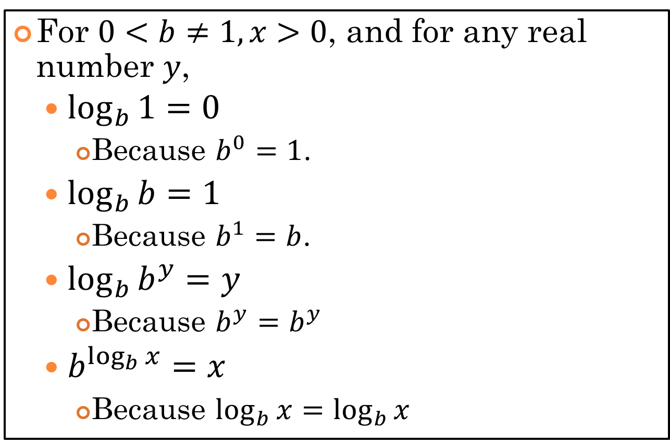
Basic Properties of Logarithms
For $0<b≠1,x>0$, and for any real number $y$,
$\log_{b}{1}=0$
Because $b^{0}=1$.
$\log_{b}{b}=1$
Because $b^{1}=b$.
$\log_{b}{b^{y}}=y$
Because $b^{y}=b^{y}$
$b^{\log_{b}{x}}=x$
Because $\log_{b}{x}=\log_{b}{x}$

Slide 4
Common Logarithms – Base $10$
The common logarithm function
$$\log_{10}{x}=\log{x}$$
This is the inverse of the exponential function:
$$f\left(x\right)={10}^{x}$$
So,
$y=\log{x}$ if and only if ${10}^{y}=x$

Slide 5
Other Properties of Logarithms
Let $x$ and $y$ be real numbers with $x>0$.
$\log{1=0}$
Because ${10}^{0}=1$
$\log{10=1}$
Because ${10}^{1}=10$
$\log{{10}^{y}=y}$
Because ${10}^{y}={10}^{y}$
${10}^{\log\left(x\right)}=x$
Because $\log{x=\log{x}}$

Slide 6
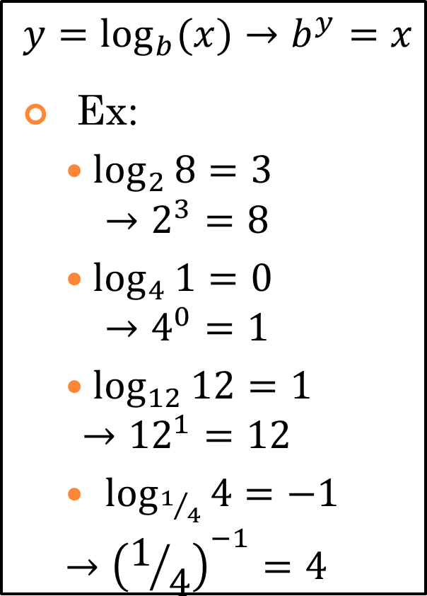
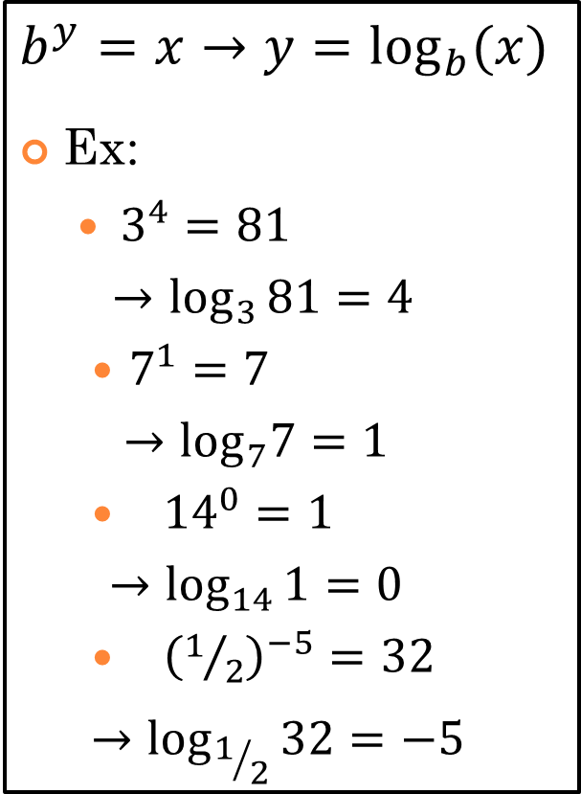
Logarithmic $↔$ Exponential
$$\log{x}→e^{x}$$
$$e^{x}→\log{x}$$
$$y=\log_{b}{(x)}→b^{y}=x$$
Ex:
$\log_{2}{8=3}$
$$→2^{3}=8$$
$\log_{4}{1=0}$
$$→4^{0}=1$$
$\log_{12}{12=1}$
$$→{12}^{1}=12$$
$\log_{1/4}{4=−1}$
$$→{\left(1/4\right)}^{−1}=4$$
$$b^{y}=x→y=\log_{b}{(x)}$$
Ex:
$3^{4}=81$
$$→\log_{3}{81=4}$$
$7^{1}=7$
$$→\log_{7}7=1$$
${14}^{0}=1$
$$→\log_{14}{1=0}$$
${\left(1/2\right)}^{−5}=32$
$$→\log_{1/2}{32=−5}$$

Slide 7
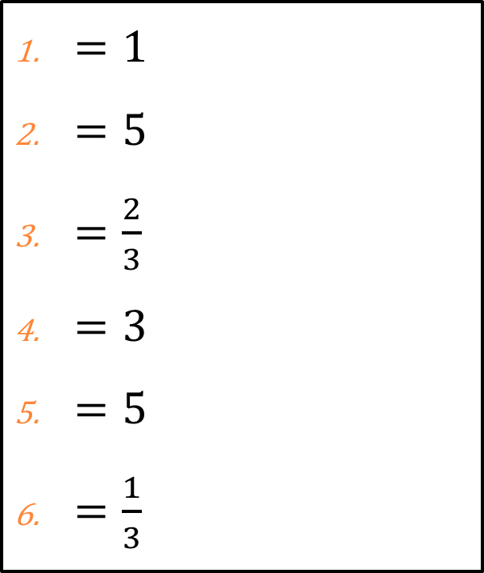
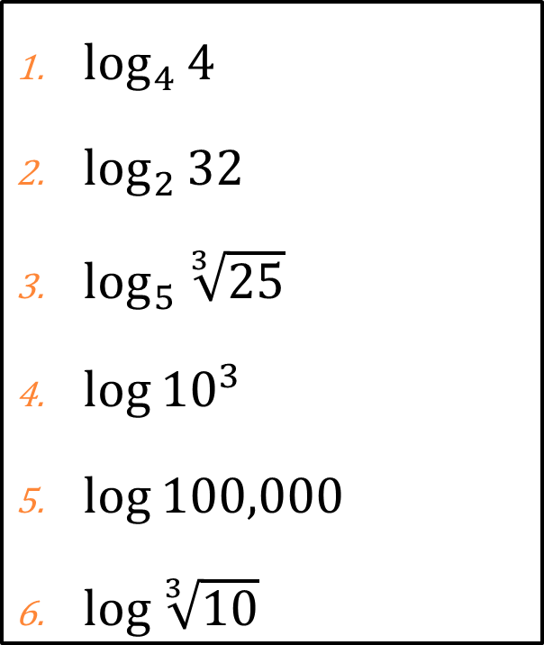
Exercises #2 – #18
Directions: Evaluate the logarithmic expression without using a calculator.
Problems
Solutions
$\log_{4}{4}$
$\log_{2}{32}$
$\log_{5}{\sqrt[3]{25}}$
$\log{{10}^{3}}$
$\log{100,000}$
$\log{\sqrt[3]{10}}$
$=1$
$=5$
$=\frac{2}{3}$
$=3$
$=5$
$=\frac{1}{3}$

Slide 8
Natural Logarithms – Base $e$
The natural logarithm function
$$\log_{e}{x}=\ln{x}$$
This is the inverse of the exponential function:
$$f\left(x\right)=e^{x}$$
So,
$y=\ln{x}$ if and only if $e^{y}=x$

Slide 9
Basic Properties of Natural Logarithms
Let $x$ and $y$ be real numbers with $x>0$.
$\ln{1=0}$
Because $e^{0}=1$.
$\ln{e=1}$
Because $e^{1}=e$.
$\ln{e^{y}=y}$
Because $e^{y}=e^{y}$
$e^{lnx}=x$
Because $\ln{x=\ln{x}}$

Slide 10
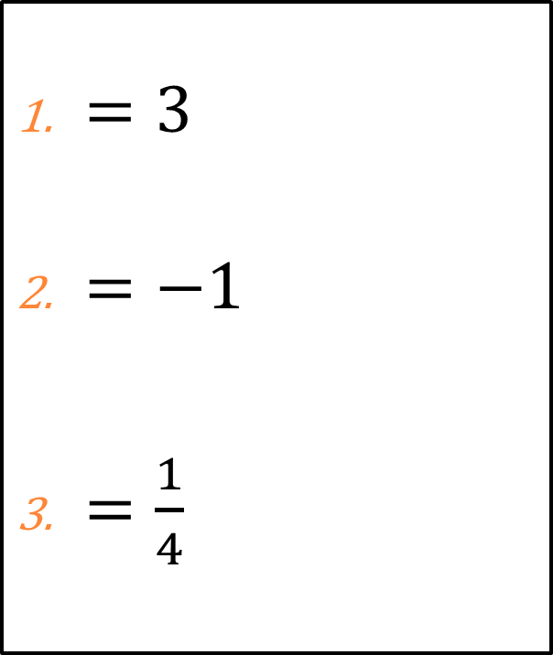
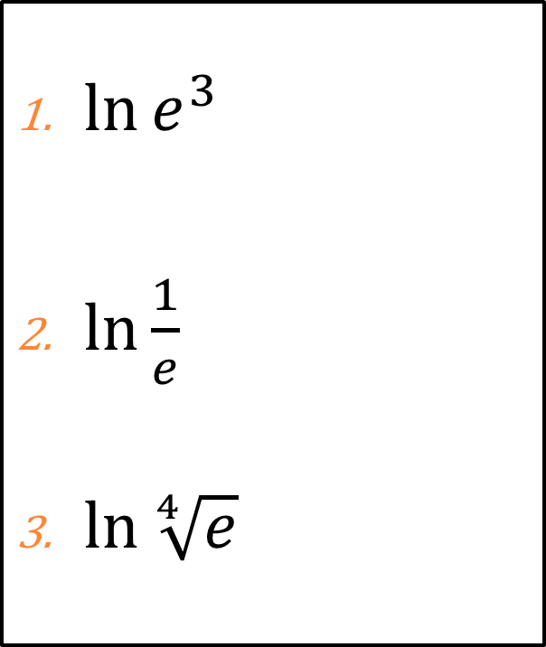
Exercises #2 – #18
Directions: Evaluate the logarithmic expression without using a calculator.
Problems
Solutions
$\ln{e^{3}}$
$\ln{\frac{1}{e}}$
$\ln{\sqrt[4]{e}}$
$=3$
$=−1$
$=\frac{1}{4}$

Slide 11
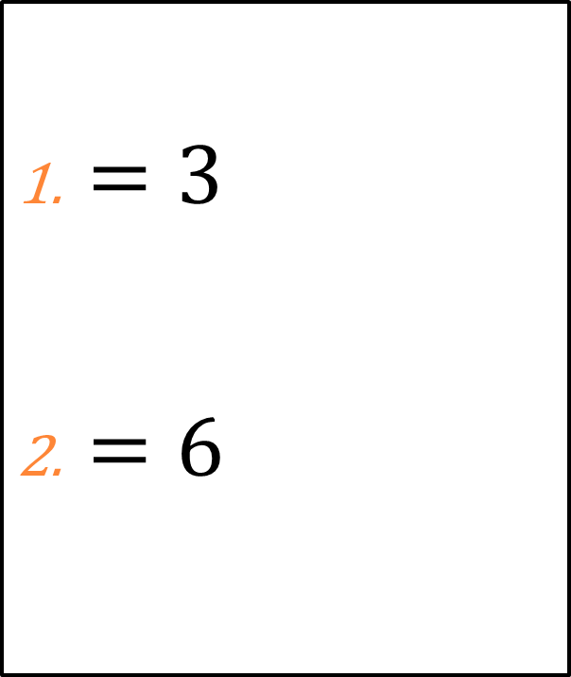
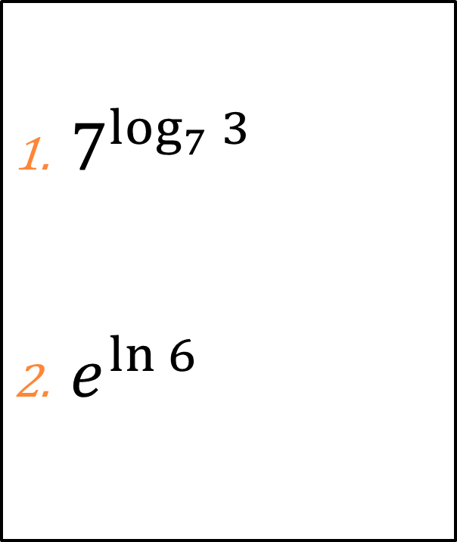
Exercises #20 – #22
Directions: Evaluate the expression without using a calculator.
Problems
Solutions
$7^{\log_{7}{3}}$
$e^{\ln{6}}$
$=3$
$=6$

Slide 12
Exit Slip
Directions: Evaluate the expression without using a calculator.
$\log_{3}{81=}$
$\log{{10}^{−4}=}$
$\ln{e^{−5}}=$
Challenge: (Extra Credit)
$\ln{\frac{1}{\sqrt{e^{7}}}}=$

Slide 13
Logarithmic Functions and Their Graphs
Section 3.3 – Day 2

Slide 14
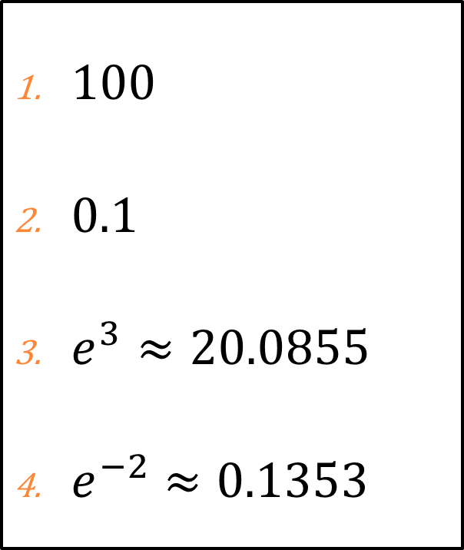
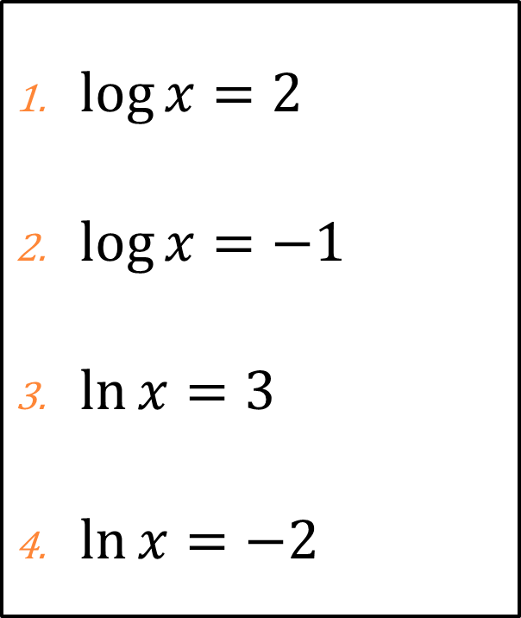
Exercises #24 – #30
Directions: Solve the equation by changing it to exponential form.
Problems
Solutions
$\log{x}=2$
$\log{x}=−1$
$\ln{x}=3$
$\ln{x}=−2$
$100$
$0.1$
$e^{3}≈20.0855$
$e^{−2}≈0.1353$

Slide 15
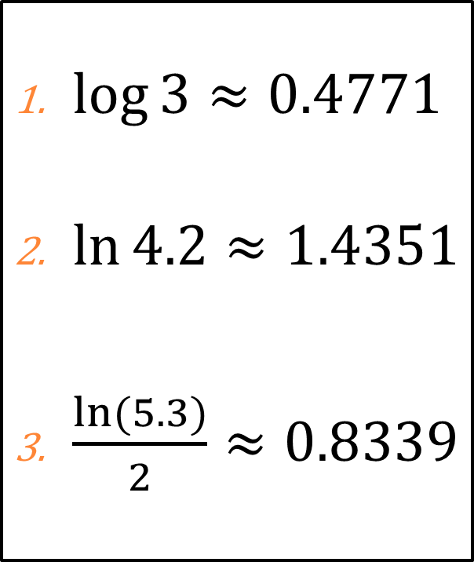
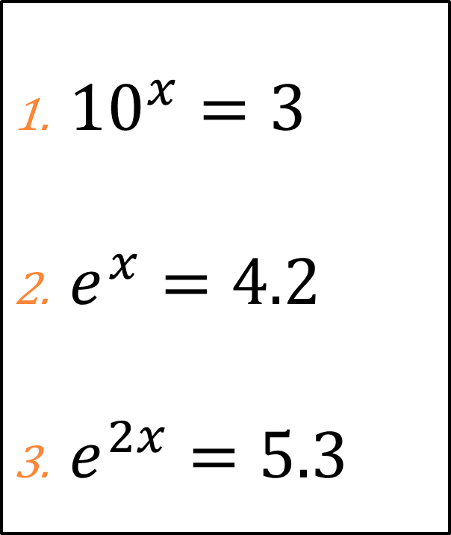
Exercises #32 – #36
Directions: Solve the equation by changing it to logarithmic form.
Problems
Solutions
${10}^{x}=3$
$e^{x}=4.2$
$e^{2x}=5.3$
$\log{3}≈0.4771$
$\ln{4.2}≈1.4351$
$\frac{ln⁡(5.3)}{2}≈0.8339$

Slide 16
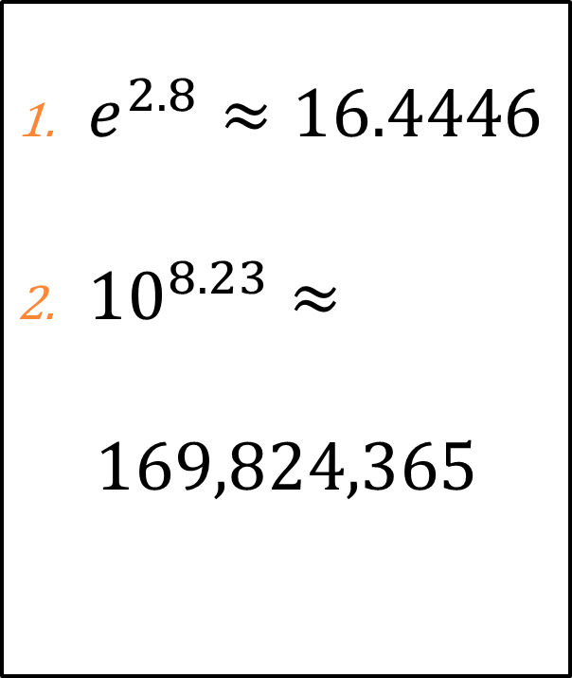
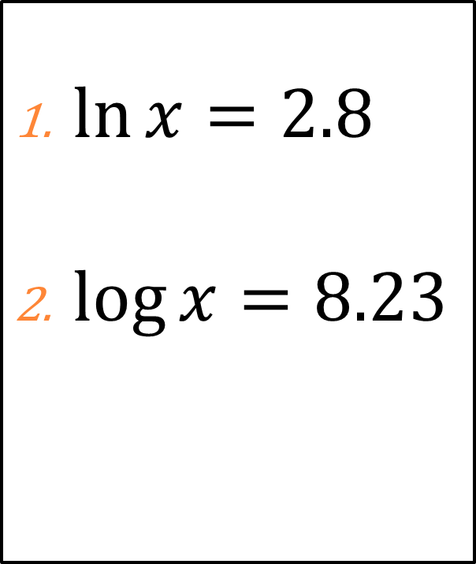
Exercises #38 – #40
Directions: Solve the equation.
Problems
Solutions
$\ln{x}=2.8$
$\log{x}=8.23$
$e^{2.8}≈16.4446$
${10}^{8.23}≈$
$$169,824,365$$

Slide 17
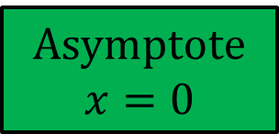
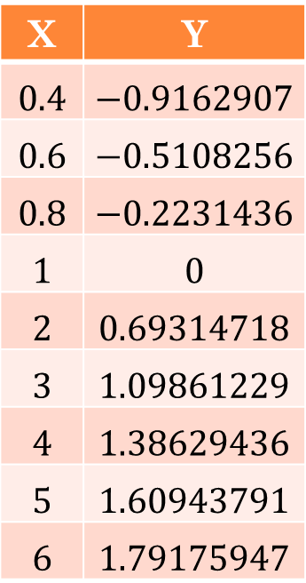
Logarithmic Graph
X | Y
$$0.4$$ | $$−0.9162907$$
$$0.6$$ | $$−0.5108256$$
$$0.8$$ | $$−0.2231436$$
$$1$$ | $$0$$
$$2$$ | $$0.69314718$$
$$3$$ | $$1.09861229$$
$$4$$ | $$1.38629436$$
$$5$$ | $$1.60943791$$
$$6$$ | $$1.79175947$$
Domain: $(0,∞)$
Range: $(−∞,∞)$
Asymptote
$$x=0$$

Slide 18
Homework: Due 1/8
P. 291 – 292
#2 – #40 (Even)

