Slide 1
Exponential and Logistic Modeling
Section 3.2 – Day 1

Slide 2
Agenda!
12/9: Start Section 3.1
12/10: Finish Section 3.1
12/11: Khan Academy
12/12: Start Section 3.2
12/15: Finish Section 3.2
12/16: Group Activity on Sections 3.1 and 3.2
12/17: Review Sections 3.1 and 3.2
12/18: Test on Sections 3.1 and 3.2
12/19: CHIRSTMAS PARTY! :D

Slide 3
Exponential Rates
Growth
Decay
$f\left(x\right)=a∗b^{x}$
$a>0$
$b>1$ - $b$ is the growth factor
Ex: $f\left(x\right)=2∗{1.2}^{x}$
Thus, $1.2$ is the growth factor.
$f\left(x\right)=a∗b^{x}$
$a>0$
$b<1$ - $b$ is the decay factor
Ex: $f\left(x\right)=6∗{0.217}^{x}$
Thus, $0.217$ is the decay factor.

Slide 4
Finding the Constant Percentage
Growth
Growth Factor $=1+$ Percentage Rate
Ex: $f\left(x\right)=52.357∙{1.36}^{x}$
$1.36$ is my growth factor.
$1.36=1+x→0.36=x$, but we want a percent, so $x=36\%$.
Decay
Decay Factor $=1−$ Percentage Rate
Ex: $f\left(x\right)=72∙{0.843}^{x}$
$0.843$ is my decay factor.
$0.843=1−x→−0.157=−x→0.157=x$, but we want a percent, so $x=15.7\%$.

Slide 5
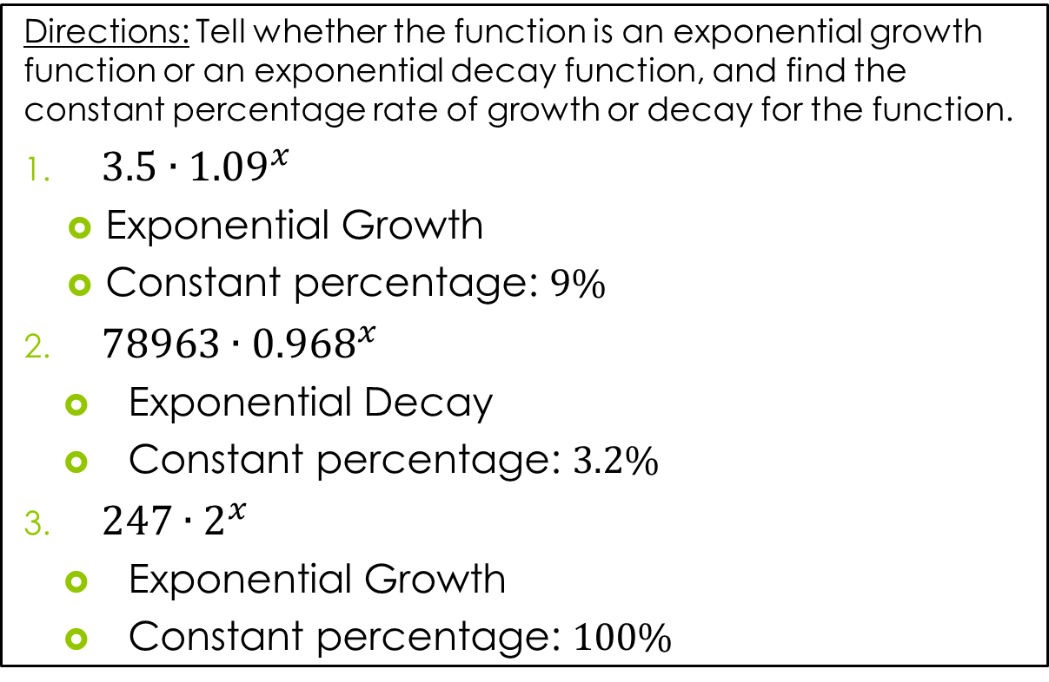
Exercises: #2 – 6
Directions: Tell whether the function is an exponential growth function or an exponential decay function, and find the constant percentage rate of growth or decay for the function.
$3.5∙{1.09}^{x}$
Exponential Growth
Constant percentage: $9\%$
$78963∙{0.968}^{x}$
Exponential Decay
Constant percentage: $3.2\%$
$247∙2^{x}$
Exponential Growth
Constant percentage: $100\%$

Slide 6
Exercises: #8 – 18
Directions: Find the exponential model that satisfies the given conditions.
Initial Value $=5$, increasing at a rate of $17\%$ per year.
$$f\left(x\right)=a∙b^{x}$$
$$f\left(x\right)=5∙{1.17}^{x}$$
Initial Value $=16$, increasing at a rate of $50\%$ per year.
$$f\left(x\right)=a∙b^{x}$$
$$f\left(x\right)=16∙{0.5}^{x}$$

Slide 7
Exercises: #8 – 18
Directions: Find the exponential model that satisfies the given conditions.
Initial Population $=502,000$, increasing at a rate of $1.7\%$ per year.
$$f\left(x\right)=a∙b^{x}$$
$$f\left(x\right)=502000∙{1.017}^{x}$$
Initial Height $=18$ cm, growing at a rate of $5.2\%$ per week.
$$f\left(x\right)=a∙b^{x}$$
$$f\left(x\right)=18∙{1.052}^{x}$$

Slide 8
Exercises: #8 – 18
Directions: Find the exponential model that satisfies the given conditions.
Initial Mass $=0.6$ g, doubling every $3$ days.
$$f\left(x\right)=a∙b^{x}$$
$$f\left(x\right)=0.6∙2^{\frac{x}{3}}$$
Initial Mass $=592$ g, halving every $6$ hours.
$$f\left(x\right)=a∙b^{x}$$
$$f\left(x\right)=592∙2^{−x/6}$$

Slide 9
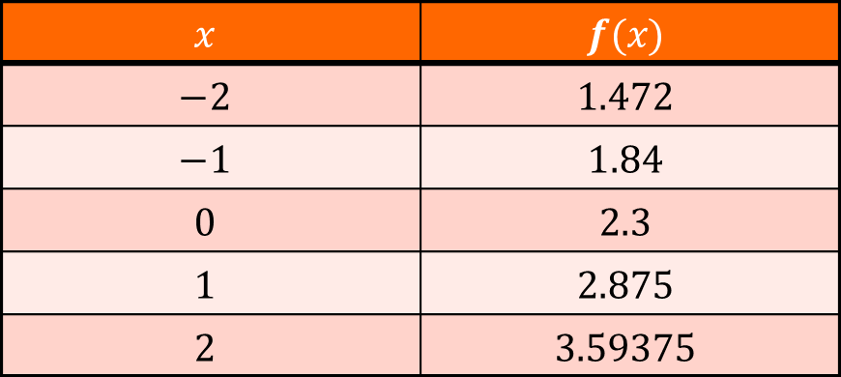
Exercise: #20
Directions: Determine a formula for the exponential functions whose values are given in the table below.
$$x$$ | $$f(x)$$
$$−2$$ | $$1.472$$
$$−1$$ | $$1.84$$
$$0$$ | $$2.3$$
$$1$$ | $$2.875$$
$$2$$ | $$3.59375$$
$$f\left(x\right)=a∙b^{x}$$
Since the $f\left(0\right)=2.3$, the initial value $a$ is $2.3$.
Since $f\left(1\right)=2.3∙b^{1}=2.875$, the base $b$ is $1.25.$
Thus, $f\left(x\right)=2.3∙{1.25}^{x}$

Slide 10
Exercise: #22
Points: $(0, 4)$ and $(5, 600.25)$
$$f\left(x\right)=a∗b^{x}$$
Since the $f\left(0\right)=4$, the initial value $a$ is $4$.
Since $f\left(2\right)=4∗b^{5}=600.25→b^{5}=150.0625$, the base $b$ is $2.724$.
Thus, $f\left(x\right)=4{\left(2.724\right)}^{x}$

Slide 11
Agenda!
12/9: Start Section 3.1
12/10: Finish Section 3.1
12/11: Khan Academy
12/12: Start Section 3.2
12/15: Finish Section 3.2
12/16: Group Activity on Sections 3.1 and 3.2
12/17: Review Sections 3.1 and 3.2
12/18: Test on Sections 3.1 and 3.2
12/19: CHIRSTMAS PARTY! :D

Slide 12
Exponential and Logistic Modeling
Section 3.2 – Day 2

Slide 13
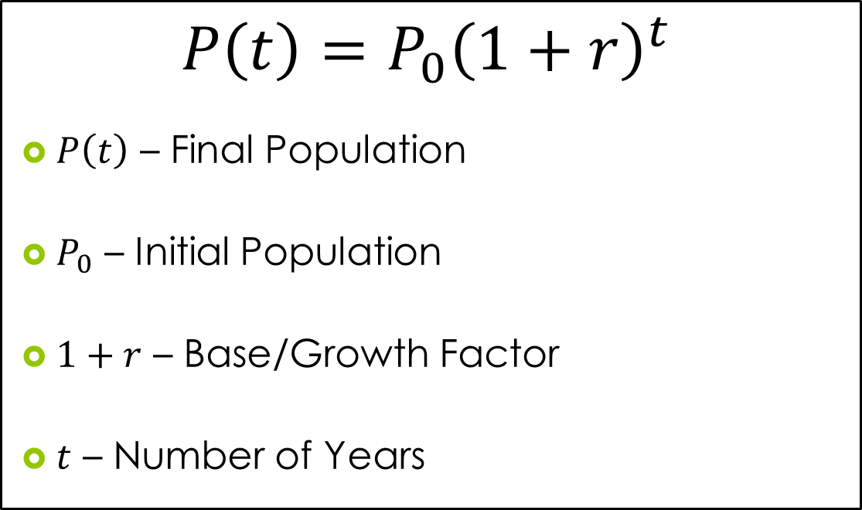
Population Function
$$P\left(t\right)=P_{0}{\left(1+r\right)}^{t}$$
$P\left(t\right)$ – Final Population
$P_{0}$ – Initial Population
$1+r$ – Base/Growth Factor
$t$ – Number of Years

Slide 14
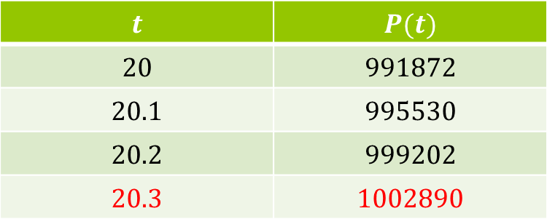
Exercise: #30
The population of Knoxville is $475,000$ and is increasing at a rate of $3.75\%$ each year. Predict when the population will be 1 million.
$$P\left(t\right)=P_{0}{\left(1+r\right)}^{t}$$
$$P(t)=475,000{\left(1+0.0375\right)}^{t}$$
$$P(t)=475,000{\left(1.0375\right)}^{t}$$
The population will be around 1 million in $20.3$ years.
$$t$$ | $$P(t)$$
$$20$$ | $$991872$$
$$20.1$$ | $$995530$$
$$20.2$$ | $$999202$$
$$20.3$$ | $$1002890$$

Slide 15
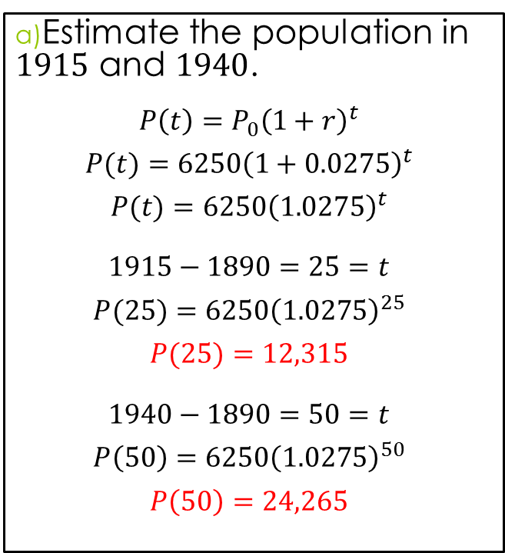
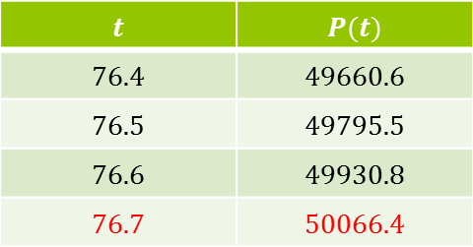
Exercise: #32
The population of Silver Run in the year $1890$ was $6250$. Assume the population increased at a rate of $2.75\%$ per year.
Estimate the population in $1915$ and $1940$.
$$P\left(t\right)=P_{0}{\left(1+r\right)}^{t}$$
$$P(t)=6250{\left(1+0.0275\right)}^{t}$$
$$P(t)=6250{\left(1.0275\right)}^{t}$$
$$1915−1890=25=t$$
$$P(25)=6250{\left(1.0275\right)}^{25}$$
$$P(25)=12,315$$
$$1940−1890=50=t$$
$$P\left(50\right)=6250{\left(1.0275\right)}^{50}$$
$$P\left(50\right)=24,265$$
Predict when the population reached $50,000$.
$$P\left(t\right)=P_{0}{\left(1+r\right)}^{t}$$
$$P(t)=6250{\left(1+0.0275\right)}^{t}$$
$$P(t)=6250{\left(1.0275\right)}^{t}$$
The population will be around $50,000$ in $76.7$ years.
Thus, $1890+76.7=1966$.
$$t$$ | $$P(t)$$
$$76.4$$ | $$49660.6$$
$$76.5$$ | $$49795.5$$
$$76.6$$ | $$49930.8$$
$$76.7$$ | $$50066.4$$

Slide 16
Homework
Due 12/16:
P. 279-280
#2 – 22 (Even)
#30 and 32

