Slide 1
Exponential and Logistic Functions
Section 3.1 – Day 1

Slide 2
Agenda!
12/9: Start Section 3.1
12/10: Finish Section 3.1
12/11: Khan Academy
12/12: Start Section 3.2
12/15: Finish Section 3.2
12/16: Group Activity on Sections 3.1 and 3.2
12/17: Review Sections 3.1 and 3.2
12/18: Test on Sections 3.1 and 3.2
12/19: CHIRSTMAS PARTY! :D

Slide 3

Exponential Functions
Definition: Let $a$ and $b$ be real number constants. An exponential function in $x$ is a function that can be written in the form
$$f\left(x\right)=a∗b^{x}$$
where $a$ is nonzero, $b$ is positive, and $b≠1$. The constant $a$ is the initial value of $f$(the value at $x=0$), and $b$ is the base.

Slide 4

Exercises: #2 – 6
Directions: Which of the following are exponential functions? For those that are exponential functions, state the initial value and the base. For those that are not, explain why they are not.
$y=x^{8}$
  This is not an exponential function as the base is x and the exponent is a number.
$y=5^{x}$
  This is an exponential function. The initial value is 1 and the base is 5.
$y=x^{\sqrt{x}}$
  Not an exponential function as the base is x and the exponent contains a square root.

Slide 5

Exercises: #8 – 10
Directions: Compute the exact value of the function for the given x-value without using a calculator.
$f\left(x\right)=3∗5^{x}$ for $x=0$
  $$f\left(x\right)=3∗5^{0}=3∗1=3$$
$f\left(x\right)=−2∗3^{x}$ for $x=\frac{1}{3}$
$$f\left(x\right)=−2∗3^{\frac{1}{3}}=−2\sqrt[3]{3}$$

Slide 6
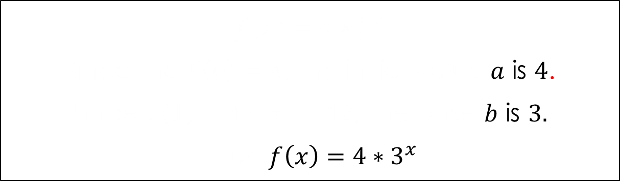
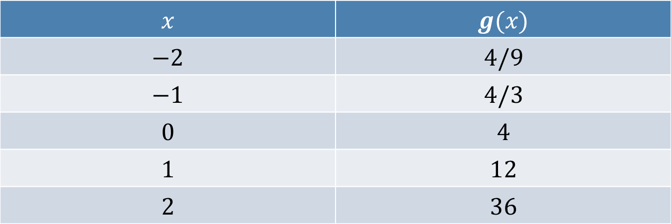
Exercises: #12
Directions: Determine a formula for the exponential functions whose values are given in the table below.
$$x$$ | $$g(x)$$
$$−2$$ | $$4/9$$
$$−1$$ | $$4/3$$
$$0$$ | $$4$$
$$1$$ | $$12$$
$$2$$ | $$36$$
$$f\left(x\right)=a∗b^{x}$$
Since the $f\left(0\right)=4$, the initial value $a$ is $4$.
Since $f\left(1\right)=4∗b^{1}=12$, the base $b$ is $3.$
Thus, $f\left(x\right)=4∗3^{x}$

Slide 7
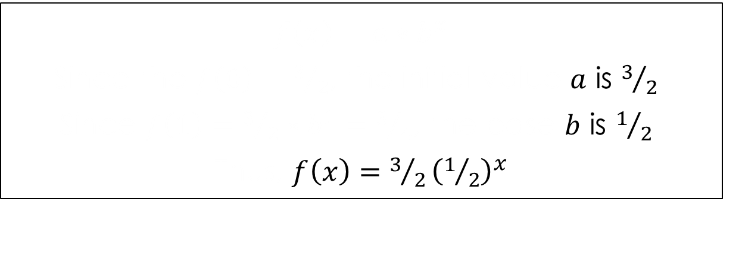
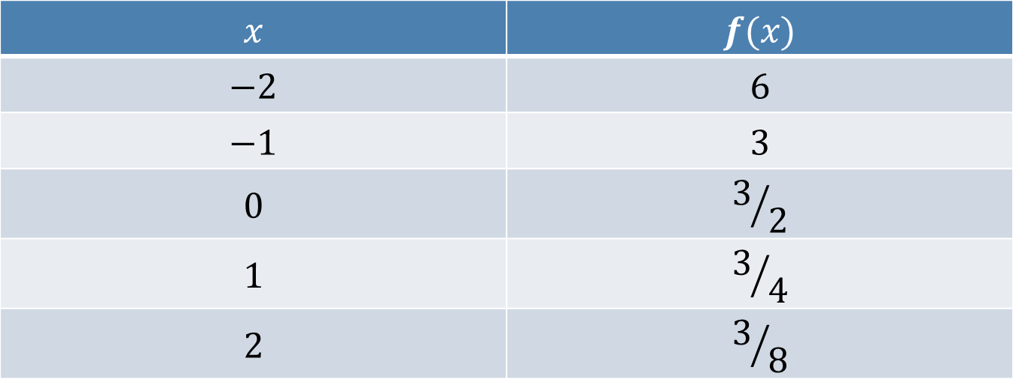
Exercises: #12
Directions: Determine a formula for the exponential functions whose values are given in the table below.
$$x$$ | $$f(x)$$
$$−2$$ | $$6$$
$$−1$$ | $$3$$
$$0$$ | $$3/2$$
$$1$$ | $$3/4$$
$$2$$ | $$3/8$$
$$f\left(x\right)=a∗b^{x}$$
Since the $f\left(0\right)=3/2$, the initial value $a$ is $3/2.$
Since $f\left(1\right)=3/2∗b^{1}=3/4$, the base $b$ is $1/2.$
Thus, $f\left(x\right)=3/2{\left(1/2\right)}^{x}$

Slide 8
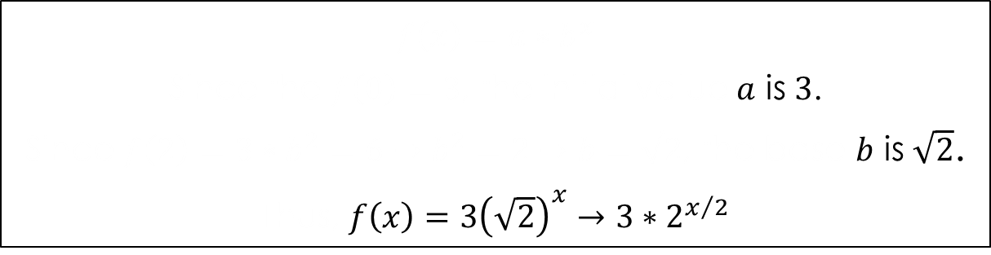


Exercises: #14
Directions: Determine a formula for the exponential function whose graph is below.
$$(2,6)$$
$$(0,3)$$
$$f\left(x\right)=a∗b^{x}$$
Since the $f\left(0\right)=3$, the initial value $a$ is $3$.
Since $f\left(2\right)=3∗b^{2}=6→b^{2}=2→b=\sqrt{2}$, the base $b$ is $\sqrt{2}$.
Thus, $f\left(x\right)=3{\left(\sqrt{2}\right)}^{x}→3∗2^{x/2}$

Slide 9
Agenda!
12/9: Start Section 3.1
12/10: Finish Section 3.1
12/11: Khan Academy
12/12: Start Section 3.2
12/15: Finish Section 3.2
12/16: Group Activity on Sections 3.1 and 3.2
12/17: Review Sections 3.1 and 3.2
12/18: Test on Sections 3.1 and 3.2
12/19: CHIRSTMAS PARTY! :D

Slide 10
Exponential and Logistic Functions
Section 3.1 – Day 2

Slide 11
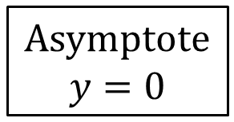
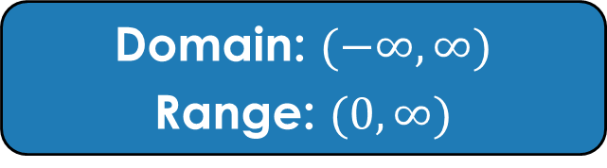
Exponential Graph
X | Y
-3 | 0.04978707
-2 | 0.13533528
-1 | 0.36787944
0 | 1
1 | 2.71828183
2 | 7.3890561
3 | 20.0855369
4 | 54.59815
5 | 148.413159
Domain: $(−∞,∞)$
Range: $(0,∞)$
Asymptote
$$y=0$$

Slide 12


Transforming Exponential Graphs
Horizontal (Inside)
Left: $y=b^{x+c}$
Right: $y=b^{x−c}$
Stretch/Shrink
Horizontal: (Inside-Reciprocal)
$y=b^{c∗x}$
  Stretch: $c<1$
  Shrink: $c>1$
Vertical: (Outside)
$$y=a∗b^{x}$$
  Stretch: $a>1$
  Shrink: $a<1$
Reflection
x-axis: (Outside)
$y={−b}^{x}$
y-axis: (Inside)
$y=b^{−x}$
Vertical (Outside)
Up: $y=b^{x}+c$
Down: $y=b^{x}−c$

Slide 13

Exercises: #16 – 24
Directions: Describe how to transform the graph of $f$ into the graph of $g$. Sketch the graph by hand and support your answer with a graphing calculator.
$f\left(x\right)=3^{x};g\left(x\right)=3^{x+4}$
  Shift to the left 4 units.
$f\left(x\right)=4^{x};g\left(x\right)=4^{−x}$
  Reflect over the y-axis.

Slide 14


Graphs
$$f\left(x\right)=3^{x};g\left(x\right)=3^{x+4}$$
$$f\left(x\right)=4^{x};g\left(x\right)=4^{−x}$$

Slide 15

Exercises: #16 – 24
Directions: Describe how to transform the graph of $f$ into the graph of $g$. Sketch the graph by hand and support your answer with a graphing calculator.
$f\left(x\right)={0.5}^{x};g\left(x\right)={3∗0.5}^{x}+4$
  Stretch vertically by $3$ and shift up $4$.
$f\left(x\right)=e^{x};g\left(x\right)=e^{−2x}$
  Shrink horizontally by 2 and reflect over the y-axis.

Slide 16


Graphs
$$f\left(x\right)={0.5}^{x};g\left(x\right)={3∗0.5}^{x}+4$$
$$f\left(x\right)=e^{x};g\left(x\right)=e^{−2x}$$

Slide 17

Exercises: #16 – 24
Directions: Describe how to transform the graph of $f$ into the graph of $g$. Sketch the graph by hand and support your answer with a graphing calculator.
$f\left(x\right)=e^{x};g\left(x\right)={2e}^{3−3x}→2e^{−3x+3}$
  H – Left $3$ units.
  S – Vertically stretch by $2$ and horizontally shrink by $1/3$.
  R – Reflection over the y-axis.
  V – None.

Slide 18

Graph
$$f\left(x\right)=e^{x}$$
$$g\left(x\right)={2e}^{3−3x}$$
$$→2e^{−\left(3x−3\right)}$$

Slide 19

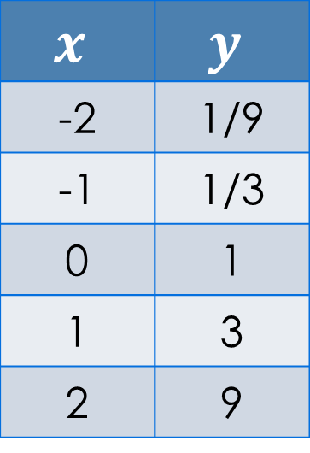
Exercises: #26 – 30
Directions:
Match the given function with its graph.
Explain how to make the choice without using a graphing calculator.
$y=3^{x}$
$$x$$ | $$y$$
-2 | 1/9
-1 | 1/3
0 | 1
1 | 3
2 | 9

Slide 20

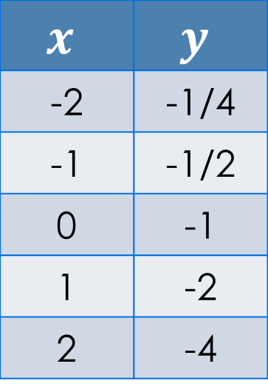
Exercises: #26 – 30
Directions:
Match the given function with its graph.
Explain how to make the choice without using a graphing calculator.
$y={−2}^{x}$
$$x$$ | $$y$$
-2 | -1/4
-1 | -1/2
0 | -1
1 | -2
2 | -4

Slide 21

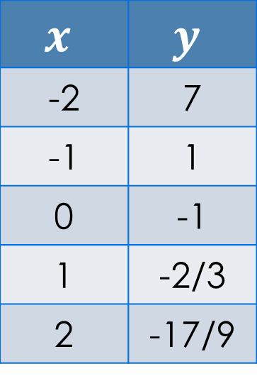
Exercises: #26 – 30
Directions:
Match the given function with its graph.
Explain how to make the choice without using a graphing calculator.
$y=3^{−x}−2$
$$x$$ | $$y$$
-2 | 7
-1 | 1
0 | -1
1 | -2/3
2 | -17/9

Slide 22
Homework
Due 12/11
  P. 270: #1 – 24 (Even)
  P. 270: #26 – 30 (All)
    #51 and #53 (Due 12/12)

Slide 23

Exercises: #51 and #53
Population Growth: Using the data in table 3.7 and assuming the growth is exponential, when will the population of El Paso surpass 800,000 persons?
City | 1990 Population | 1996 Population
Columbus, Ohio | 632,945 | 657,053
El Paso, Texas | 515,342 | 599,865
$$f\left(x\right)=a∗b^{x}$$
$$a=515,342$$
$$f\left(x\right)=\left(515342\right)∗b^{x}$$
What is $x$?
$$1996−1990=6→x=6$$
Plug that in to b:
$$\left(515342\right)∗b^{6}=599865$$
$$b^{6}=\frac{599865}{515342}=\sqrt[6]{\frac{599865}{515342}}$$
$$=1.025$$
$$f\left(x\right)=515342{\left(1.025\right)}^{x}$$
Ohio
El Paso

Slide 24
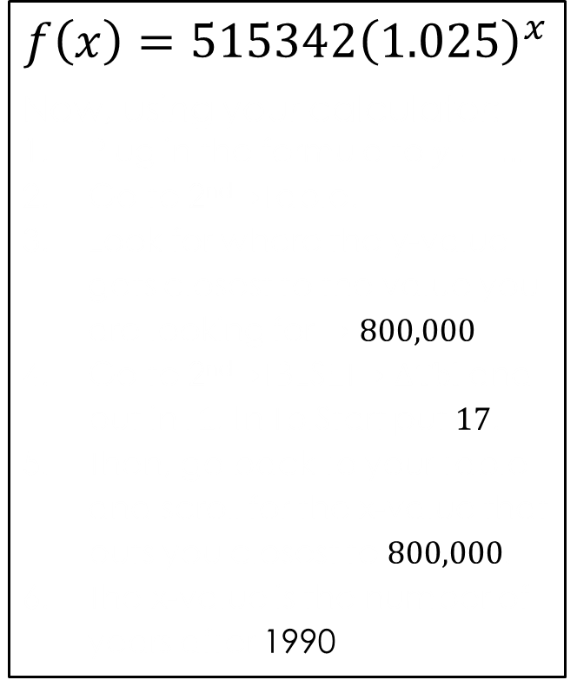

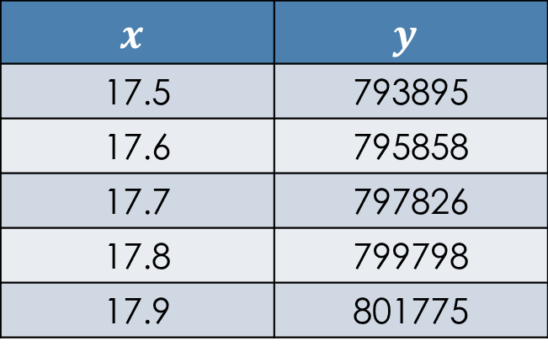
Exercises: #51 and #53
Population Growth: Using the data in table 3.7 and assuming the growth is exponential, when will the population of El Paso surpass 800,000 persons?
$$x$$ | $$y$$
17.5 | 793895
17.6 | 795858
17.7 | 797826
17.8 | 799798
17.9 | 801775
$$f\left(x\right)=515342{\left(1.025\right)}^{x}$$
Now, using your calculator:
Plug in the formula to $y= …$
Go to 2nd$→$Table.
Look for where the y-value gets closest to the value you are looking for $→800,000$
Go to 2nd$→$TBLSET$→∆Tbl$ and put in $.1$. In TblStart put $17$.
Then, go back to your table and scroll for the x-value that puts you closest to $800,000$.
The x-value is the number of years after 1990.
Thus, the population of El Paso will surpass 800,000 in about 17.9 years.
Thus, $1990+17.9=2007.9$
$$≈2008$$

