Slide 1
Solving Inequalities in One Variable
Section 2.8

Slide 2
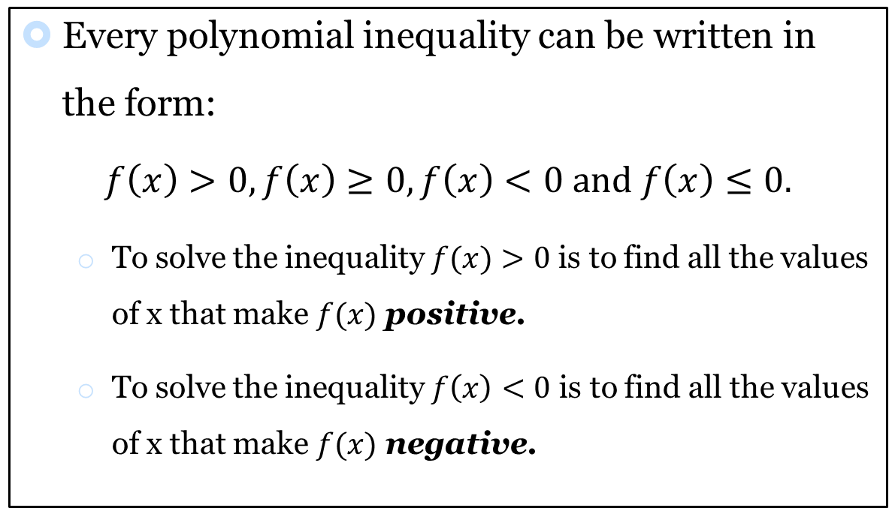
Polynomial Inequalities
Every polynomial inequality can be written in the form:
$$f\left(x\right)>0, f\left(x\right)≥0, f\left(x\right)<0 and f\left(x\right)≤0.$$
  To solve the inequality $f(x)>0$ is to find all the values of x that make $f(x)$ positive.
  To solve the inequality $f\left(x\right)<0$ is to find all the values of x that make $f(x)$ negative.

Slide 3
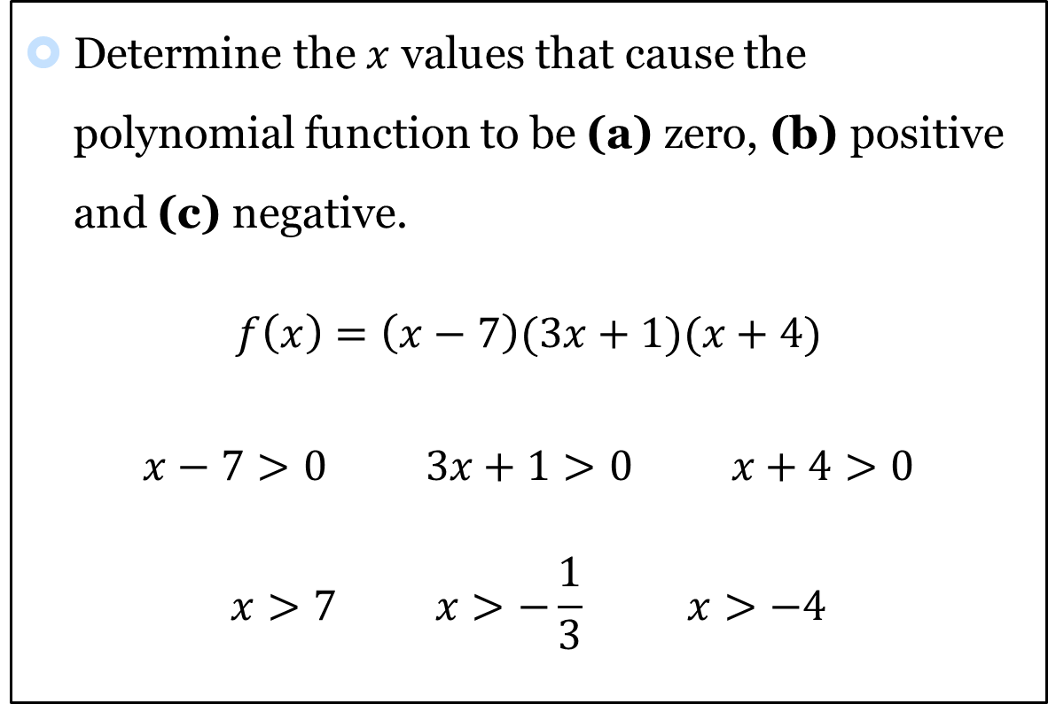
Exercises: #1-6
Determine the $x$ values that cause the polynomial function to be (a) zero, (b) positive and (c) negative.
$$f\left(x\right)=\left(x−7\right)(3x+1)(x+4)$$
$$x−7>0 3x+1>0 x+4>0$$
$$x>7 x>−\frac{1}{3} x>−4$$

Slide 4


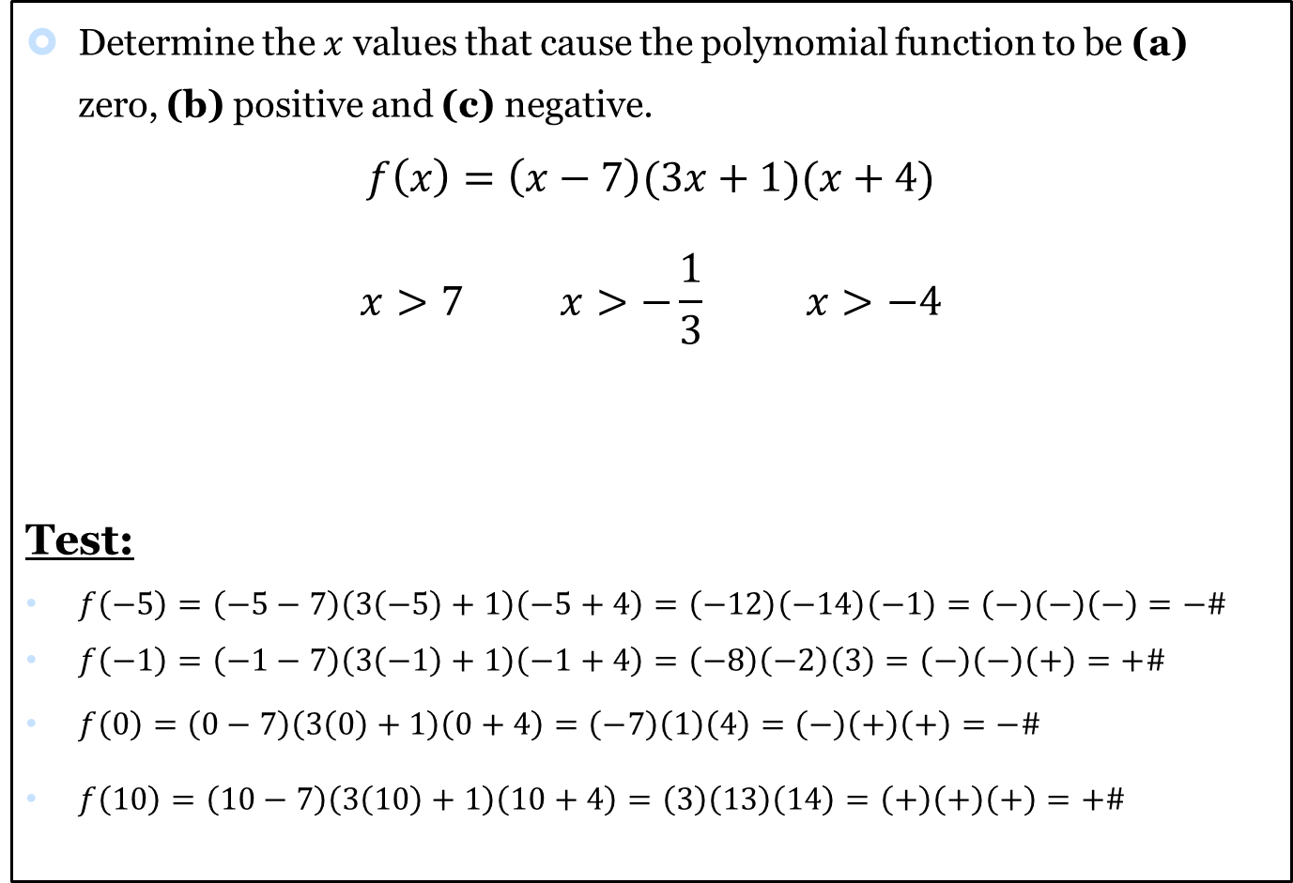





Exercises: #1-6
Determine the $x$ values that cause the polynomial function to be (a) zero, (b) positive and (c) negative.
$$f\left(x\right)=\left(x−7\right)(3x+1)(x+4)$$
$$x>7 x>−\frac{1}{3} x>−4$$
Test:
$f\left(−5\right)=\left(−5−7\right)\left(3\left(−5\right)+1\right)\left(−5+4\right)=\left(−12\right)\left(−14\right)\left(−1\right)=\left(−\right)\left(−\right)\left(−\right)=−\#$
$f\left(−1\right)=\left(−1−7\right)\left(3\left(−1\right)+1\right)\left(−1+4\right)=\left(−8\right)\left(−2\right)\left(3\right)=\left(−\right)\left(−\right)\left(+\right)=+\#$
$f\left(0\right)=\left(0−7\right)\left(3\left(0\right)+1\right)\left(0+4\right)=\left(−7\right)\left(1\right)\left(4\right)=\left(−\right)\left(+\right)\left(+\right)=−\#$
$f\left(10\right)=\left(10−7\right)\left(3\left(10\right)+1\right)\left(10+4\right)=\left(3\right)\left(13\right)\left(14\right)=\left(+\right)\left(+\right)\left(+\right)=+\#$
$$−\#$$
$$−4$$
$$+\#$$
$$−\frac{1}{3}$$
$$−\#$$
$$7$$
$$+\#$$

Slide 5
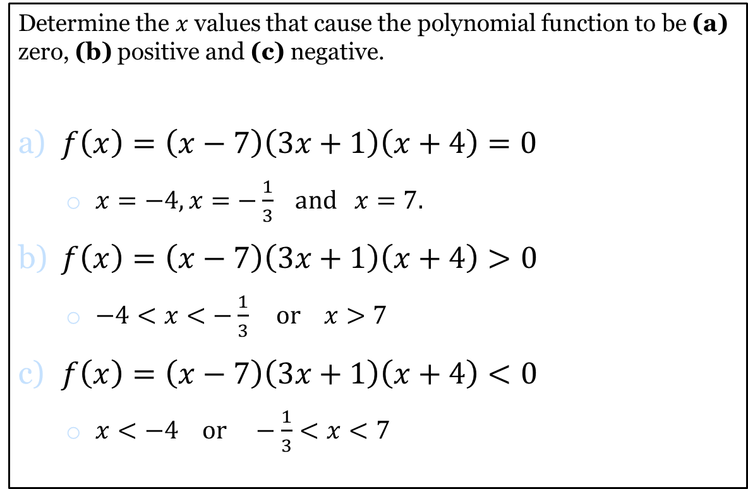
Solution
Determine the $x$ values that cause the polynomial function to be (a) zero, (b) positive and (c) negative.
$f\left(x\right)=\left(x−7\right)\left(3x+1\right)\left(x+4\right)=0$
  $x=−4, x=−\frac{1}{3} and x=7.$
$f\left(x\right)=\left(x−7\right)\left(3x+1\right)\left(x+4\right)>0$
  $−4<x<−\frac{1}{3} or x>7$
$f\left(x\right)=\left(x−7\right)\left(3x+1\right)\left(x+4\right)<0$
  $x<−4 or −\frac{1}{3}<x<7$

Slide 6
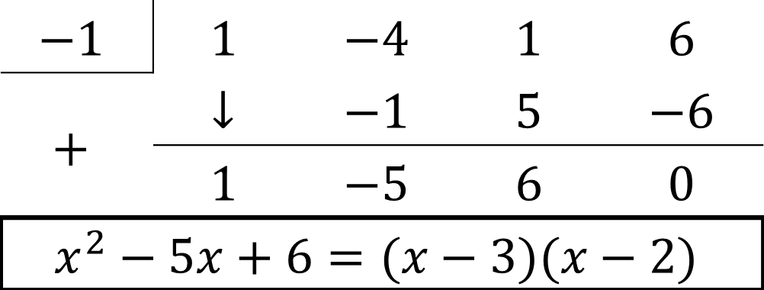

Exercises: #7-12
Complete the factoring if needed, and solve the polynomial inequality using a sign chart. Support graphically.
$$f\left(x\right)=x^{3}−4x^{2}+x+6≤0$$
$\left(x+1\right)\left(x−3\right)\left(x−2\right)≤0$
$$−1$$ | $$1$$ | $$−4$$ | $$1$$ | $$6$$
$$+$$ | $$↓$$ | $$−1$$ | $$5$$ | $$−6$$
 | $$1$$ | $$−5$$ | $$6$$ | $$0$$
$$x^{2}−5x+6=(x−3)(x−2)$$

Slide 7
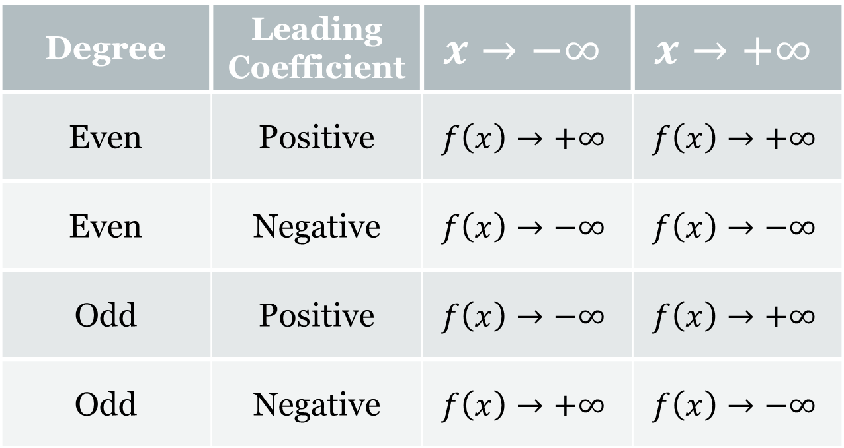
End Behavior:
Degree | Leading Coefficient | $$x→−∞$$ | $$x→+∞$$
Even | Positive | $$f\left(x\right)→+∞$$ | $$f\left(x\right)→+∞$$
Even | Negative | $$f\left(x\right)→−∞$$ | $$f\left(x\right)→−∞$$
Odd | Positive | $$f\left(x\right)→−∞$$ | $$f\left(x\right)→+∞$$
Odd | Negative | $$f\left(x\right)→+∞$$ | $$f\left(x\right)→−∞$$

Slide 8






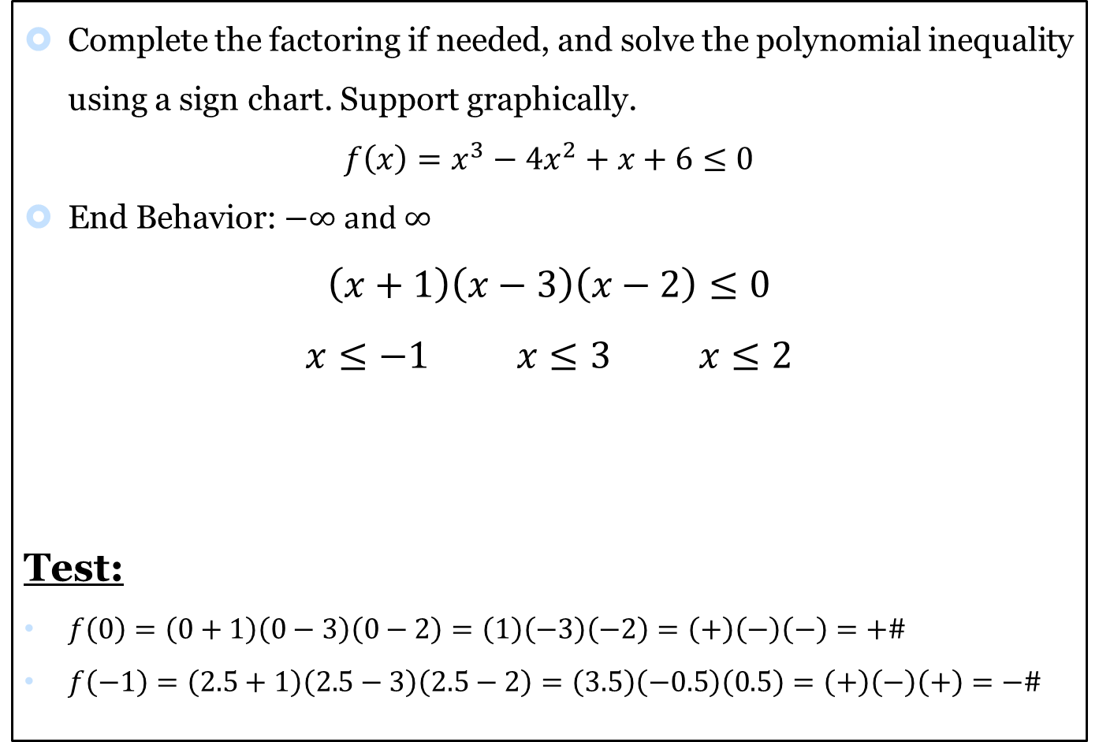

Exercises: #7-12
Complete the factoring if needed, and solve the polynomial inequality using a sign chart. Support graphically.
$$f\left(x\right)=x^{3}−4x^{2}+x+6≤0$$
End Behavior: $−∞ and ∞$
$$\left(x+1\right)\left(x−3\right)\left(x−2\right)≤0$$
$$x≤−1 x≤3 x≤2$$
Test:
$f\left(0\right)=\left(0+1\right)\left(0−3\right)\left(0−2\right)=\left(1\right)\left(−3\right)\left(−2\right)=\left(+\right)\left(−\right)\left(−\right)=+\#$
$f\left(−1\right)=\left(2.5+1\right)\left(2.5−3\right)\left(2.5−2\right)=\left(3.5\right)\left(−0.5\right)\left(0.5\right)=\left(+\right)\left(−\right)\left(+\right)=−\#$
$$−\#$$
$$+\#$$
$$−\#$$
$$+\#$$
$$−1$$
$$2$$
$$3$$

Slide 9

Solution
Complete the factoring if needed, and solve the polynomial inequality using a sign chart. Support graphically.
$$f\left(x\right)=\left(x+1\right)\left(x−3\right)\left(x−2\right)≤0$$
  $$\left(−∞,−1\right]∪[2, 3]$$

Slide 10

Exercises: #13-20
Directions: Solve the polynomial inequality graphically.
$$f\left(x\right)=2x^{3}−5x^{2}+3x<0$$
$x=0,x=1 and x=\frac{3}{2}$
Solution: $\left(−∞,0\right]∪[1,\frac{3}{2}]$

Slide 11
Homework: Due 11/24
P. 246: #1-33

Slide 12
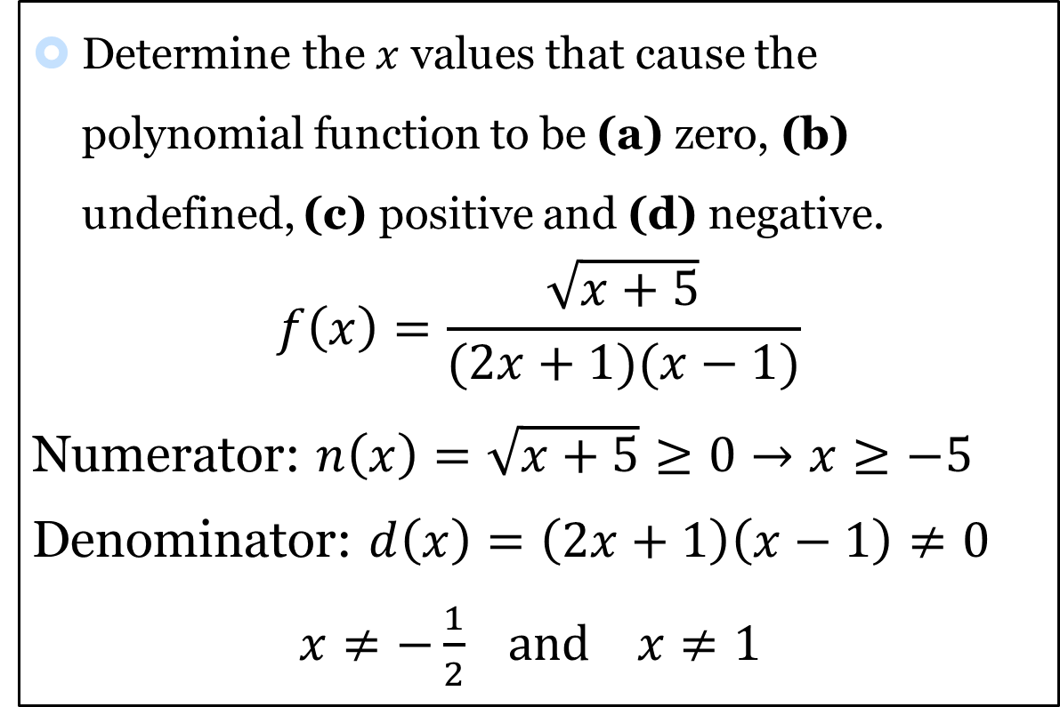
Exercises: #21-28
Determine the $x$ values that cause the polynomial function to be (a) zero, (b) undefined, (c) positive and (d) negative.
$$f\left(x\right)=\frac{\sqrt{x+5}}{(2x+1)(x−1)}$$
Numerator: $n\left(x\right)=\sqrt{x+5}≥0→x≥−5$
Denominator: $d\left(x\right)=\left(2x+1\right)\left(x−1\right)≠0$
$x≠−\frac{1}{2} and x≠1$

Slide 13



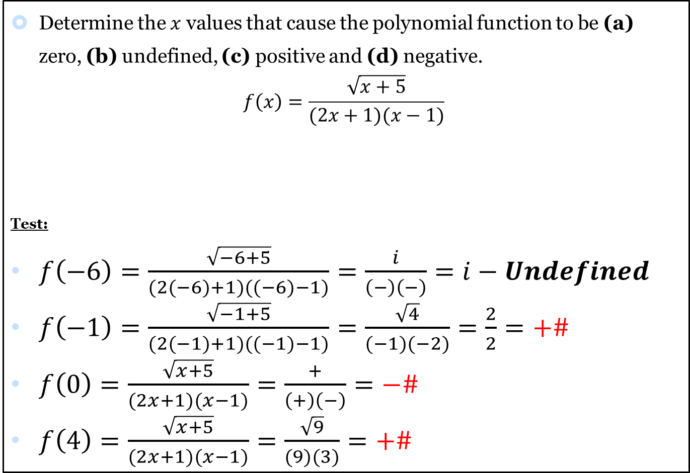




Exercises: #21-28
Determine the $x$ values that cause the polynomial function to be (a) zero, (b) undefined, (c) positive and (d) negative.
$$f\left(x\right)=\frac{\sqrt{x+5}}{(2x+1)(x−1)}$$
Test:
$f\left(−6\right)=\frac{\sqrt{−6+5}}{(2(−6)+1)((−6)−1)}=\frac{i}{\left(−\right)\left(−\right)}=i−Undefined$
$f\left(−1\right)=\frac{\sqrt{−1+5}}{(2(−1)+1)((−1)−1)}=\frac{\sqrt{4}}{(−1)(−2)}=\frac{2}{2}=+\#$
$f\left(0\right)=\frac{\sqrt{x+5}}{(2x+1)(x−1)}=\frac{+}{\left(+\right)\left(−\right)}=−\#$
$f\left(4\right)=\frac{\sqrt{x+5}}{(2x+1)(x−1)}=\frac{\sqrt{9}}{(9)(3)}=+\#$
$$Undefined$$
$$−5$$
$$+\#$$
$$−\frac{1}{2}$$
$$−\#$$
$$1$$
$$+\#$$

Slide 14
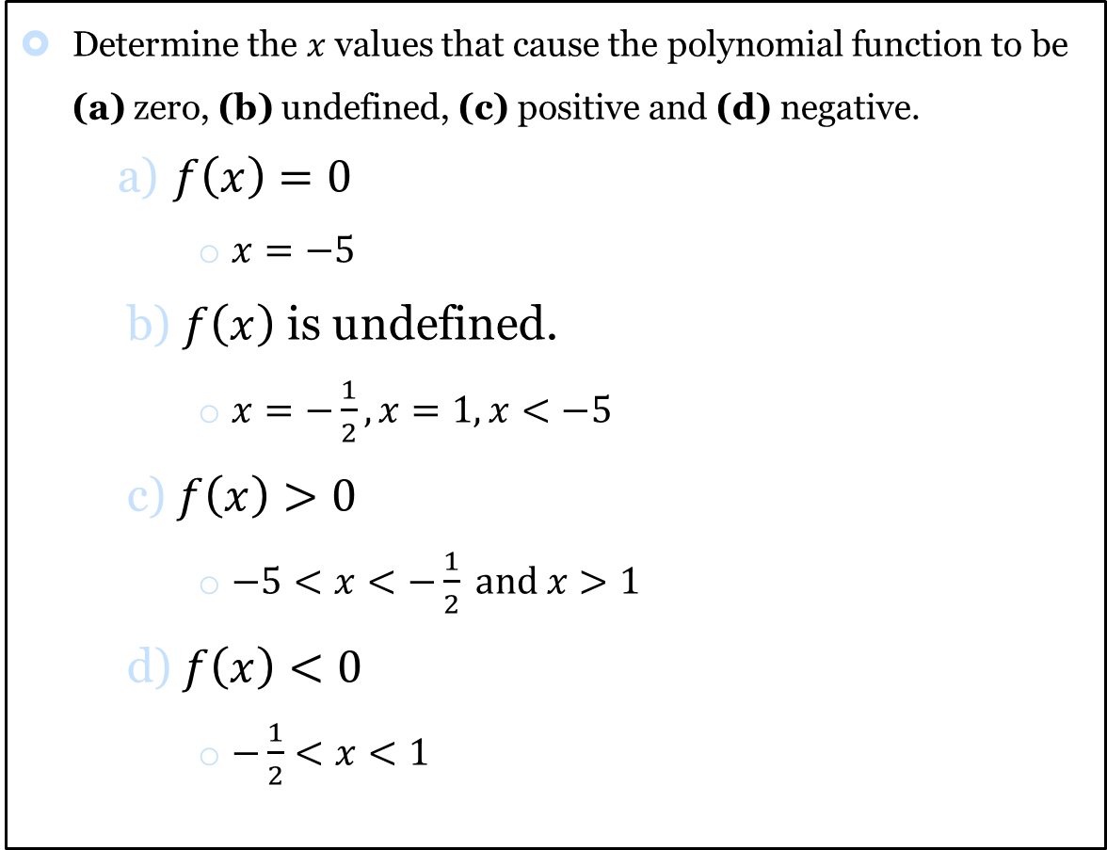
Solution
Determine the $x$ values that cause the polynomial function to be (a) zero, (b) undefined, (c) positive and (d) negative.
$f\left(x\right)=0$
  $x=−5$
$f\left(x\right)$ is undefined.
  $x=−\frac{1}{2}, x=1, x<−5$
$f\left(x\right)>0$
  $−5<x<−\frac{1}{2} and x>1$
$f\left(x\right)<0$
  $−\frac{1}{2}<x<1$

Slide 15
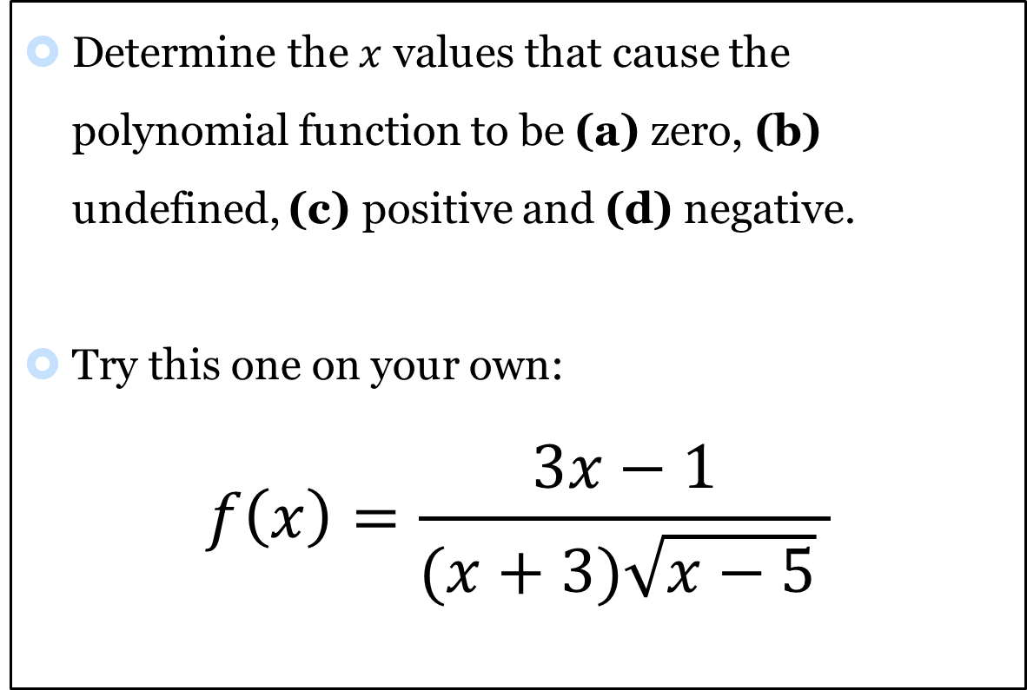
Exercises: #21-28
Determine the $x$ values that cause the polynomial function to be (a) zero, (b) undefined, (c) positive and (d) negative.
Try this one on your own:
$$f\left(x\right)=\frac{3x−1}{(x+3)\sqrt{x−5} }$$

Slide 16
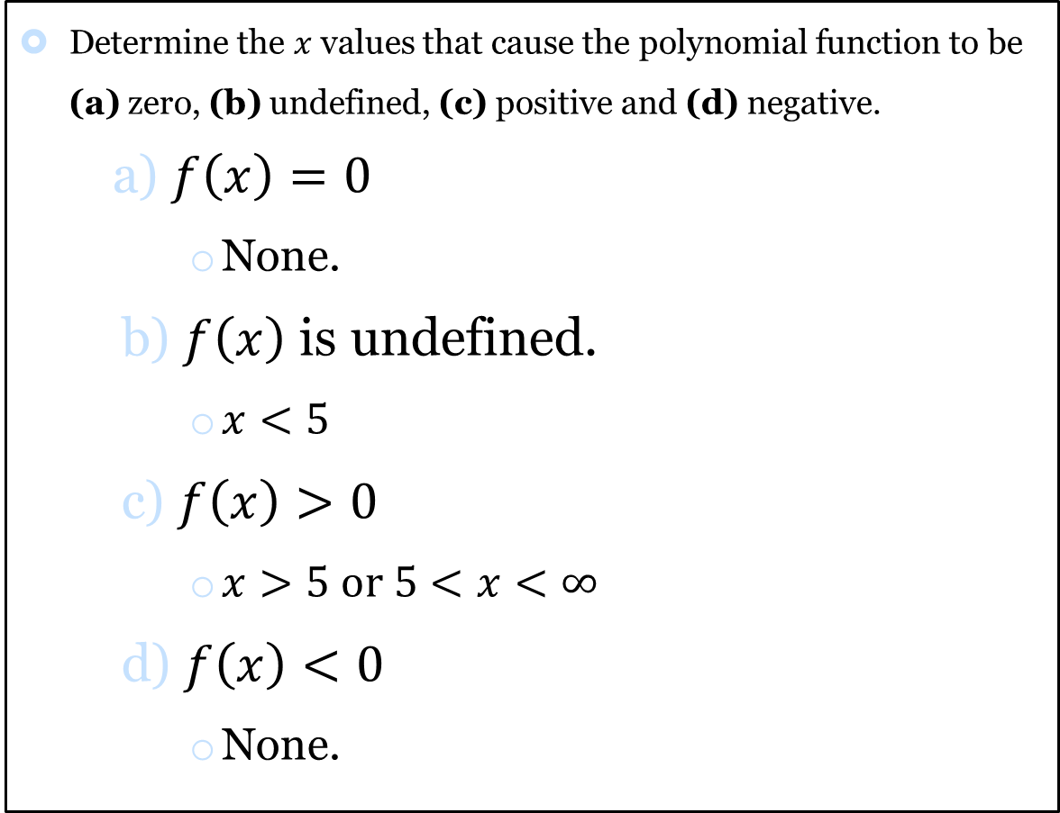
Solution
Determine the $x$ values that cause the polynomial function to be (a) zero, (b) undefined, (c) positive and (d) negative.
$f\left(x\right)=0$
  None.
$f\left(x\right)$ is undefined.
  $x<5$
$f\left(x\right)>0$
  $x>5 or 5<x<∞$
$f\left(x\right)<0$
  None.

Slide 17
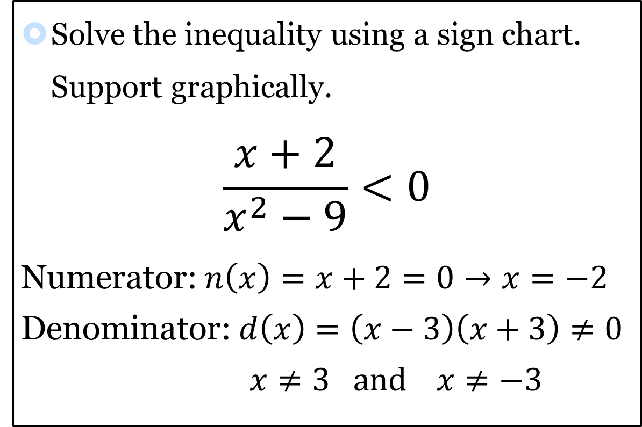
Exercises: #29-34
Solve the inequality using a sign chart. Support graphically.
$$\frac{x+2}{x^{2}−9}<0$$
Numerator: $n\left(x\right)=x+2=0→x=−2$
Denominator: $d\left(x\right)=\left(x−3\right)\left(x+3\right)≠0$
$x≠3 and x≠−3$

Slide 18



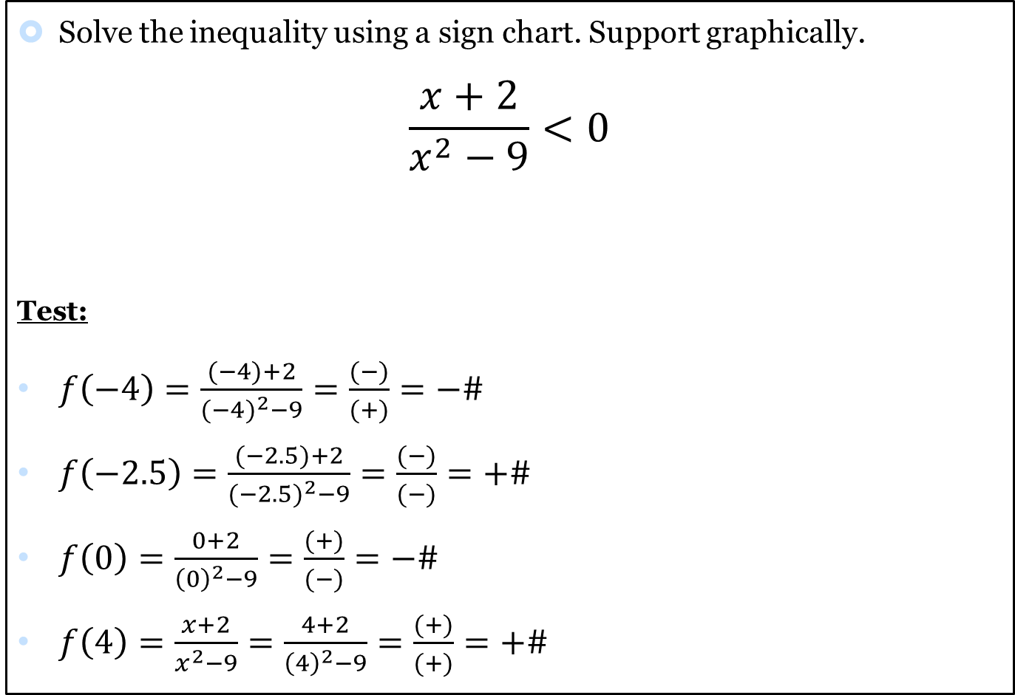




Exercises: #29-34
Solve the inequality using a sign chart. Support graphically.
$$\frac{x+2}{x^{2}−9}<0$$
Test:
$f\left(−4\right)=\frac{(−4)+2}{{(−4)}^{2}−9}=\frac{(−)}{(+)}=−\#$
$f\left(−2.5\right)=\frac{(−2.5)+2}{{(−2.5)}^{2}−9}=\frac{(−)}{(−)}=+\#$
$f\left(0\right)=\frac{0+2}{{\left(0\right)}^{2}−9}=\frac{(+)}{(−)}=−\#$
$f\left(4\right)=\frac{x+2}{x^{2}−9}=\frac{4+2}{{\left(4\right)}^{2}−9}=\frac{(+)}{(+)}=+\#$
$$−\#$$
$$−3$$
$$+\#$$
$$−2$$
$$−\#$$
$$3$$
$$+\#$$

Slide 19
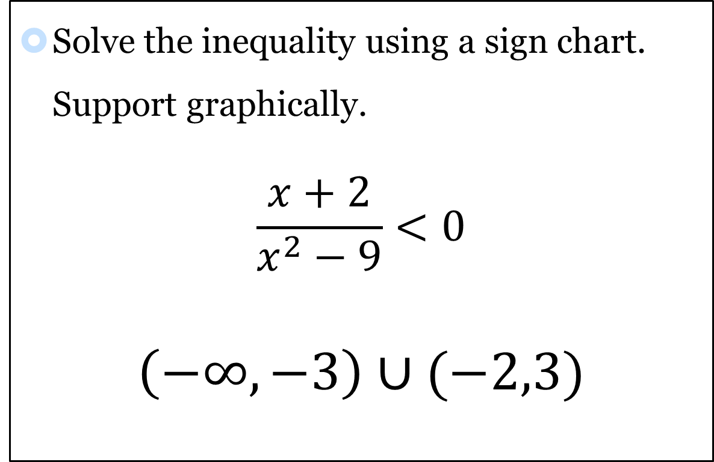
Solution
Solve the inequality using a sign chart. Support graphically.
$$\frac{x+2}{x^{2}−9}<0$$
$$\left(−∞,−3\right)∪(−2,3)$$

Slide 20
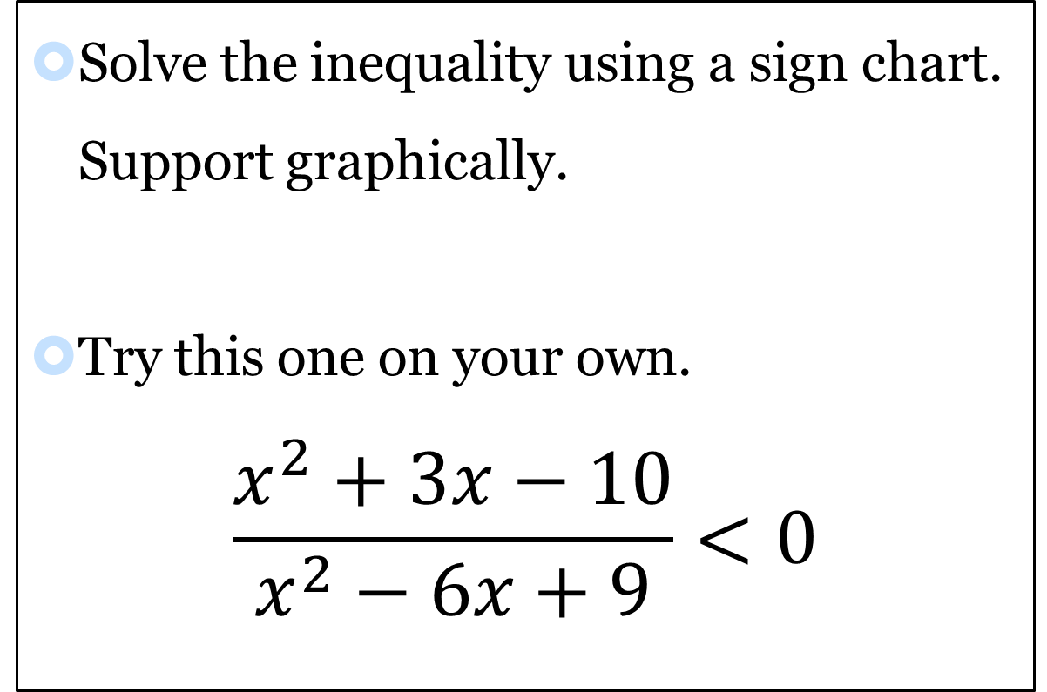
Exercises: #29-34
Solve the inequality using a sign chart. Support graphically.
Try this one on your own.
$$\frac{x^{2}+3x−10}{x^{2}−6x+9}<0$$

Slide 21
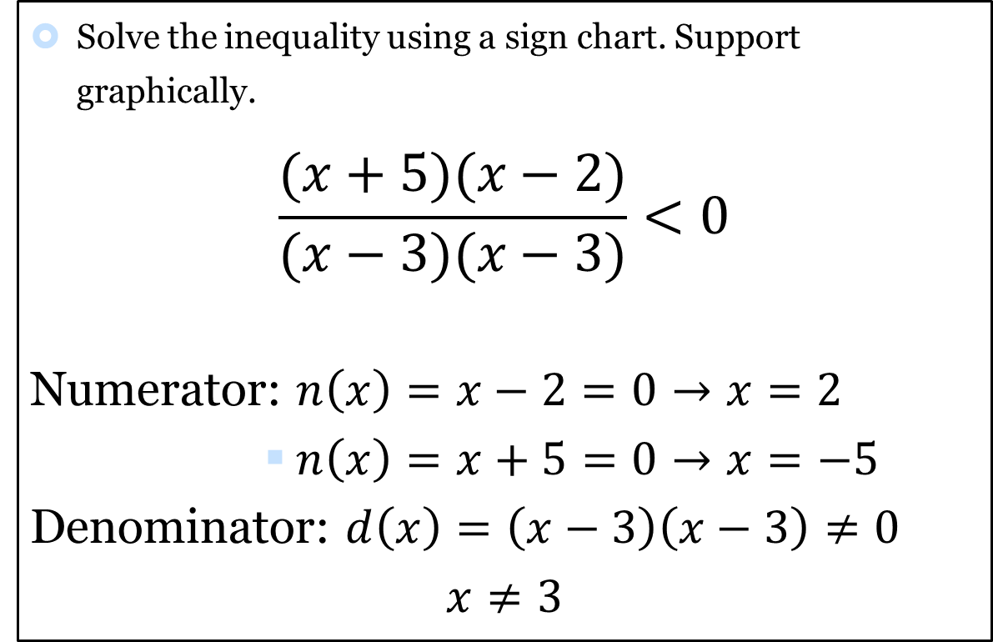
Exercises: #29-34
Solve the inequality using a sign chart. Support graphically.
$$\frac{(x+5)(x−2)}{(x−3)(x−3)}<0$$
Numerator: $n\left(x\right)=x−2=0→x=2$
        $n\left(x\right)=x+5=0→x=−5$
Denominator: $d\left(x\right)=\left(x−3\right)\left(x−3\right)≠0$
$$x≠3$$

Slide 22
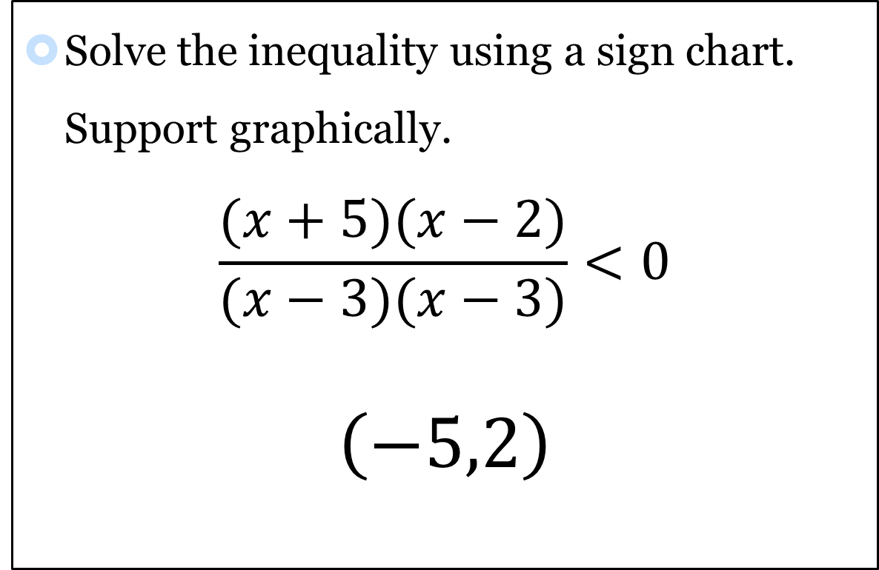
Solution
Solve the inequality using a sign chart. Support graphically.
$$\frac{(x+5)(x−2)}{(x−3)(x−3)}<0$$
$$\left(−5,2\right)$$

