Slide 1
Real Zeros of Polynomial Functions
Section 2.4

Slide 2
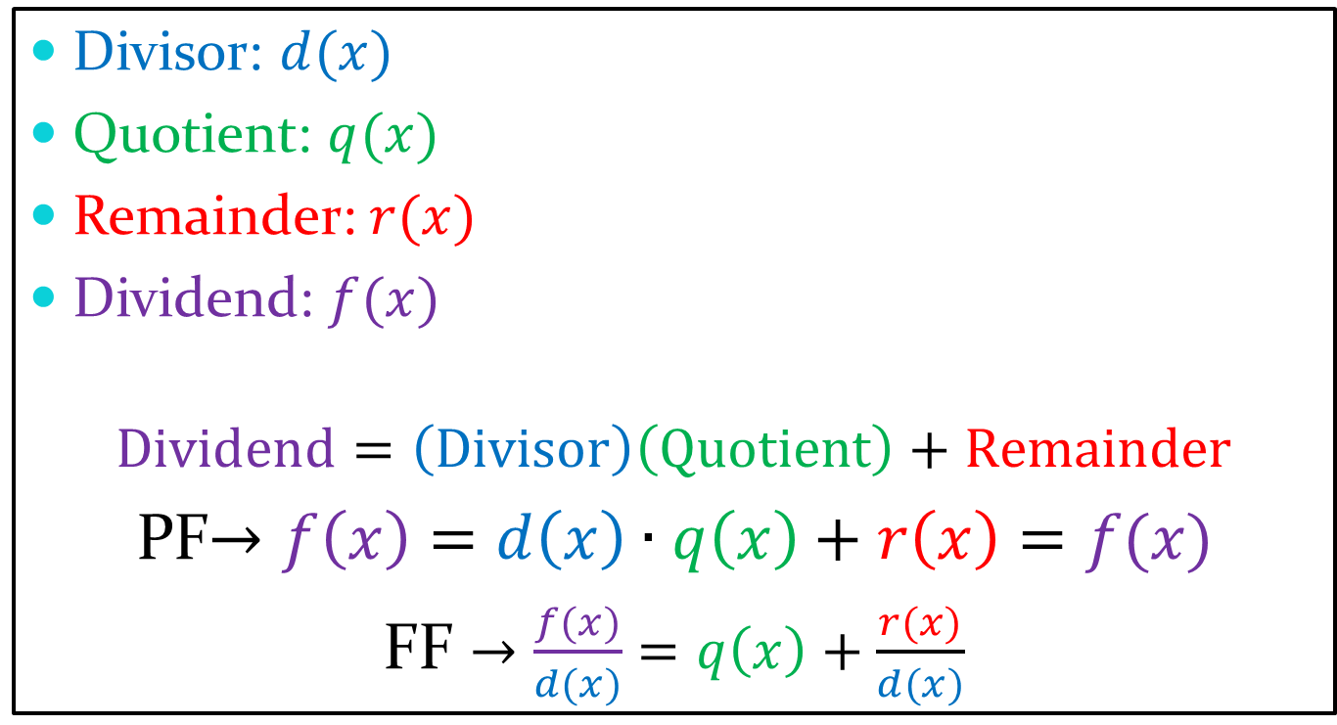
Terms
Divisor: $d(x)$
Quotient: $q(x)$
Remainder:$r(x)$
Dividend: $f(x)$
$$Dividend=\left(Divisor\right)\left(Quotient\right)+Remainder$$
PF$→f\left(x\right)=d\left(x\right)∙q\left(x\right)+r\left(x\right)=f(x)$
  FF $→\frac{f(x)}{d(x)}=q\left(x\right)+\frac{r(x)}{d(x)}$

Slide 3
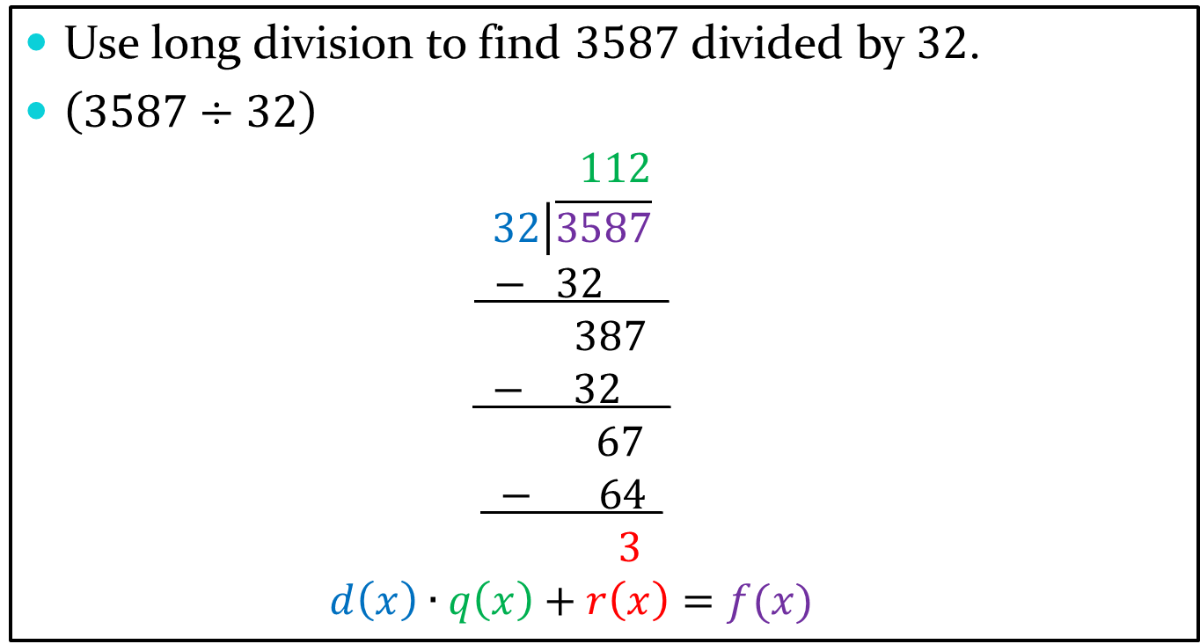
Long Division
Use long division to find $3587$ divided by $32$.
$\left(3587÷32\right)$
  $$112$$
  $$32\left|\overline{3587}\right.$$
  $$− 32____$$
  $$387$$
  $$− 32___$$
  $$67$$
  $$−_ 64_$$
  $$3$$
  $$d\left(x\right)∙q\left(x\right)+r\left(x\right)=f(x)$$

Slide 4
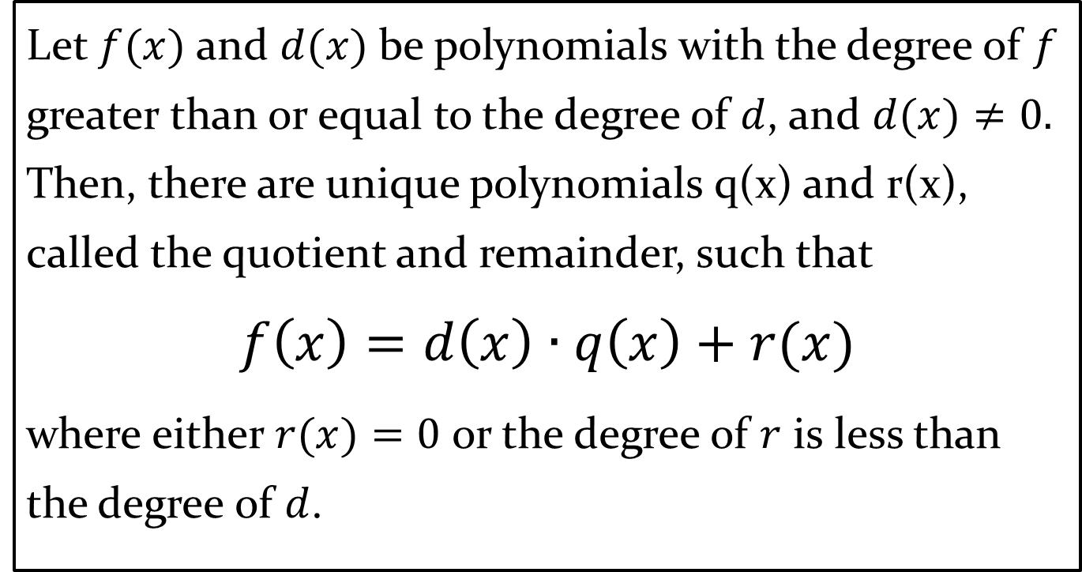
Division Algorithm for Polynomials
Let $f(x)$and $d(x)$be polynomials with the degree of $f$ greater than or equal to the degree of $d$, and $d(x)≠0.$ Then, there are unique polynomials q(x) and r(x), called the quotient and remainder, such that
$$f\left(x\right)=d\left(x\right)∙q\left(x\right)+r(x)$$
where either $r(x)=0$or the degree of $r$ is less than the degree of $d$.

Slide 5
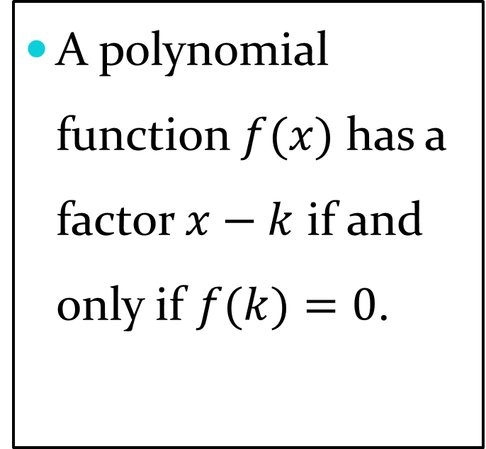
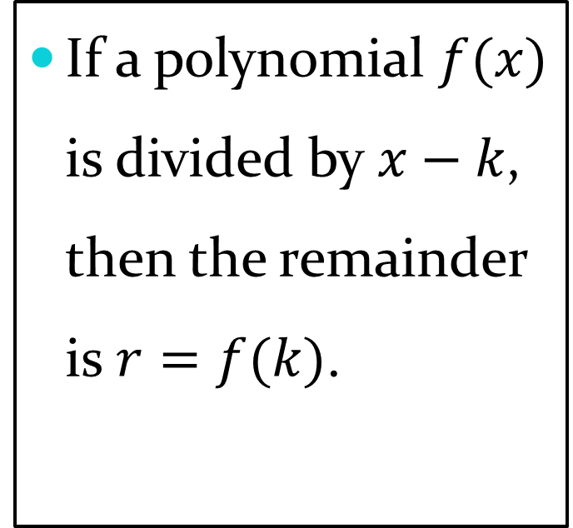
Theorems
Remainder Theorem
Factor Theorem
If a polynomial $f(x)$ is divided by $x−k$, then the remainder is $r=f(k)$.
A polynomial function $f(x)$ has a factor $x−k$ if and only if $f(k)=0$.

Slide 6
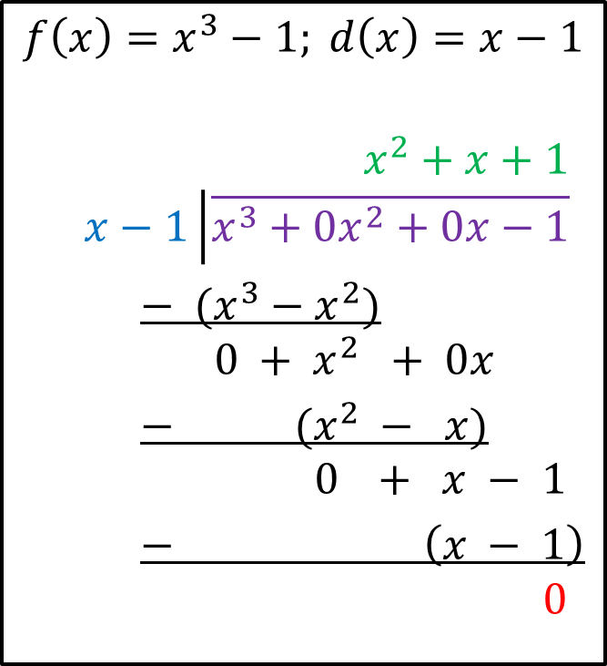

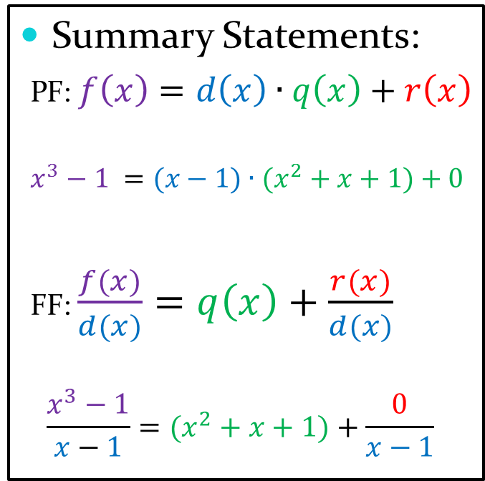
Long Division with Polynomials
Divide $f(x)$by $d(x)$ and write a summary statement in polynomial form.
$$f\left(x\right)=x^{3}−1; d\left(x\right)=x−1$$
  $$x^{2}+x+1$$
  $$x−1\left|\overline{x^{3}+0x^{2}+0x−1}\right.$$
  $− (x^{3}−x^{2})$
  $$0 + x^{2} + 0x$$
  $− (x^{2} − x)$
  $$0 + x − 1$$
  $− \left(x − 1\right)$
  $$0$$
Summary Statements:
PF: $f\left(x\right)=d\left(x\right)∙q\left(x\right)+r\left(x\right)$
$$x^{3}−1 =(x−1)∙(x^{2}+x+1)+0$$
  FF: $\frac{f(x)}{d(x)}=q\left(x\right)+\frac{r(x)}{d(x)}$
$$\frac{x^{3}−1}{x−1}=(x^{2}+x+1)+\frac{0}{x−1}$$

Slide 7
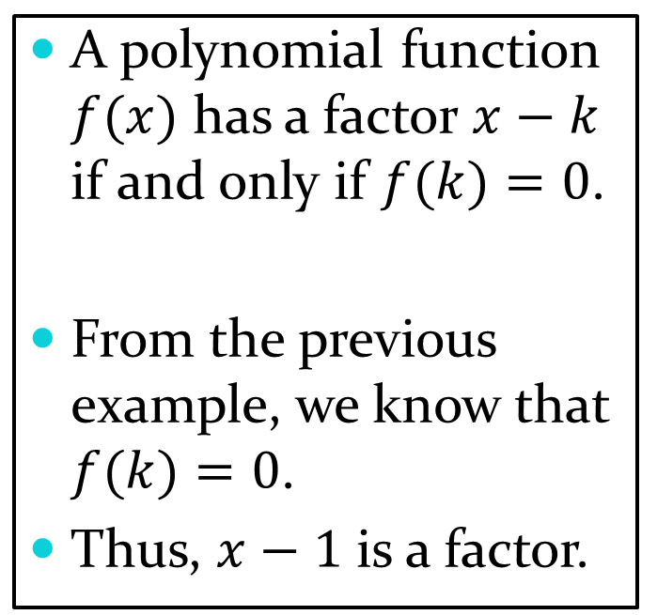
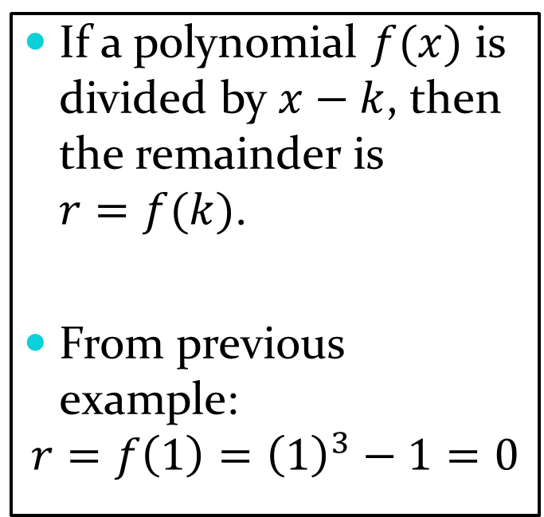
Theorems
Remainder Theorem
Factor Theorem
If a polynomial $f(x)$ is divided by $x−k$, then the remainder is $r=f(k)$.
From previous example:
$$r=f\left(1\right)={\left(1\right)}^{3}−1=0$$
A polynomial function $f(x)$ has a factor $x−k$ if and only if $f(k)=0$.
From the previous example, we know that $f(k)=0$.
Thus, $x−1$ is a factor.

Slide 8
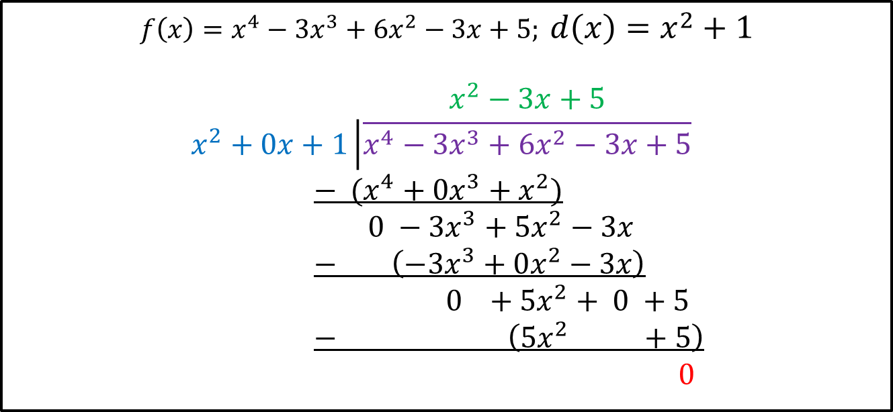
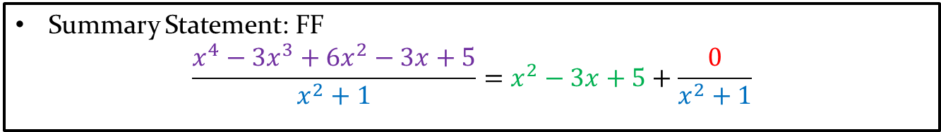
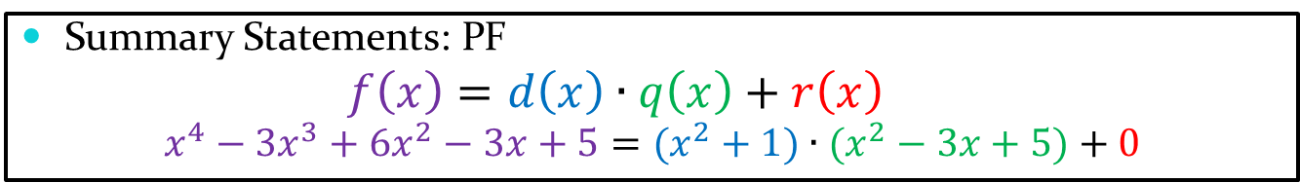
Long Division with Polynomials
Divide $f(x)$by $d(x)$ and write a summary statement in polynomial form.
$$f\left(x\right)=x^{4}−3x^{3}+6x^{2}−3x+5; d\left(x\right)=x^{2}+1$$
  $$x^{2}−3x+5$$
$$x^{2}+0x+1\left|\overline{x^{4}−3x^{3}+6x^{2}−3x+5}\right.$$
  $− (x^{4}+0x^{3}+x^{2})$
  $0 −3x^{3}+5x^{2}−3x$
  $− \left(−3x^{3}+0x^{2}−3x\right)$
  $0 +5x^{2}+ 0 +5$
  $− \left(5x^{2} +5\right)$
  $0$
Summary Statements: PF
  $$f\left(x\right)=d\left(x\right)∙q\left(x\right)+r\left(x\right)$$
$$x^{4}−3x^{3}+6x^{2}−3x+5=(x^{2}+1)∙(x^{2}−3x+5)+0$$
Summary Statement: FF
$$\frac{x^{4}−3x^{3}+6x^{2}−3x+5}{x^{2}+1}=x^{2}−3x+5+\frac{0}{x^{2}+1}$$

Slide 9
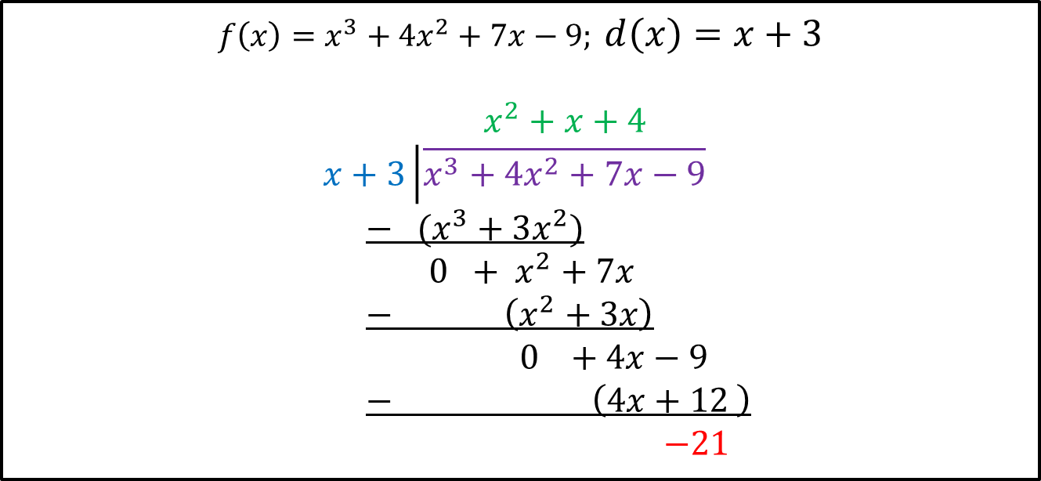
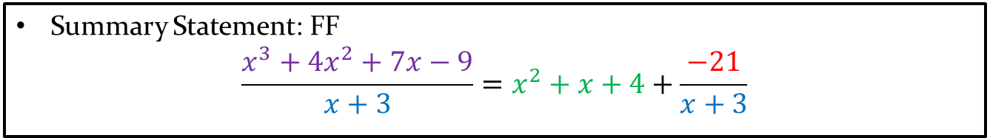
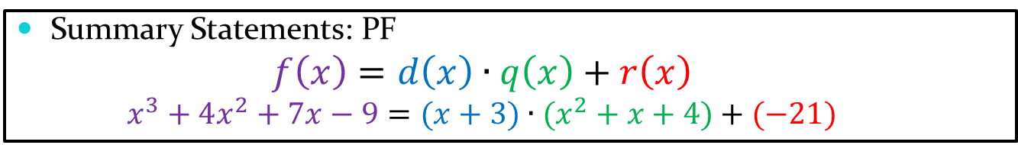
Long Division with Polynomials
Divide $f(x)$by $d(x)$ and write a summary statement in polynomial form.
$$f\left(x\right)=x^{3}+4x^{2}+7x−9; d\left(x\right)=x+3$$
$x^{2}+x+4$
$$x+3\left|\overline{x^{3}+4x^{2}+7x−9}\right.$$
  $− (x^{3}+3x^{2})$
  $0 + x^{2}+7x$
  $− \left(x^{2}+3x\right)$
  $0 +4x−9$
  $− \left(4x+12 \right)$
  $−21$
Summary Statements: PF
  $$f\left(x\right)=d\left(x\right)∙q\left(x\right)+r\left(x\right)$$
  $$x^{3}+4x^{2}+7x−9=(x+3)∙(x^{2}+x+4)+(−21)$$
Summary Statement: FF
$$\frac{x^{3}+4x^{2}+7x−9}{x+3}=x^{2}+x+4+\frac{−21}{x+3}$$

Slide 10
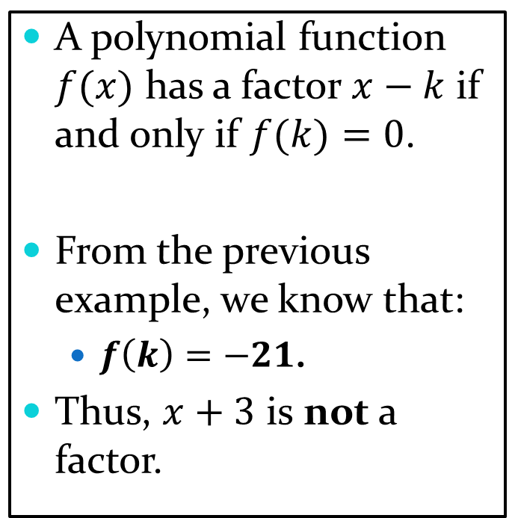
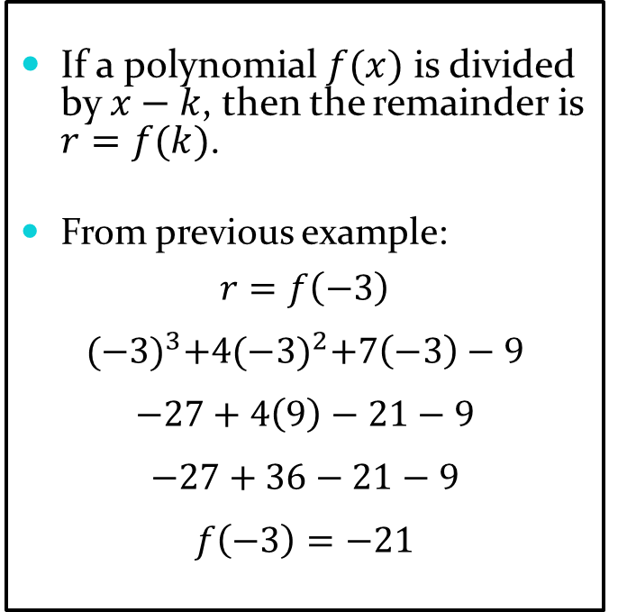
Theorems
Remainder Theorem
Factor Theorem
If a polynomial $f(x)$ is divided by $x−k$, then the remainder is $r=f(k)$.
From previous example:
$$r=f\left(−3\right)$$
$${(−3)}^{3}+4{(−3)}^{2}+7\left(−3\right)−9$$
$$−27+4\left(9\right)−21−9$$
$$−27+36−21−9$$
$$f\left(−3\right)=−21$$
A polynomial function $f(x)$ has a factor $x−k$ if and only if $f(k)=0$.
From the previous example, we know that:
  $f\left(k\right)=−21$.
Thus, $x+3$ is not a factor.

Slide 11

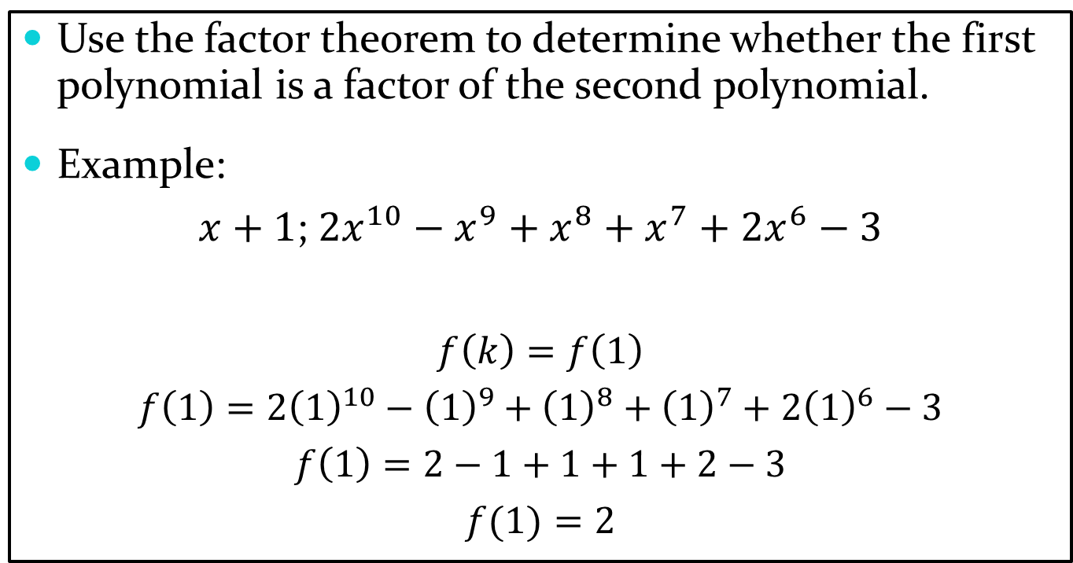
Factor Theorem
Use the factor theorem to determine whether the first polynomial is a factor of the second polynomial.
Example:
$x+1$; $2x^{10}−x^{9}+x^{8}+x^{7}+2x^{6}−3$
$$f\left(k\right)=f\left(1\right)$$
$$f\left(1\right)=2{\left(1\right)}^{10}−{\left(1\right)}^{9}+{\left(1\right)}^{8}+{\left(1\right)}^{7}+2{\left(1\right)}^{6}−3$$
$$f\left(1\right)=2−1+1+1+2−3$$
$$f(1)=2$$
Factor Theorem Definition: $f(k)=0$.
Thus, $x+1$ is not a polynomial factor of $2x^{10}−x^{9}+x^{8}+x^{7}+2x^{6}−3$.

Slide 12
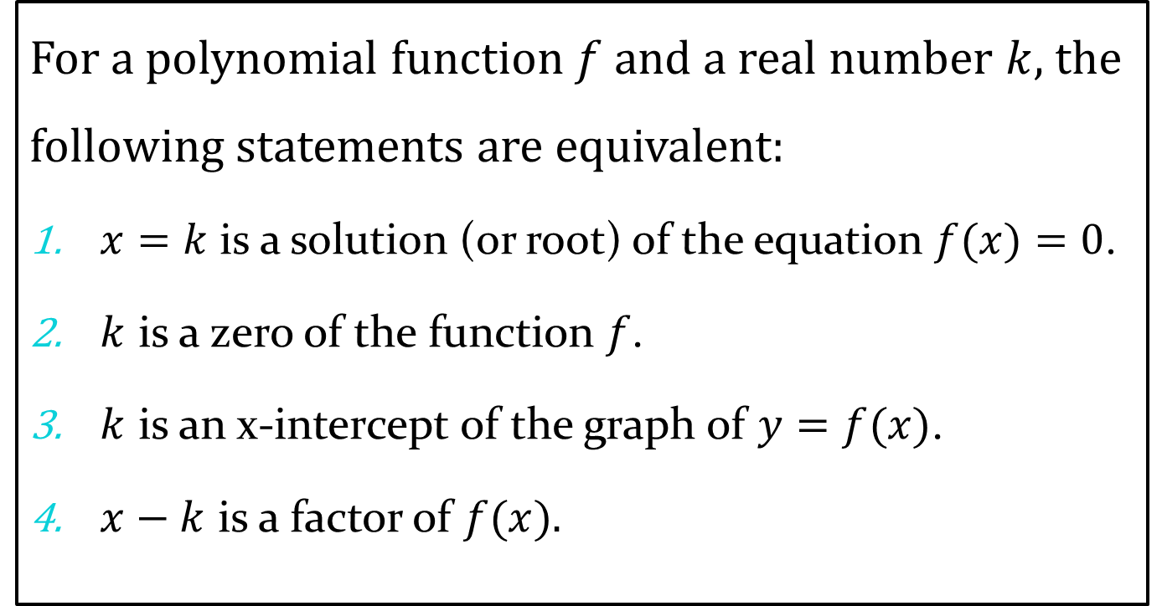
Various Ways to say the Same Thing
For a polynomial function $f$ and a real number $k$, the following statements are equivalent:
$x=k$ is a solution (or root) of the equation $f(x)=0$.
$k$ is a zero of the function $f$.
$k$ is an x-intercept of the graph of $y=f(x)$.
$x−k$ is a factor of $f(x).$

Slide 13
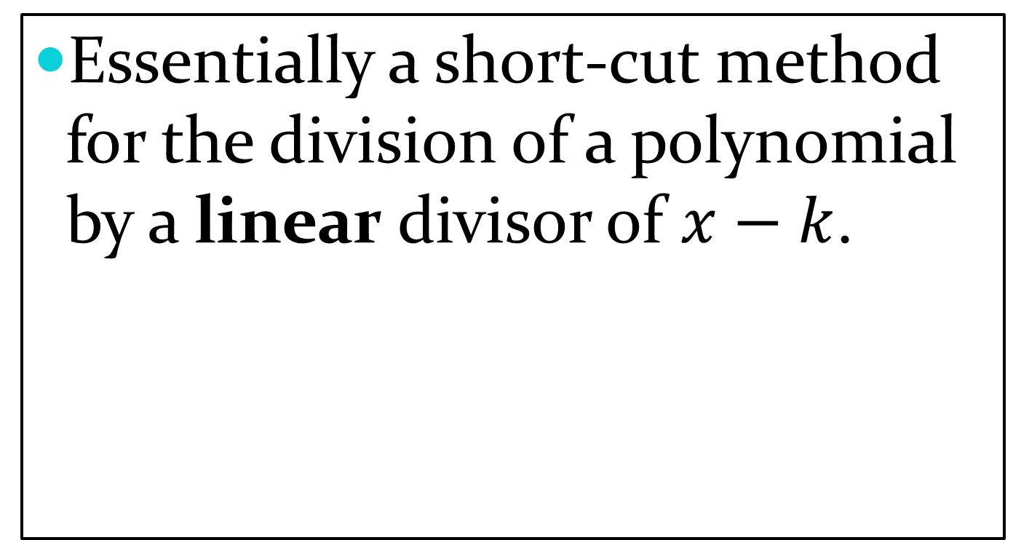
Synthetic Division
Essentially a short-cut method for the division of a polynomial by a linear divisor of $x−k$.

Slide 14
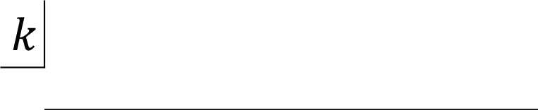
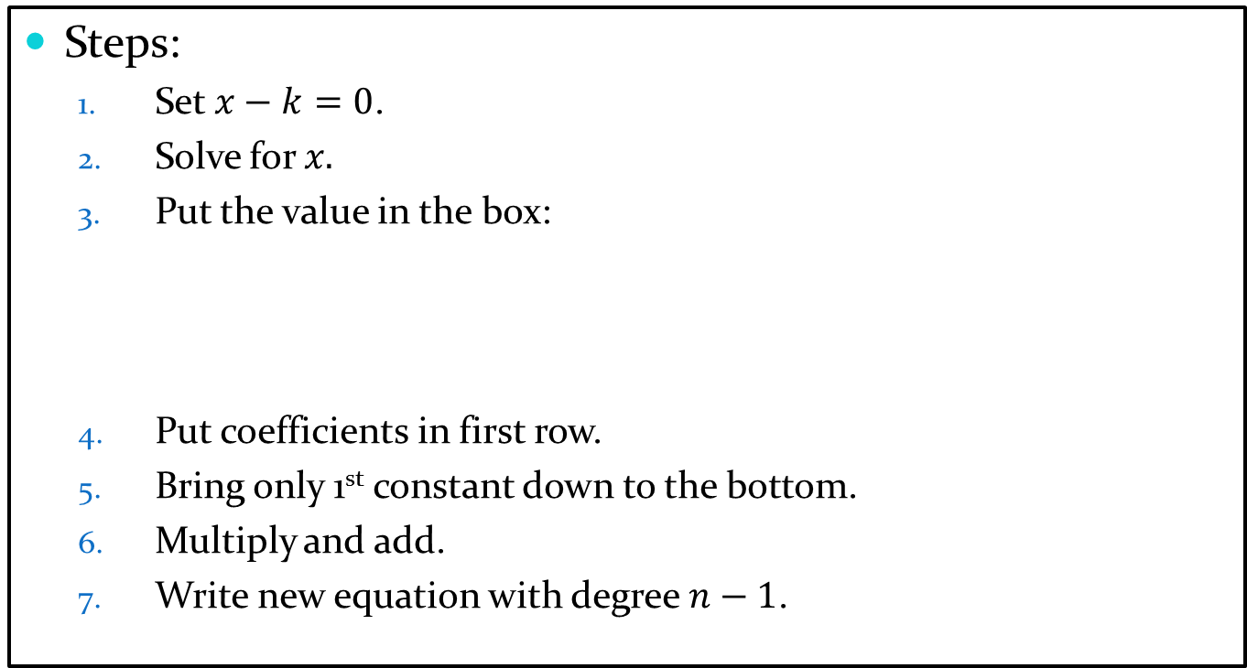
Synthetic Division
Steps:
  Set $x−k=0$.
  Solve for $x.$
  Put the value in the box:
  Put coefficients in first row.
  Bring only 1st constant down to the bottom.
  Multiply and add.
  Write new equation with degree $n−1$.
$$k$$

Slide 15
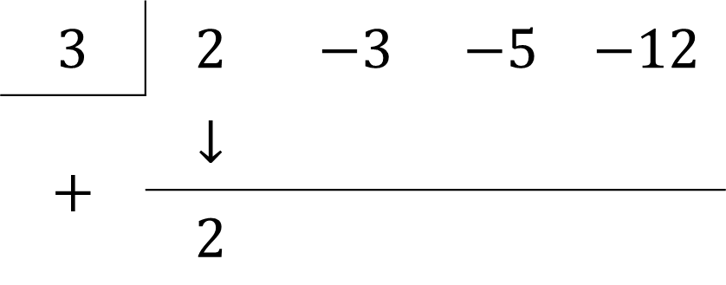
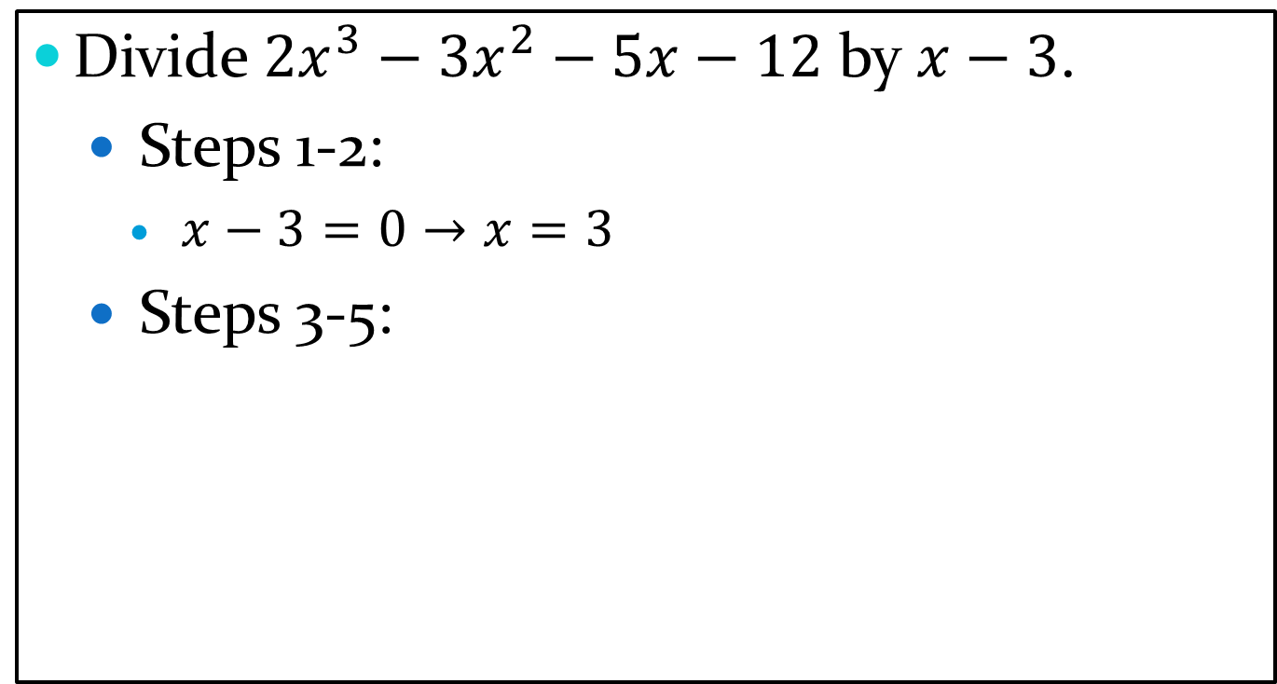
Synthetic Division: Example 1
Divide $2x^{3}−3x^{2}−5x−12$ by $x−3$.
  Steps 1-2:
    $x−3=0→x=3$
  Steps 3-5:
$$3$$ | $$2$$ | $$−3$$ | $$−5$$ | $$−12$$
$$+$$ | $$↓$$
 | $$2$$

Slide 16

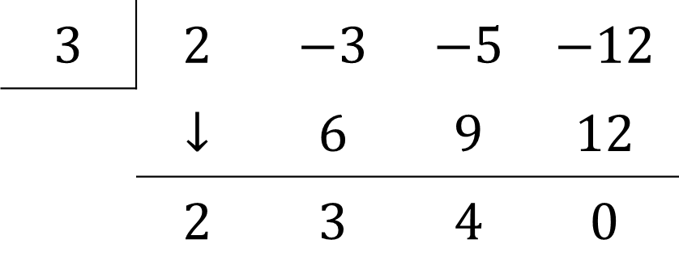







Synthetic Division: Example 1
Divide $2x^{3}−3x^{2}−5x−12$ by $x−3$.
  Steps 1-2: $x−3=0→x=3$
  Steps 3-5:
$$2x^{2}+3x+4$$
$$3$$ | $$2$$ | $$−3$$ | $$−5$$ | $$−12$$
 | $$↓$$ | $$6$$ | $$9$$ | $$12$$
 | $$2$$ | $$3$$ | $$4$$ | $$0$$
$$3×2$$
$$=$$
$$=$$
$$=$$
$$3×3$$
$$3×4$$

Slide 17
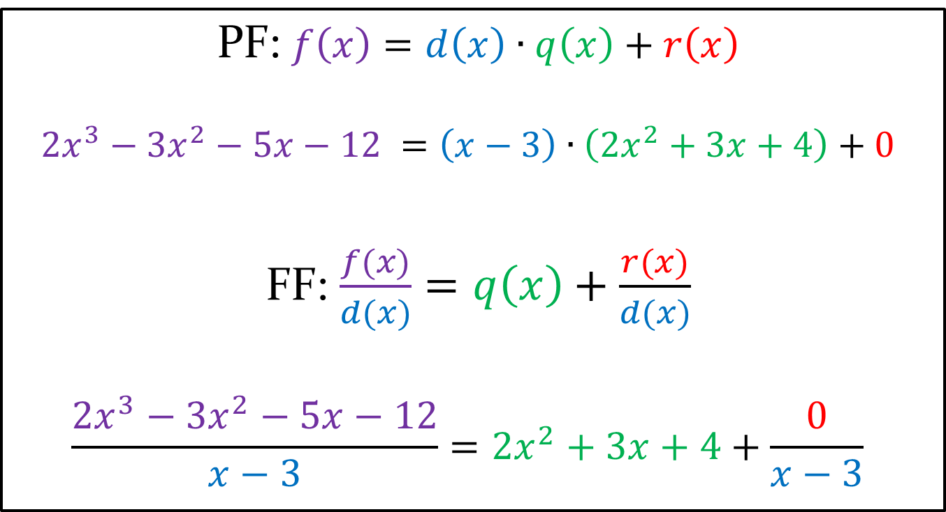
Summary Statements
PF: $f\left(x\right)=d\left(x\right)∙q\left(x\right)+r\left(x\right)$
$${2x}^{3}−3x^{2}−5x−12 =\left(x−3\right)∙\left({2x}^{2}+3x+4\right)+0$$
  FF: $\frac{f(x)}{d(x)}=q\left(x\right)+\frac{r(x)}{d(x)}$
$$\frac{{2x}^{3}−3x^{2}−5x−12}{x−3}={2x}^{2}+3x+4+\frac{0}{x−3}$$

Slide 18
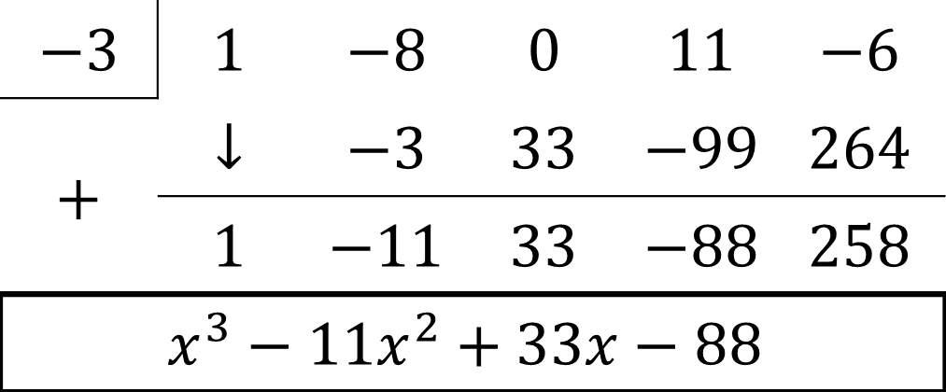
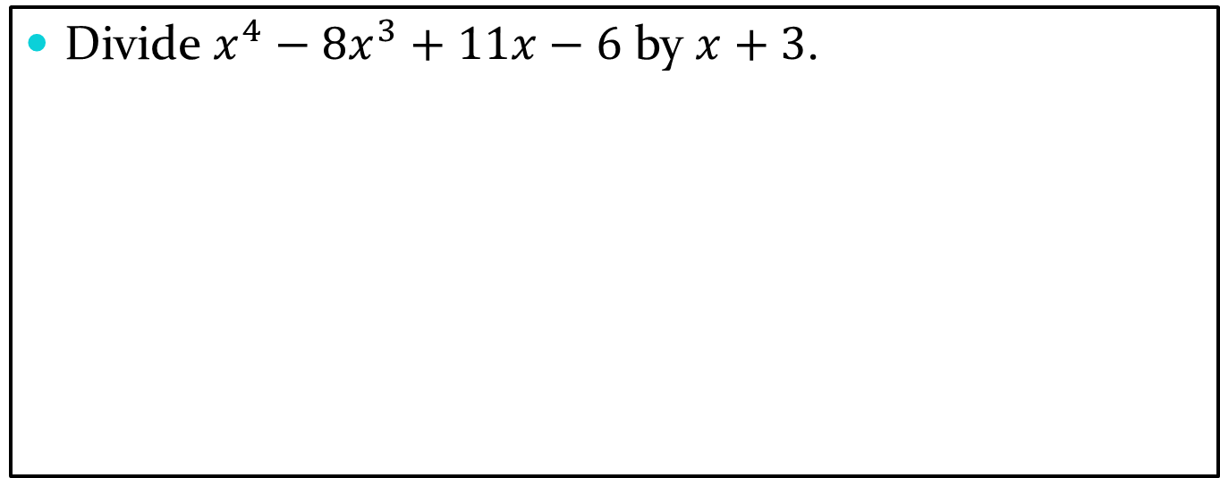
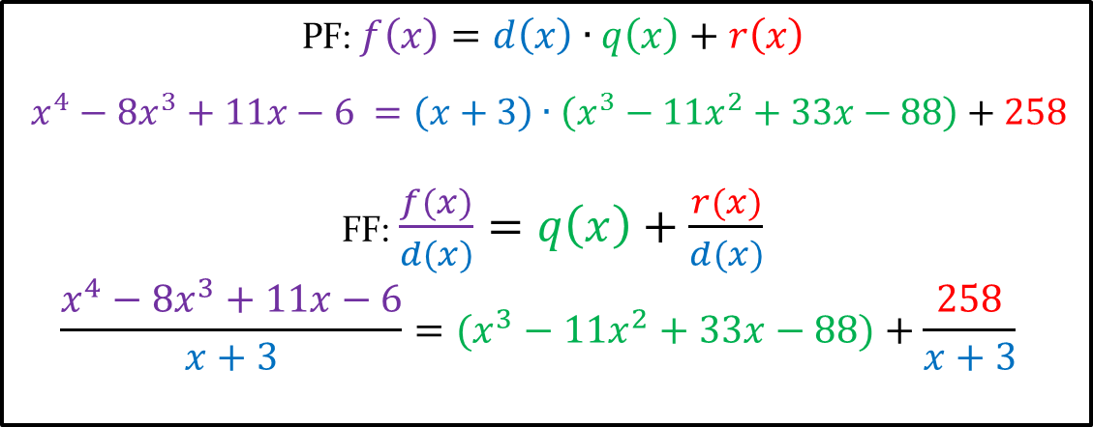
Synthetic Division: Example 2
Divide $x^{4}−8x^{3}+11x−6$ by $x+3$.
$$−3$$ | $$1$$ | $$−8$$ | $$0$$ | $$11$$ | $$−6$$
$$+$$ | $$↓$$ | $$−3$$ | $$33$$ | $$−99$$ | $$264$$
 | $$1$$ | $$−11$$ | $$33$$ | $$−88$$ | $$258$$
$$x^{3}−11x^{2}+33x−88$$
PF: $f\left(x\right)=d\left(x\right)∙q\left(x\right)+r\left(x\right)$
$$x^{4}−8x^{3}+11x−6 =\left(x+3\right)∙\left(x^{3}−11x^{2}+33x−88\right)+258$$
  FF: $\frac{f(x)}{d(x)}=q\left(x\right)+\frac{r(x)}{d(x)}$
$$\frac{x^{4}−8x^{3}+11x−6}{x+3}=(x^{3}−11x^{2}+33x−88)+\frac{258}{x+3}$$

Slide 19
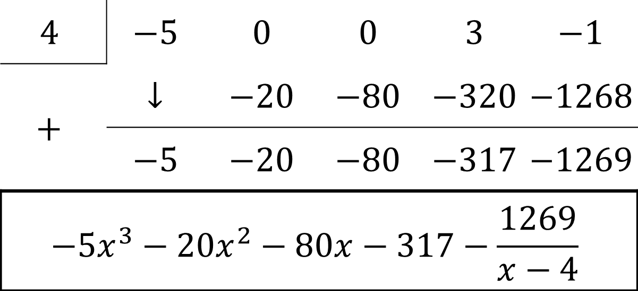

Synthetic Division: Example 3
Divide ${5x}^{4}−3x+1$ by $4−x$.
$$4$$ | $$−5$$ | $$0$$ | $$0$$ | $$3$$ | $$−1$$
$$+$$ | $$↓$$ | $$−20$$ | $$−80$$ | $$−320$$ | $$−1268$$
 | $$−5$$ | $$−20$$ | $$−80$$ | $$−317$$ | $$−1269$$
$${−5x}^{3}−20x^{2}−80x−317−\frac{1269}{x−4}$$

Slide 20
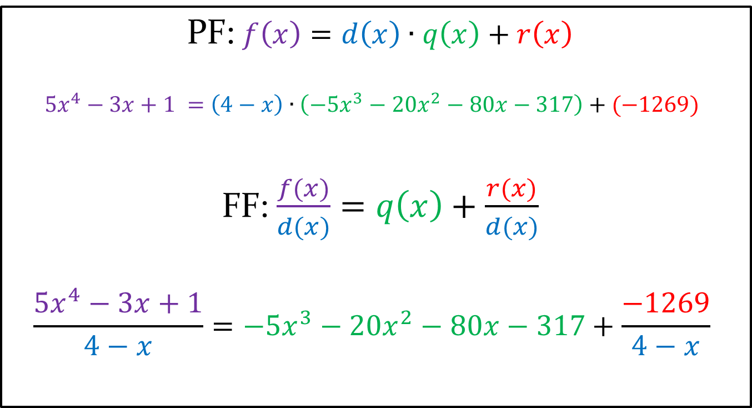
Summary Statements
PF: $f\left(x\right)=d\left(x\right)∙q\left(x\right)+r\left(x\right)$
$${5x}^{4}−3x+1 =\left(4−x\right)∙\left(−5x^{3}−20x^{2}−80x−317\right)+(−1269)$$
  FF: $\frac{f(x)}{d(x)}=q\left(x\right)+\frac{r(x)}{d(x)}$
$$\frac{{5x}^{4}−3x+1}{4−x}={−5x^{3}−20x}^{2}−80x−317+\frac{−1269}{4−x}$$

Slide 21
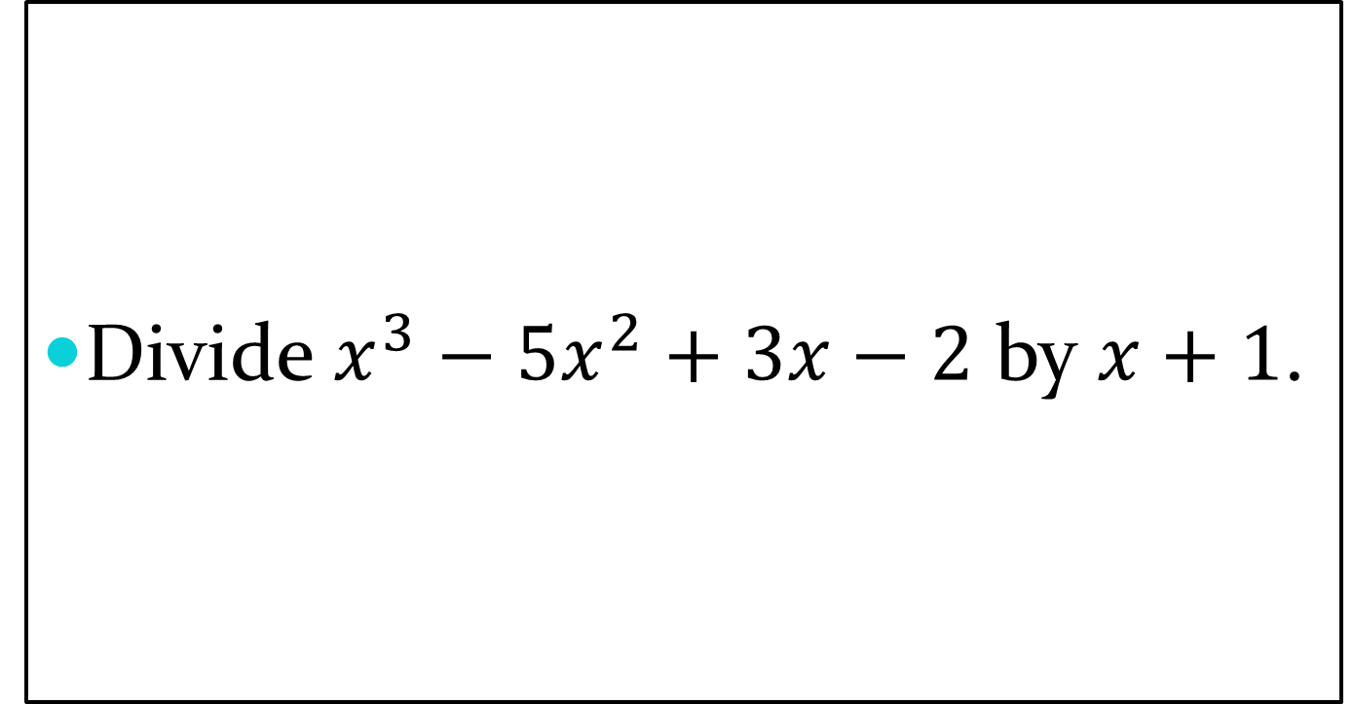
Division: Exit Slip
Divide $x^{3}−5x^{2}+3x−2$ by $x+1$.

Slide 22
Homework:
Due 10/24
  P. 196: #7-10, 13-16 and 37-42.
  P. 208: #1-6 and 19-24.
  P. 208: #7-18 and 25-26.

Slide 23
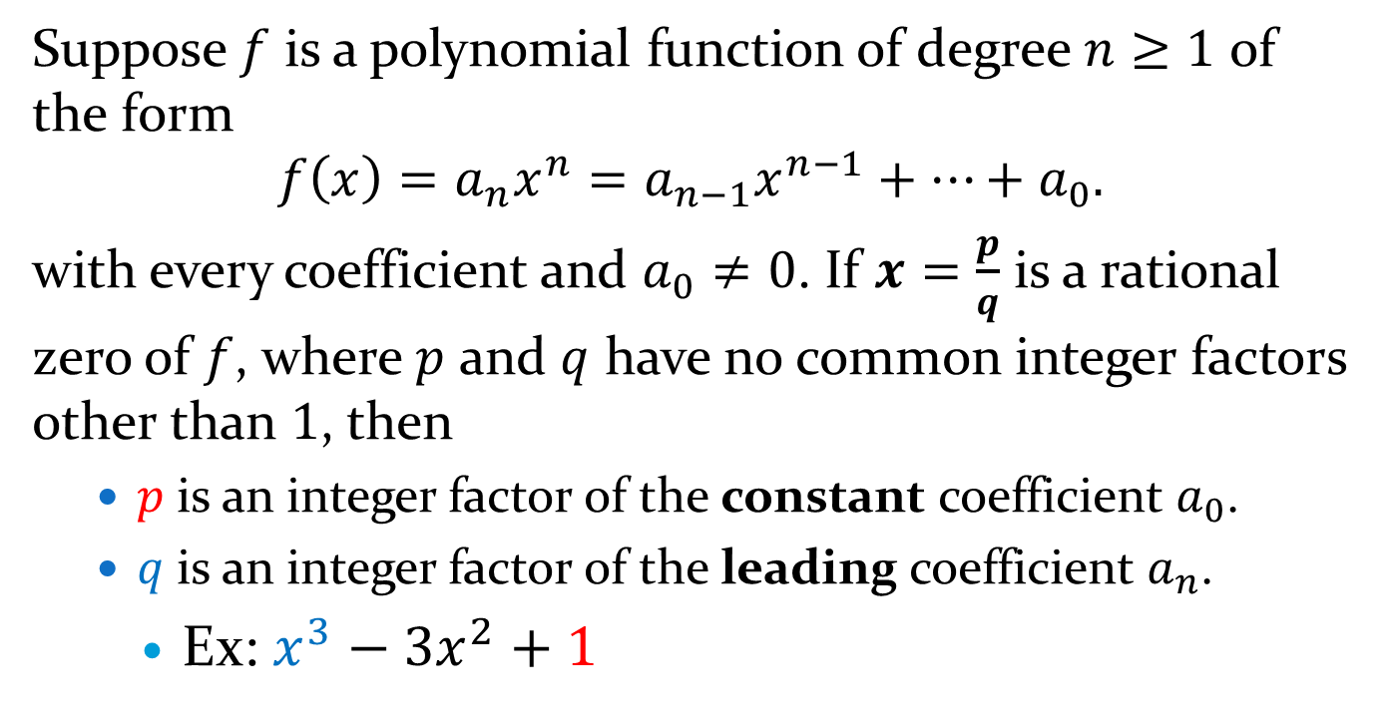
Rational Zero Theorem
Suppose $f$ is a polynomial function of degree $n≥1$ of the form
$$f\left(x\right)=a_{n}x^{n}=a_{n−1}x^{n−1}+…+a_{0}.$$
with every coefficient and $a_{0}≠0$. If $x=\frac{p}{q}$ is a rational zero of $f$, where $p$ and $q$ have no common integer factors other than $1$, then
  $p$ is an integer factor of the constant coefficient $a_{0}$.
  $q$ is an integer factor of the leading coefficient $a_{n}$.
    Ex: $x^{3}−3x^{2}+1$

Slide 24
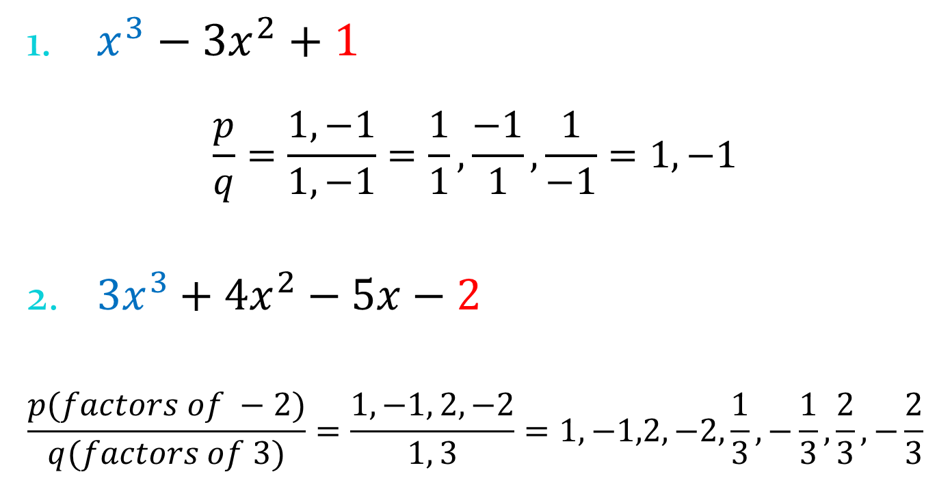
Using the Theorem Examples
$x^{3}−3x^{2}+1$
$$\frac{p}{q}=\frac{1,−1}{1, −1}=\frac{1}{1},\frac{−1}{1},\frac{1}{−1}=1,−1$$
$3x^{3}+4x^{2}−5x−2$
$$\frac{p(factors of −2)}{q(factors of 3)}=\frac{1,−1, 2,−2}{1, 3}=1,−1,2,−2,\frac{1}{3}, −\frac{1}{3},\frac{2}{3},−\frac{2}{3}$$

Slide 25

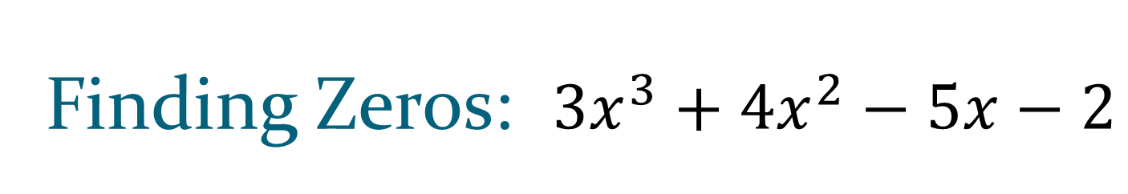
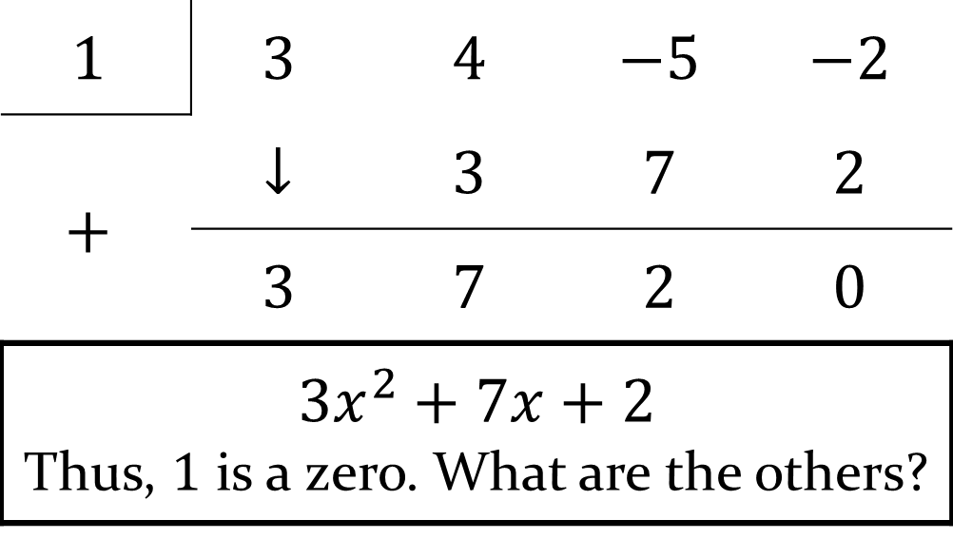
Finding Zeros: $3x^{3}+4x^{2}−5x−2$
Check if $1$ is a zero using synthetic division.
$$1$$ | $$3$$ | $$4$$ | $$−5$$ | $$−2$$
$$+$$ | $$↓$$ | $$3$$ | $$7$$ | $$2$$
 | $$3$$ | $$7$$ | $$2$$ | $$0$$
$$3x^{2}+7x+2$$ Thus, $1$ is a zero. What are the others?

Slide 26
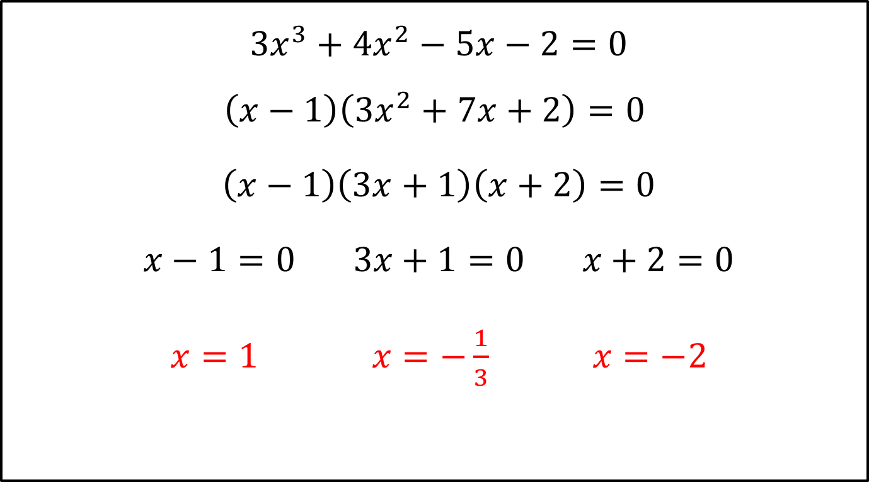
Finding Zeros
$3x^{3}+4x^{2}−5x−2=0$
$$\left(x−1\right)\left(3x^{2}+7x+2\right)=0$$
$\left(x−1\right)\left(3x+1\right)\left(x+2\right)=0$
$x−1=0 3x+1=0 x+2=0$
$x=1 x=−\frac{1}{3} x=−2$
Rational

Slide 27

Applying the Theorem
${2x}^{4}−7x^{3}−8x^{2}+14x+8$
$$\frac{p(factors of 8)}{q(factors of 2)}=\frac{±1,±2,±4,±8}{±1,±2}=±1,±2,±4,±8,±\frac{1}{2}$$

Slide 28

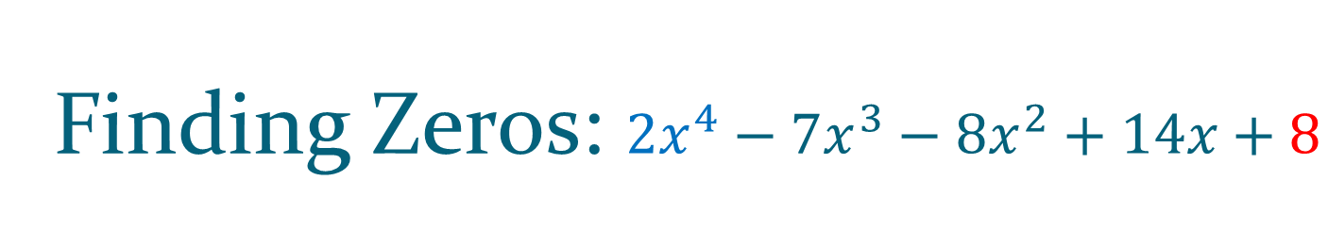
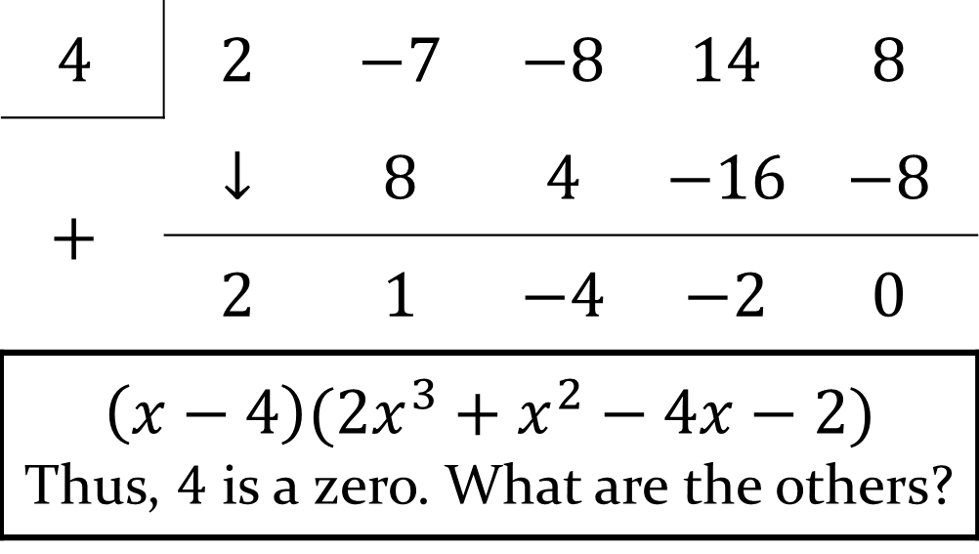
Finding Zeros: ${2x}^{4}−7x^{3}−8x^{2}+14x+8$
Check if $4$ is a zero using synthetic division.
$$4$$ | $$2$$ | $$−7$$ | $$−8$$ | $$14$$ | $$8$$
$$+$$ | $$↓$$ | $$8$$ | $$4$$ | $$−16$$ | $$−8$$
 | $$2$$ | $$1$$ | $$−4$$ | $$−2$$ | $$0$$
$$\left(x−4\right)(2x^{3}+x^{2}−4x−2)$$ Thus, $4$ is a zero. What are the others?

Slide 29

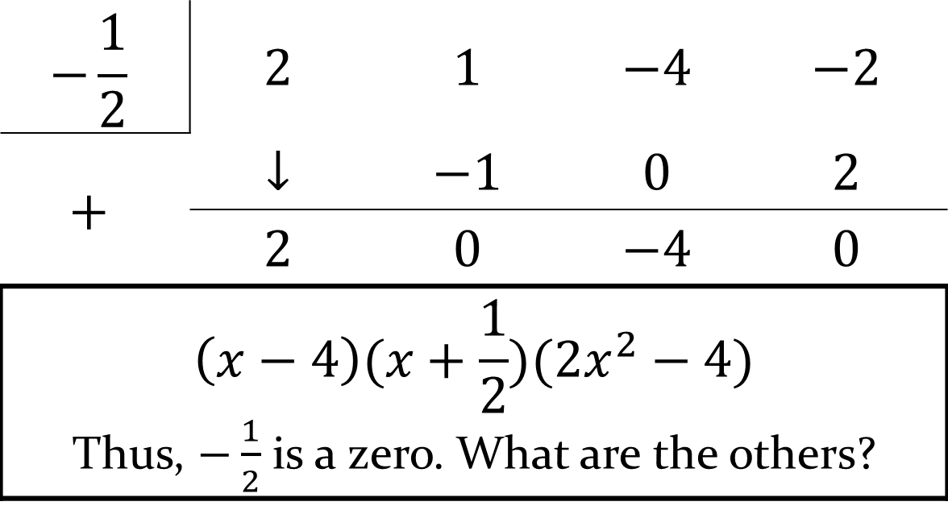
Finding Zeros: ${2x}^{4}−7x^{3}−8x^{2}+14x+8$
Check if $−\frac{1}{2}$ is a zero using synthetic division.
$$−\frac{1}{2}$$ | $$2$$ | $$1$$ | $$−4$$ | $$−2$$
$$+$$ | $$↓$$ | $$−1$$ | $$0$$ | $$2$$
 | $$2$$ | $$0$$ | $$−4$$ | $$0$$
$$\left(x−4\right)(x+\frac{1}{2})(2x^{2}−4)$$ Thus, $−\frac{1}{2}$ is a zero. What are the others?

Slide 30
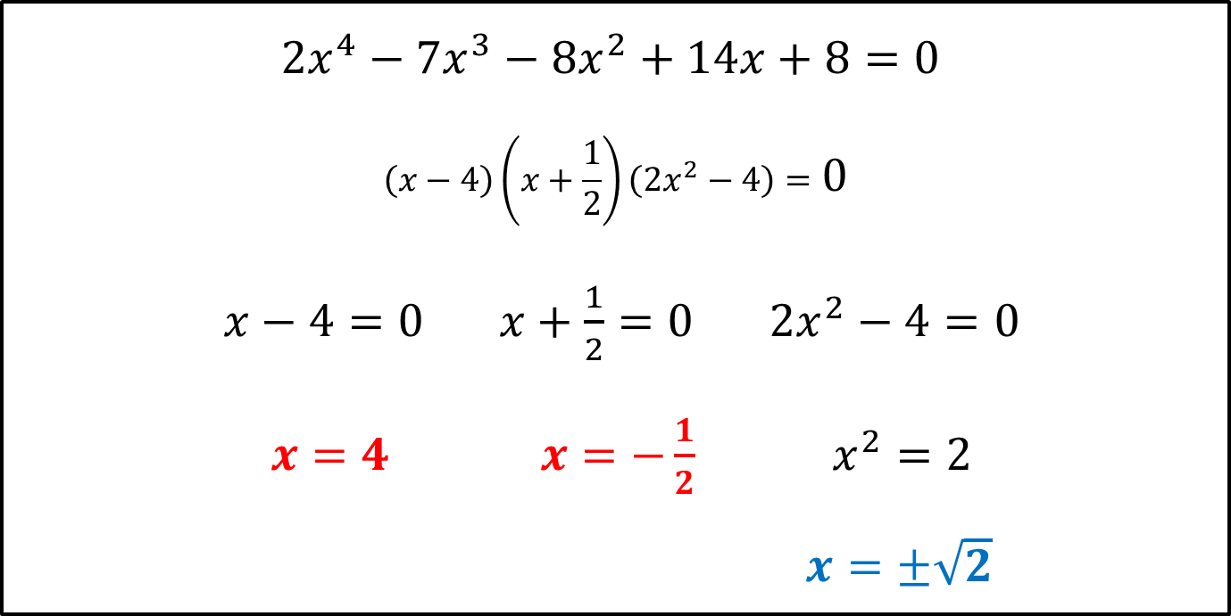
Finding Zeros
$${2x}^{4}−7x^{3}−8x^{2}+14x+8=0$$
$$\left(x−4\right)\left(x+\frac{1}{2}\right)\left(2x^{2}−4\right)=0$$
$x−4=0 x+\frac{1}{2}=0 2x^{2}−4=0$
$x=4 x=−\frac{1}{2} x^{2}=2$
$x=±\sqrt{2}$
Irrational
Rational

