Slide 1
Rational Functions
Domain, Range, Vertical Asymptotes and Horizontal Asymptotes

Slide 2
What is a rational function?
Definition: A function of the form $\frac{f(x)}{g(x)}$, where $f(x)$ and $g(x)$ are polynomials and $g(x)$ is not the zero polynomial.
$$\frac{f(x)}{g(x)};where g(x)≠0$$
What is the most common form of the equation?
$$f\left(x\right)=\frac{1}{x}$$

Slide 3
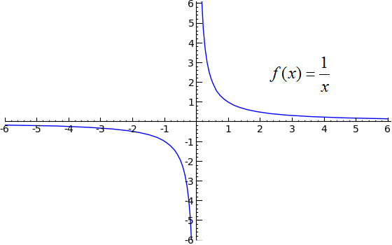
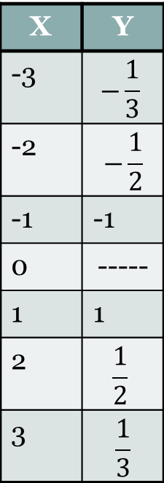
What does it look like?
X | Y
-3 | $$−\frac{1}{3}$$
-2 | $$−\frac{1}{2}$$
-1 | -1
0 | -----
1 | 1
2 | $$\frac{1}{2}$$
3 | $$\frac{1}{3}$$
Domain:$(−∞,0)∪(0,∞)$
Range:$(−∞,0)∪(0,∞)$

Slide 4
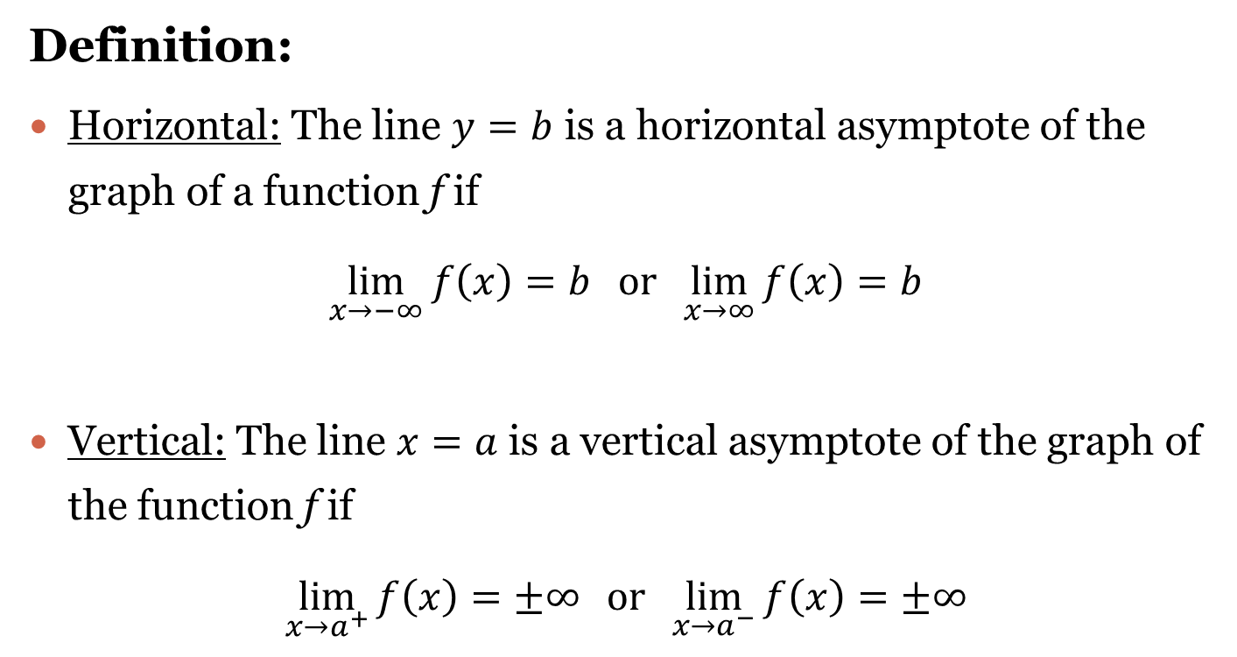
Asymptotes
Definition:
Horizontal: The line $y=b$ is a horizontal asymptote of the graph of a function f if
$$\lim_{x→−∞}{f\left(x\right)=b} or\lim_{x→∞}{f\left(x\right)=b}$$
Vertical: The line $x=a$ is a vertical asymptote of the graph of the function f if
$$\lim_{x→a^{+}}{f\left(x\right)=±∞} or\lim_{x→a^{−}}{f\left(x\right)=±∞}$$

Slide 5
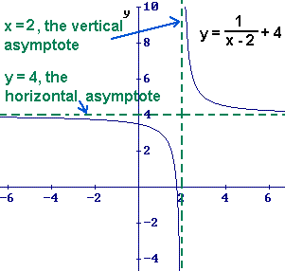
What do Asymptotes look like?
Horizontal: $y=4$
Vertical: $x=2$

Slide 6
Finding Asymptotes
Vertical
Horizontal
$\lim_{x→a^{+}}{f\left(x\right)=±∞} or\lim_{x→a^{−}}{f\left(x\right)=±∞}$
Where do they come from?
Vertical asymptotes go through what axis?
The X-Axis
Thus, we are looking for discontinuities or values that x can’t be.
In rational equations:
$f\left(x\right)=\frac{1}{x};x≠0$, as $x$ is in the denominator.
Thus, we are going to set the values of the denominator $>0$ and solve for $x.$
The asymptote is $x=0$.
$\lim_{x→−∞}{f\left(x\right)=b} or\lim_{x→∞}{f\left(x\right)=b}$
Where do they come from?
Horizontal asymptotes go through what axis?
The Y-Axis
Like radical equations, our horizontal asymptote changes when a value is being added or subtracted to the outside of the fraction.
In rational equations:
$f\left(x\right)=\frac{1}{x}−2$
The asymptote that was $y=0$ is now $y=−2$.

Slide 7
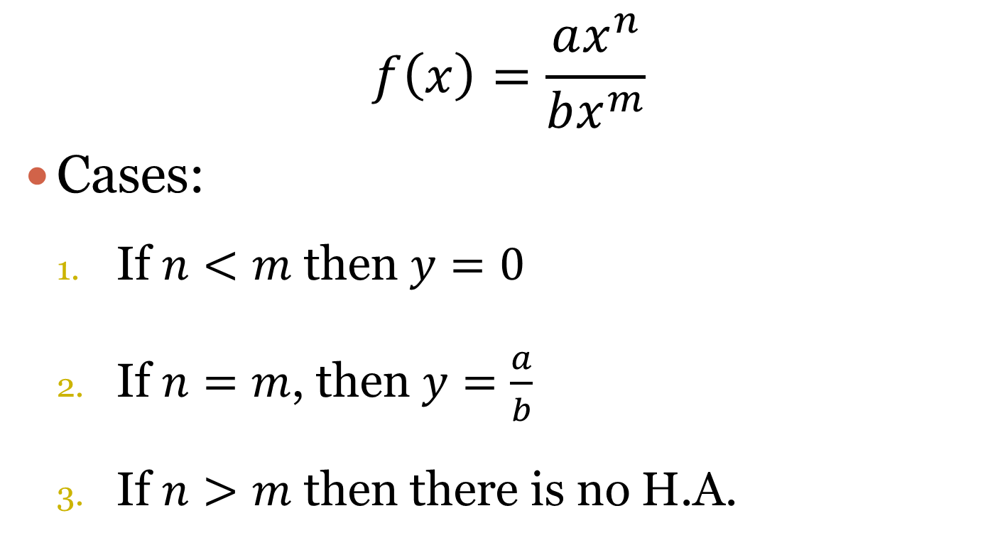
Horizontal Asymptotes
$$f\left(x\right)=\frac{ax^{n}}{bx^{m}}$$
Cases:
If $n<m$ then $y=0$
If $n=m$, then $y=\frac{a}{b}$
If $n>m$ then there is no H.A.

Slide 8
Where are the asymptotes for the graph $f\left(x\right)=\frac{1}{x}?$
Horizontal: $y=0$
Vertical: $x=0$

Slide 9
Domain and Range: $\left(−∞,__\right)∪(__ ,∞)$
Domain: x-values
Range: y-values
Restrictions:
Since the denominator can never equal zero. We must look at all values of x that would cause that to happen.
Example:
$y=\frac{1}{x−3};x−3=0→x≠3$
Domain: $\left(−∞,3\right)∪(3,∞)$
The missing value occurs at horizontal asymptote of the graph.
The original asymptote is at $y=0.$
Thus, we are looking at any vertical shifts that occur in the graph.
Example:
$y=\frac{1}{x}−2$
Range: $\left(−∞,−2\right)∪(−2,∞)$

Slide 10
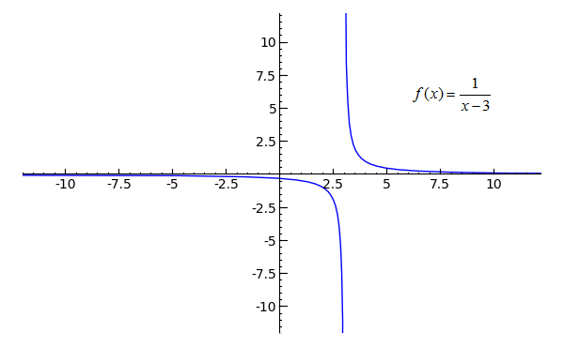
Graphs
$$y=\frac{1}{x−3}$$
$$y=\frac{1}{x}−2$$
Asymptotes:
$$x=3 and y=0$$
Asymptotes:
$$x=0 and y=−2$$

Slide 11
Examples
$$y=\frac{x−5}{x−3}$$
$$y=\frac{x^{2}−9}{x^{2}−4}$$
Vertical Asymptote:
$x−3=0→x≠3$
$x=3$ is the asymptote.
Horizontal Asymptote:
The degree of x in the numerator is the same as the degree of x in the denominator, so:
$\frac{1x}{1x}→1$
Domain:
$(−∞,3)∪(3,∞)$
Range:
$(−∞,1)∪(1,∞)$
Vertical Asymptote:
$x^{2}−4=0→x^{2}=4→x=±2$
$x=2 and x=−2$ are the asymptotes.
Horizontal Asymptote:
The degree of x in the numerator is the same as the degree of x in the denominator, so:
$\frac{1x^{2}}{1x^{2}}→1$
Domain:
$(−∞,−2)∪\left(−2, 2\right)∪(2,∞)$
Range:
$(−∞,1)∪(1,∞)$

Slide 12
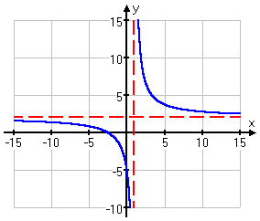
Example #1
$$y=\frac{2x+5}{x−1}$$
Graph
Vertical Asymptote:
$x−1=0→x≠1$
$x=1$ is the asymptote.
Horizontal Asymptote: $n=m so y=\frac{a}{b}$
$y=\frac{2}{1}→2$ so $y=2$ is the asymptote.
Domain:
$(−∞,1)∪(1,∞)$
Range:
$(−∞,2)∪(2,∞)$

Slide 13
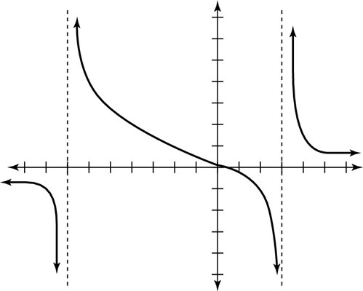
Example #2
$$y=\frac{3x−1}{x^{2}+4x−21}$$
Graph
Vertical Asymptote:
$x^{2}+4x−21→\left(x+7\right)\left(x−3\right)→x≠−7 and x≠3$
So, $x=−7 and x=3$ are the asymptotes.
Horizontal Asymptote: $n<m$
The degree in the numerator is less than the degree in the denominator so $y=0$.
Domain:
$(−∞,−7)∪(−7, 3)∪(3,∞)$
Range:
$(−∞,0)∪(0,∞)$

Slide 14
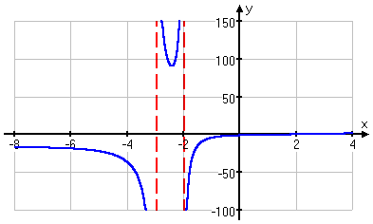
Example #3
$$y=\frac{x^{3}−8}{x^{2}+5x+6}$$
Graph
Vertical Asymptote:
$x^{2}+5x−6→\left(x+3\right)\left(x+2\right)→x≠−3 and x≠−2$
So, $x=−3 and x=−2$ are the asymptotes.
Horizontal Asymptote:
$n>m$ so there is no H.A.
Domain:
$(−∞,−3)∪\left(−3, −2\right)∪(−2,∞)$
Range:
$(−∞,∞)$

Slide 15
Hole
Definition: Holes in the graph of a rational function are generally produced by factors that are common to both the numerator and the denominator!
$$Example: f\left(x\right)=\frac{x^{2}(x−2)}{x−2}$$
$$f\left(x\right)=\frac{x^{2}(x−2)}{x−2}→f\left(x\right)=x^{2}$$
$x−2=0→x=2$
Thus, there is a hole at $x=2.$

Slide 16
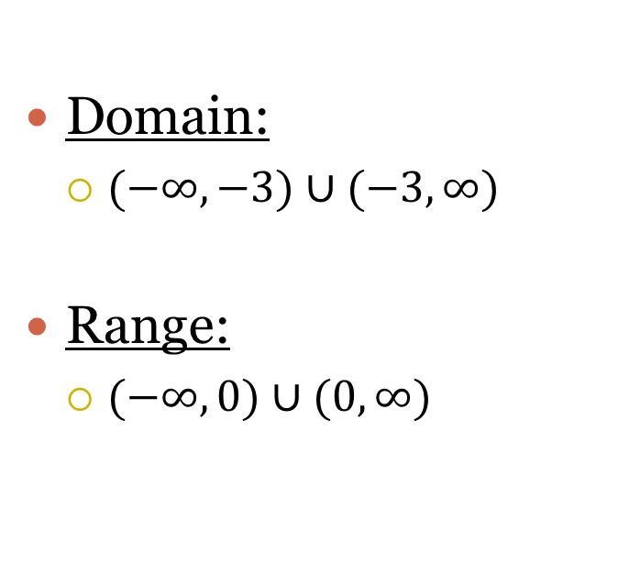
Example #4
$$y=\frac{x+2}{x^{2}−x−6}$$
Continued…
Vertical Asymptote:
$x^{2}−x−6→\left(x−3\right)\left(x+2\right)$
However, $x+2$ is the numerator so it cancels and a hole in the graph occurs.
S0, $x=3$ is the only V.A.
Horizontal Asymptote:
$n<m$so $y=0$.
Also, because there is a hole we must find the y-coordinates of the hole.
$y=0$ is the asymptote.
Domain:
$(−∞,−3)∪(−3,∞)$
Range:
$(−∞,0)∪(0,∞)$

Slide 17
$$y=\frac{x+2}{x^{2}−x−6}$$
Graph
$$y=0$$
$x=3$

