Slide 1
Radical Functions
Domain, Range, Maximum and Minimum

Slide 2
What is a radical function?
Definition: Any expression of the form $\sqrt[n]{a}$ denoting the principal n^{th} root of $a$ where $n>1$.
$$\sqrt[n]{a};where n=2, 3, 4, 5, …$$
What is the most common form of the equation?
$$f\left(x\right)=\sqrt{x}=x^{\frac{1}{2}}$$

Slide 3
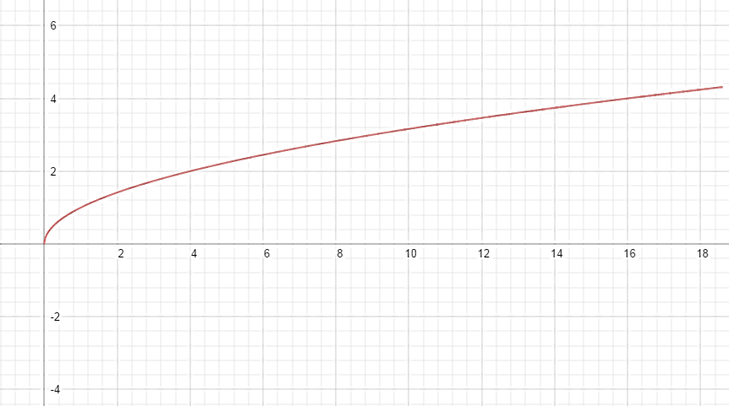
Square Root of X: $f\left(x\right)=\sqrt{x}$
X | Y
-1 | -----
0 | 0
1 | 1
4 | 2
9 | 3
16 | 4
25 | 5
$$y=\sqrt{x}$$
Domain: $[0,∞)$
Range: $[0,∞)$

Slide 4
Cube Root of X: $f\left(x\right)=\sqrt[3]{x}$
X | Y
-27 | -3
-8 | -2
-1 | -1
0 | 0
1 | 1
8 | 2
27 | 3
Domain: $(−∞,∞)$
Range: $(−∞,∞)$

Slide 5
Other Radical Functions
$$f\left(x\right)=\sqrt{x}$$
$$f\left(x\right)=\sqrt[3]{x}$$
$$f\left(x\right)=\sqrt[4]{x}$$

Slide 6
Looking at the Radical
$$\sqrt[n]{x};where n is even$$
$$\sqrt[n]{x};where n is odd$$
n is even – 2, 4, 6, …
Restrictions:
What can’t the square root be?
Negative!!!
Can it be 0? ($\sqrt{0})$
Yes!!!
$\sqrt{0}=0$
n is odd – 3, 5, 7, …
Restrictions?
Can x be negative?
Yes!!!
Can it be 0? ($\sqrt{0})$
Yes!!!
$\sqrt{0}=0$

Slide 7
Domain and Range
Domain: x-values
Range: y-values
Lowest x value to greatest x value.
Even:
$x≥0$
x is nonnegative
Odd:
x can be any real number.
Lowest y value to greatest y value.
Even:
$f\left(x\right)≥0 or y≥0$
Odd:
$f(x)$ or $y$ can be any real number.

Slide 8
Absolute Maximum and Minimum
Maximum
Minimum
Domain: $[0,∞)$
Range:$[0,∞)$
Max: (0, -2)
Min: (-3,0)

Slide 9
Finding Domain: $$\sqrt[n]{x};where n is even$$
Review – Restrictions:
What can’t the square root be?
Negative!!!
So, the value under the square root must be $≥0.$
Example:
$f\left(x\right)=\sqrt{x−5}$
$x−5≥0→x≥5$
Domain: $[5,∞)$
Range: $[0,∞)$
$f\left(x\right)=\sqrt{3x+6}$
$3x+6≥0→3x≥−6→x≥−2$
Domain: $[−2,∞)$
Range: $[0,∞)$

Slide 10
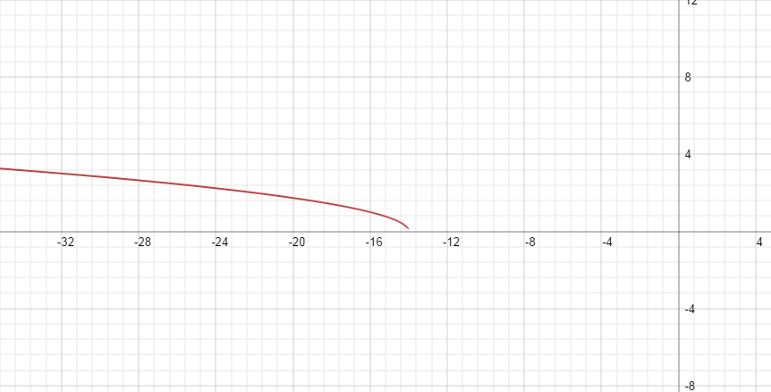
More Examples:
Multiplying or Dividing by a Negative
Graphs
$f\left(x\right)=\sqrt{4−x}$
4$−x≥0→−x≥−4→x≤4$
Domain: $(−∞,4]$
Range: $[0,∞)$
$f\left(x\right)=\sqrt{−\frac{1}{2}x−7}$
$$−\frac{1}{2}x−7≥0→−\frac{1}{2}x≥7$$
$$→x≤−14$$
Domain: $(−∞,−14]$
Range: $[0,∞)$

Slide 11
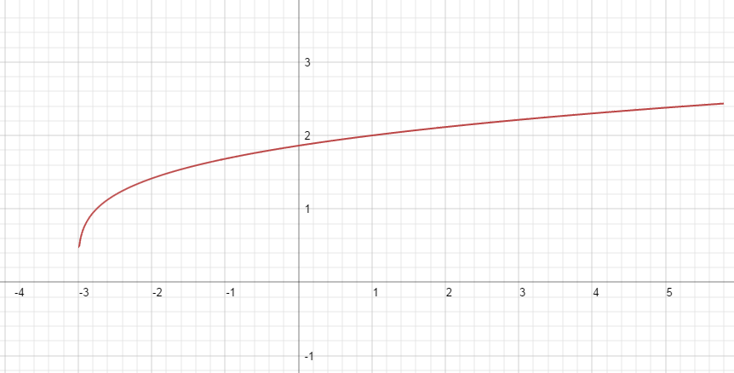
More Examples:
Different Roots: $\sqrt[3]{x}$, $\sqrt[4]{x}$, …
Graphs
$f\left(x\right)=\sqrt[3]{x−1}$
$$x−1≥0→x≥1$$
Domain: $(−∞,∞)$
Range: $(−∞,∞)$
$f\left(x\right)=\sqrt[4]{4x+12}$
$$4x+12≥0→4x≥−12$$
$$→x≥−3$$
Domain: $[−3,∞)$
Range: $[0,∞)$

Slide 12
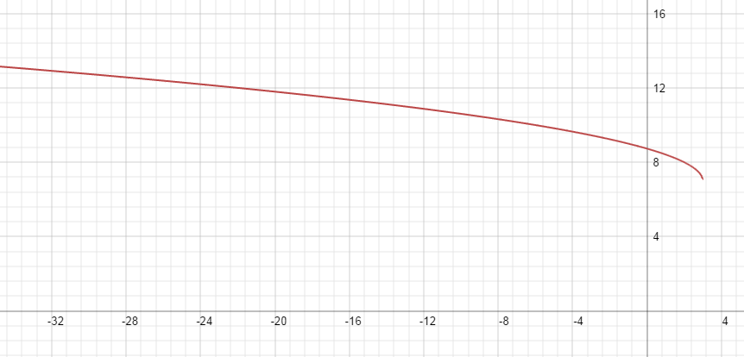
More Examples:
Equations where the range change!
Graphs
$f\left(x\right)=\sqrt{x+2}−5$
$$x+2≥0→x≥−2$$
Domain: $[−2,∞)$
Range: $[−5,∞)$
$f\left(x\right)=\sqrt{3−x}+7$
$$3−x≥0→−x≥−3→x≤3$$
Domain: $(−∞,3]$
Range: $[7,∞)$

