Slide 1
Power Functions
Section 2.2

Slide 2
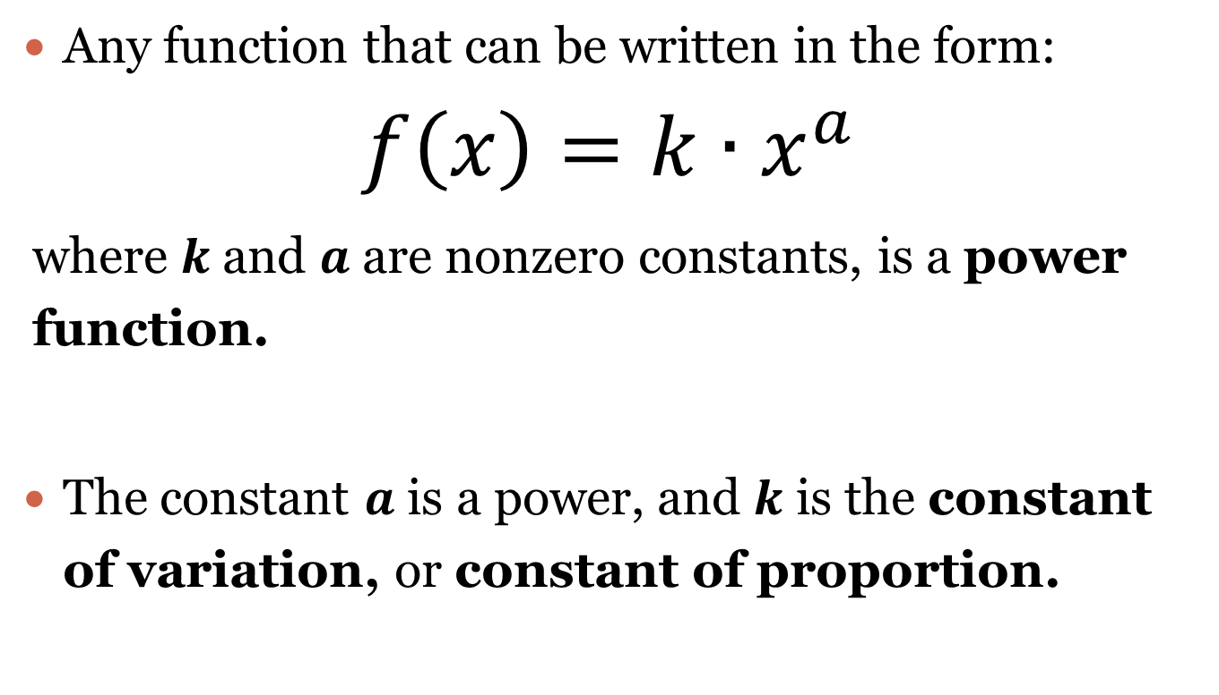
Power Function
Any function that can be written in the form:
$$f\left(x\right)=k∙x^{a}$$
where $k$ and $a$ are nonzero constants, is a power function.
The constant $a$ is a power, and $k$ is the constant of variation, or constant of proportion.

Slide 3
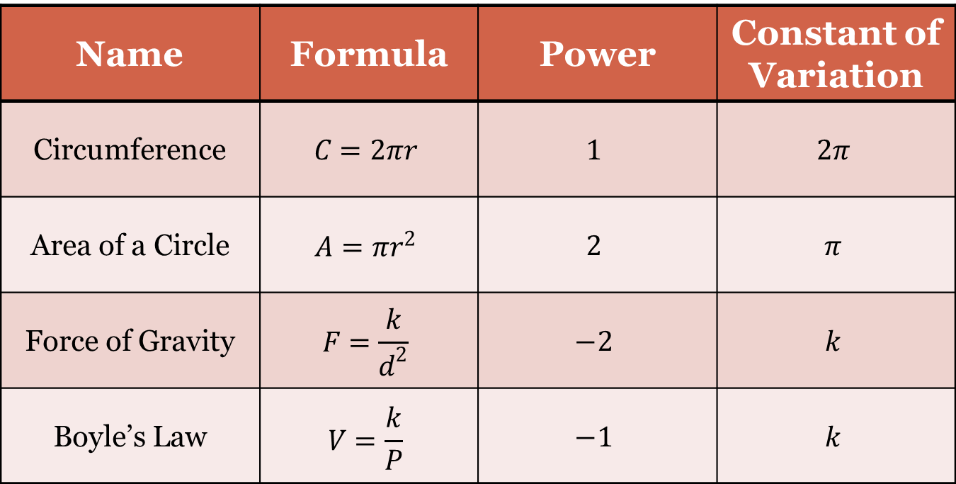
Common Formulas
Name | Formula | Power | Constant of Variation
Circumference | $$C=2πr$$ | $$1$$ | $$2π$$
Area of a Circle | $$A=πr^{2}$$ | $$2$$ | $$π$$
Force of Gravity | $$F=\frac{k}{d^{2}}$$ | $$−2$$ | $$k$$
Boyle’s Law | $$V=\frac{k}{P}$$ | $$−1$$ | $$k$$

Slide 4
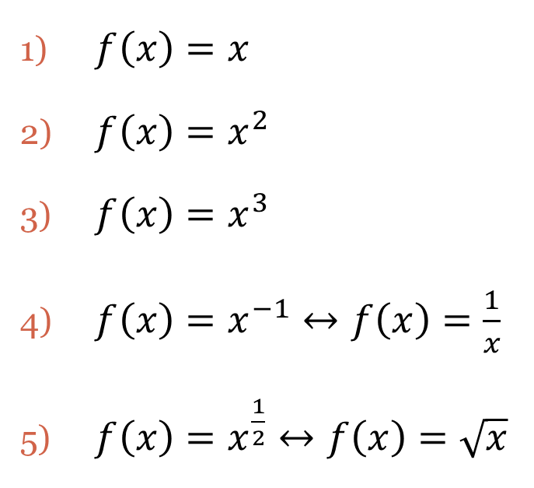
Basic Power Functions
Name
Equation
Linear
Quadratic
Cubic
Rational
Radical
$f\left(x\right)=x$
$f\left(x\right)=x^{2}$
$f\left(x\right)=x^{3}$
$f\left(x\right)=x^{−1}↔f\left(x\right)=\frac{1}{x}$
$f\left(x\right)=x^{\frac{1}{2}}↔f\left(x\right)=\sqrt{x}$

Slide 5
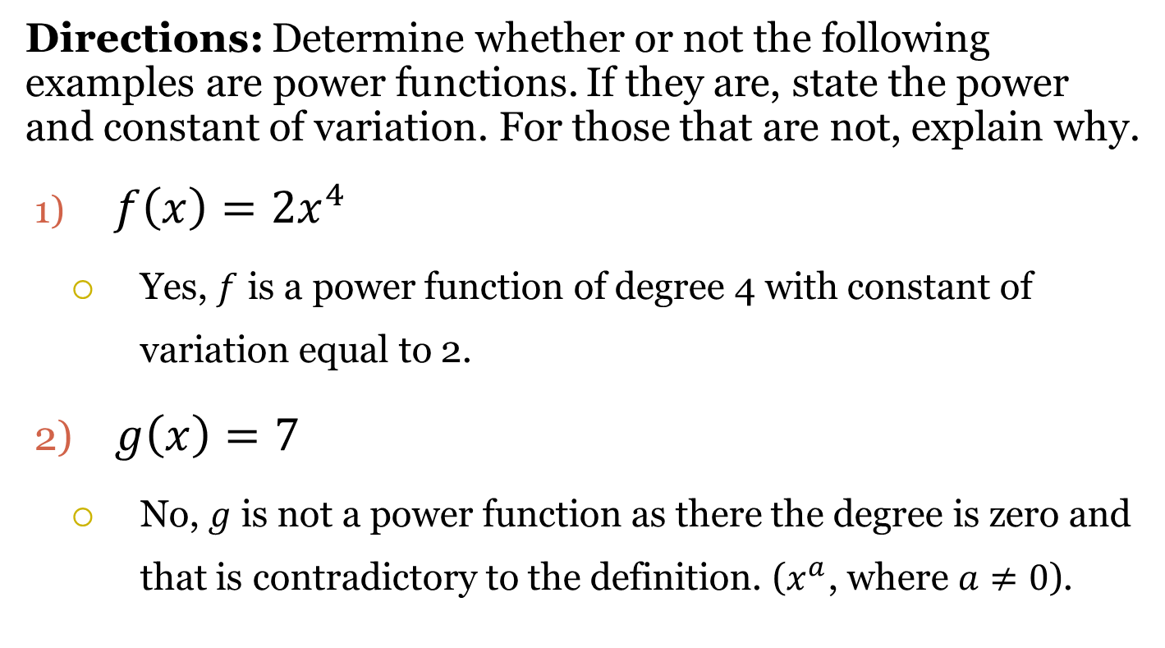
Examples
Directions: Determine whether or not the following examples are power functions. If they are, state the power and constant of variation. For those that are not, explain why.
$f\left(x\right)=2x^{4}$
Yes, $f$ is a power function of degree 4 with constant of variation equal to 2.
$g\left(x\right)=7$
No, $g$ is not a power function as there the degree is zero and that is contradictory to the definition. ($x^{a}$, where $a≠0$).

Slide 6
Examples
Directions: Determine whether or not the following examples are power functions. If they are, state the power and constant of variation. For those that are not, explain why.
$h\left(x\right)=4∙3^{x}$
No, $h$ is not a power function as the degree is $x$ and according to our definition, $a$ has to be a constant. Also, $3^{x}$ is an exponential function.
$k\left(x\right)=\frac{5}{x^{3}}$
Yes, $k$ is a power function of degree $−3$with constant of variation equal to $5$.

Slide 7
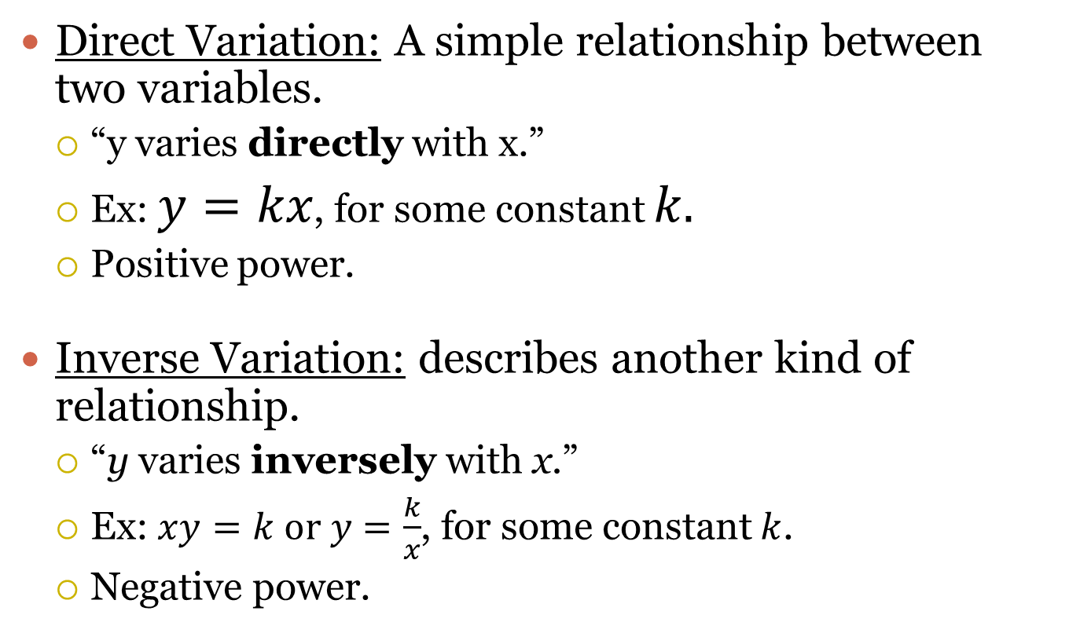
Variation
Direct Variation: A simple relationship between two variables.
“y varies directly with x.”
Ex: $y=kx$, for some constant $k.$
Positive power.
Inverse Variation: describes another kind of relationship.
“y varies inversely with x.”
Ex: $xy=k or y=\frac{k}{x}$, for some constant $k$.
Negative power.

Slide 8
Statement to Function
Directions: Write a the statement as a power function equation.
$y$ is directly proportional to the cube root of $x$.
$$y=kx^{\frac{1}{3}}↔y=k\sqrt[3]{x}$$
$p$ varies inversely with $m$.
$$p=km^{−1}↔p=\frac{k}{m}$$
$y$ varies directly with the fourth power of $x$.
$$y=kx^{4}$$

Slide 9
Statement to Function
Directions: Write a the statement as a power function equation.
The perimeter varies directly as the lengths $s$ of the sides of a square.
$$P=ks$$
The surface area $S$ of a sphere varies directly as the square of the radius $r$.
$$S=kr^{2}$$
The force of gravity $G$ acting on an object is inversely proportional to the square of the distance $d$ from the object to the center of the earth.
$$G=\frac{k}{d^{2}}$$

Slide 10
Function to Statement
Directions: Write a sentence that expresses the relationship in the formula.
$y=3x^{−2}$
$y$varies inversely (or is inversely proportional to) with the square of $x$ with constant of variation $3$.
$y=\frac{1}{4}x^{5}$
$y$varies directly with (or is directly proportional to) the fifth power of $x$ with constant of variation $\frac{1}{4}$.
$y=\frac{12}{\sqrt{x}}$
$y$varies inversely with (or is inversely proportional to) the square root of $x$ with constant of variation $12$.

Slide 11
Function to Statement
Directions: Write a sentence that expresses the relationship in the formula.
$A=πr^{2}$, where $A$ and $r$ are the area and the radius of a circle and $π$ is the usual mathematical constant.
The area $A$ of the circle varies directly with the square of the radius $r$, with constant of variation $π$.
$F=kx$, where F is the force it takes to stretch a spring $x$ units from its unstressed length and $k$ is the spring’s force constant.
The force $F$ needed varies directly with the distance $x$ from its upstretched position, with constant of variation $k$.

Slide 12
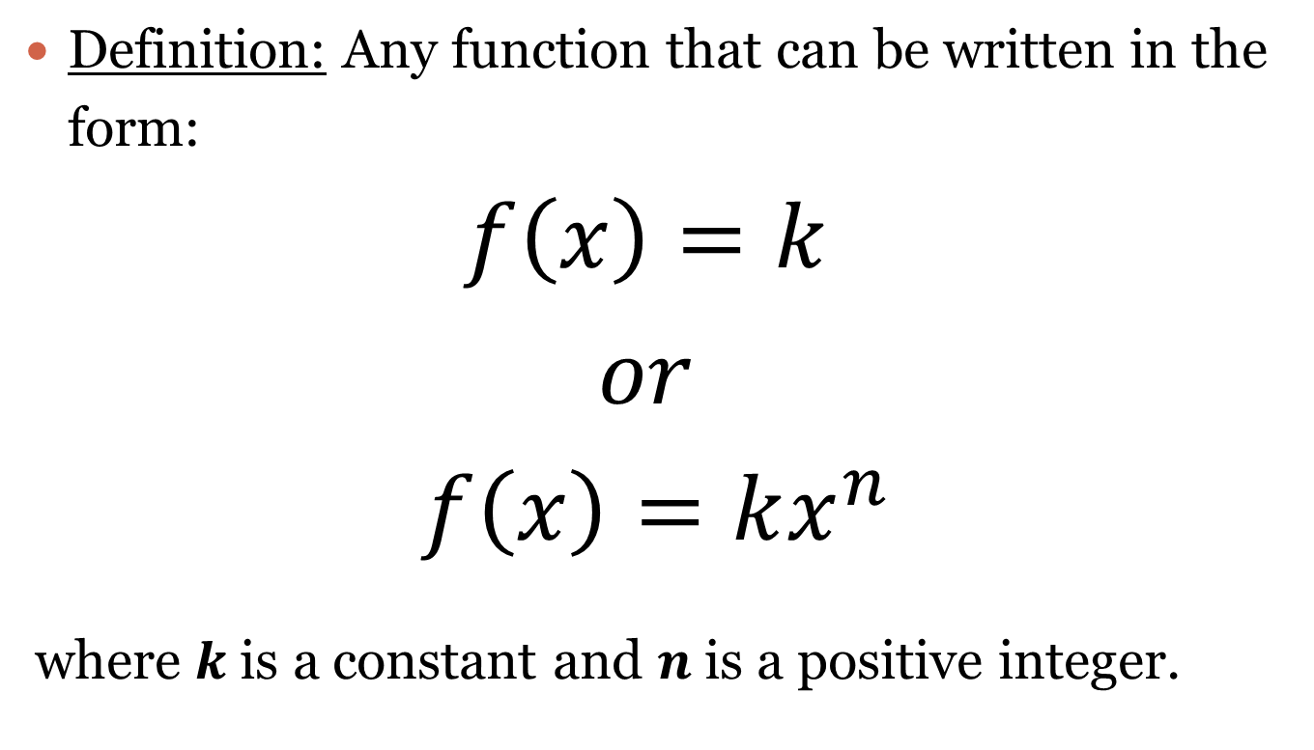
Monomial Function
Definition: Any function that can be written in the form:
$$f\left(x\right)=k$$
$$or$$
$$f\left(x\right)=kx^{n}$$
where $k$ is a constant and $n$ is a positive integer.

Slide 13
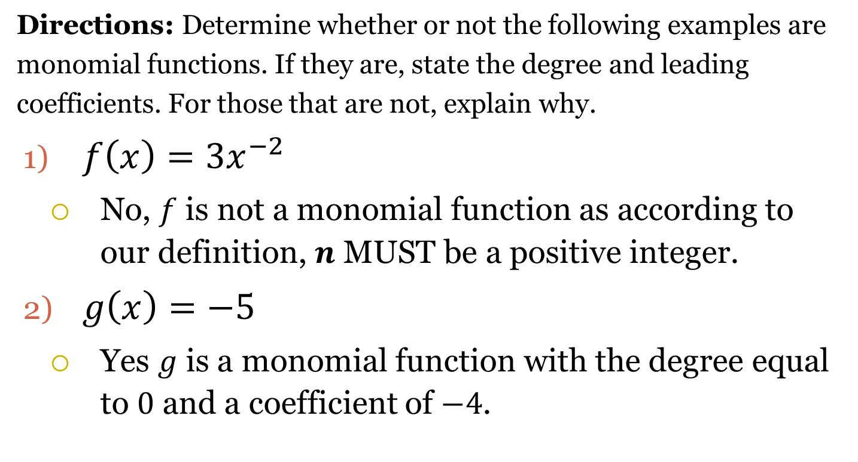
Examples
Directions: Determine whether or not the following examples are monomial functions. If they are, state the degree and leading coefficients. For those that are not, explain why.
$f\left(x\right)=3x^{−2}$
No, $f$ is not a monomial function as according to our definition, $n$ MUST be a positive integer.
$g\left(x\right)=−5$
Yes $g$ is a monomial function with the degree equal to $0$ and a coefficient of $−4$.

Slide 14
Examples
Directions: Determine whether or not the following examples are monomial functions. If they are, state the degree and leading coefficients. For those that are not, explain why.
$h\left(x\right)=4∙3^{x}$
No, $h$ is not a monomial function as the degree is $x$ and according to our definition, $a$ has to be a constant.
$k\left(x\right)=\frac{5}{x^{3}}$
Yes, $k$ is a monomial function of degree $−3$with constant of variation equal to $5$.

Slide 15
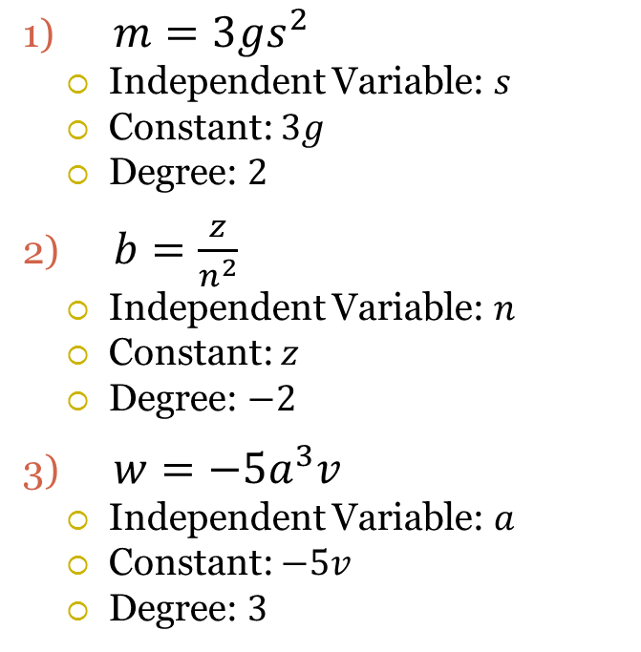
Independent Variables
Definition
Examples
Variable that represents the domain value of a function.
Usually denoted by $x$.
We have independent variables when function notation is not used.
$f\left(x\right)$
$m=3gs^{2}$
Independent Variable: $s$
Constant: $3g$
Degree: $2$
$b=\frac{z}{n^{2}}$
Independent Variable: $n$
Constant: $z$
Degree: $−2$
$w=−5a^{3}v$
Independent Variable: $a$
Constant: $−5v$
Degree: $3$

Slide 16
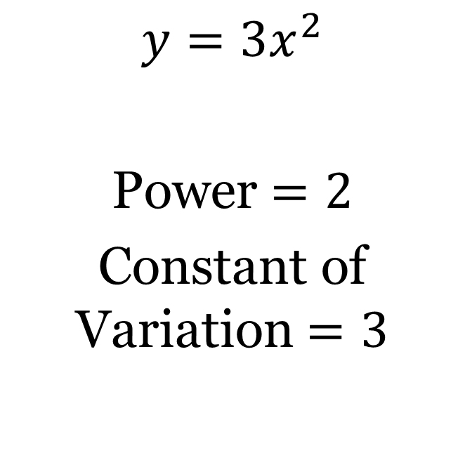
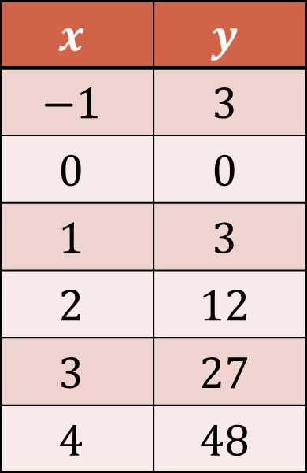
Given a Table
Data
Equation
$$x$$ | $$y$$
$$−1$$ | $$3$$
$$0$$ | $$0$$
$$1$$ | $$3$$
$$2$$ | $$12$$
$$3$$ | $$27$$
$$4$$ | $$48$$
$$y=3x^{2}$$
Power $=2$
Constant of Variation $=3$

Slide 17
Homework – Due 10/20
Section 2.2 from the book.
Page 184
Problems: #1 – 26
#28 for extra credit.
Make sure you read the directions.
Attempt every problem.

