Slide 1
Linear and Quadratic Functions
Polynomials, Function Notation and Vertex Form

Slide 2
Warm-Up: 10/14
Perform the indicated operations: (7minutes)
$$f\left(x\right)=x^{2}+2x g\left(x\right)=3x^{2}−6x$$
$f\left(2\right)+g(3)$
$f\left(g\left(−1\right)\right)$
What is the standard form for a linear equation? A quadratic?
Write a quadratic equation for a function that has a vertical shift to the right 4, a vertical stretch by 2, a reflection over the x-axis and a vertical shift down 1.

Slide 3
Polynomial Function
Definition: Let n be a nonnegative integer and let $a_{0},a_{1},a_{2},…, a_{n−1},a_{n}$be real numbers with $a_{n}≠0.$ The function given by
$$f\left(x\right)=a_{n}x^{n}+a_{n−1}x^{n−1}+…+a_{2}x^{2}+a_{1}x+a_{0}$$
is a polynomial function of degree n. The leading coefficient is $a_{n}$.

Slide 4
Polynomial Examples
Determine whether or not each expression is a polynomial:
$f\left(x\right)=4x^{3}−5x−\frac{1}{2}$
Yes, $f$ is a polynomial function of degree 3 with leading coefficient $4.$
$g\left(x\right)=6x^{−4}+7$
No, $g$ is not a polynomial functions because of the exponent $−4$.

Slide 5
Polynomial Examples
Determine whether or not each expression is a polynomial:
$h\left(x\right)=\sqrt{9x^{4}+16x^{2}}$
No, $h$ is not a polynomial function as it can’t be simplified into polynomial form.
$k\left(x\right)=15x−2x^{4}$
Yes, $k$ is a polynomial function of degree 4 with leading coefficient of $−2$.

Slide 6
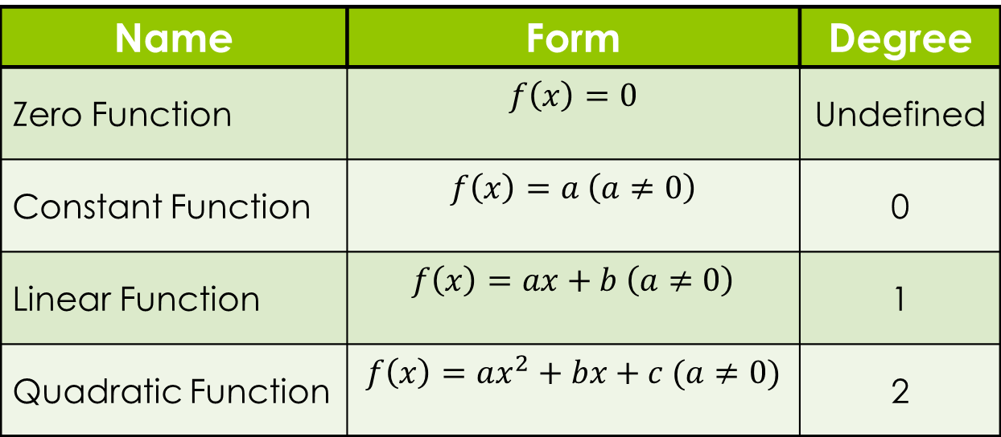
Polynomial Degree
Name | Form | Degree
Zero Function | $$f\left(x\right)=0$$ | Undefined
Constant Function | $$f\left(x\right)=a \left(a≠0\right)$$ | 0
Linear Function | $$f\left(x\right)=ax+b \left(a≠0\right)$$ | 1
Quadratic Function | $$f\left(x\right)=ax^{2}+bx+c (a≠0)$$ | 2

Slide 7
Linear Function
Definition: A function that can be written in the form:
$f\left(x\right)=mx+b$
where $m≠0$ and b are real numbers. Also, $m$is the slope and $b$ is the y-intercept.
Polynomial of degree 1.
Slope:
Positive: $m>0$
Negative: $m<0$

Slide 8
Writing Linear Equations
Calculation
Graphing
Given two points:
Find the slope: $m=\frac{y_{2}−y_{1}}{x_{2}−x_{1}}$.
Plug in slope and 1 point into $y=mx+b$ to find $b$.
Given two points:
Plot on a coordinate plane and connect by a line.
Determine slope by doing $\frac{rise}{run}$.
Determine y-intercept by looking for the point at which the line crosses the y-axis.

Slide 9
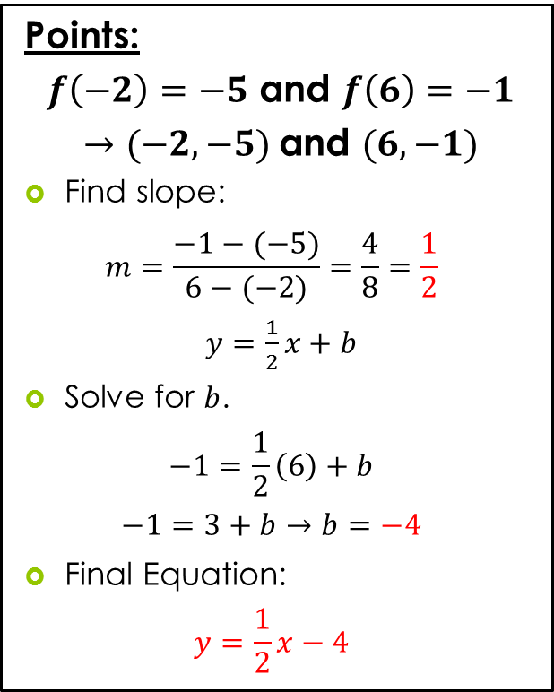
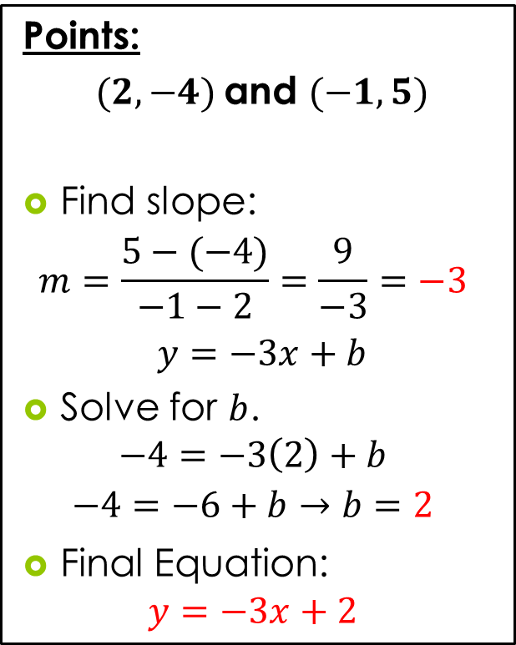
Examples #1 and #2
Points:
$(2,−4)$and $(−1,5)$
Find slope:
$$m=\frac{5−(−4)}{−1−2}=\frac{9}{−3}=−3$$
$y=−3x+b$
Solve for $b$.
$$−4=−3\left(2\right)+b$$
$$−4=−6+b→b=2$$
Final Equation:
$$y=−3x+2$$
Points:
$f\left(−2\right)=−5$ and $f\left(6\right)=−1$
$→(−2,−5)$and $(6,−1)$
Find slope:
$$m=\frac{−1−(−5)}{6−(−2)}=\frac{4}{8}=\frac{1}{2}$$
$y=\frac{1}{2}x+b$
Solve for $b$.
$$−1=\frac{1}{2}\left(6\right)+b$$
$$−1=3+b→b=−4$$
Final Equation:
$$y=\frac{1}{2}x−4$$

Slide 10
Quadratic Function
Definition: A function that can be written in the form:
$f\left(x\right)=ax^{2}+bx+c$
where $a, b,$and $c$ are real numbers and $a≠0$.
Polynomial of degree 2.
Parabola:
Up: $a>0$
Down: $a<0$

Slide 11
Vertex Form
Definition: Any quadratic function $f\left(x\right)=ax^{2}+bx+c$, $a≠0$, can be written in the vertex form:
$f\left(x\right)=a{\left(x−h\right)}^{2}+k$.
The graph of $f$ is a parabola with vertex $(h,k)$ and axis $x=h$, where $h=−\frac{b}{2a}$ and $k=c−ah^{2}$ or $k=f\left(−\frac{b}{2a}\right)$.

Slide 12
Converting to Vertex Form
$$f\left(x\right)=−3x^{2}+6x−5$$
$a=−3, b=6$ and $c=−5$
Find our vertex point:
$$h=\frac{−6}{2\left(−3\right)}=\frac{−6}{−6}=1$$
$$k=f\left(h\right)=f\left(1\right)=−3{\left(1\right)}^{2}+6\left(1\right)−5=−2$$
Now write in vertex form: $f\left(x\right)=a{\left(x−h\right)}^{2}+k$.
$$f\left(x\right)=−3{\left(x−1\right)}^{2}−2$$
Downward opening parabola with line of symmetry $x=1$ and vertex $(1, −2)$.

Slide 13
$$f\left(x\right)=−3{\left(x−1\right)}^{2}−2$$

Slide 14
Writing in General Form
Vertex: $(−1, 2)$ and Point: $(0, 5)$
$$f\left(x\right)=a{\left(x−\left(−1\right)\right)}^{2}+2$$
$$f\left(x\right)=a{\left(x+1\right)}^{2}+2$$
What is$a$? (Plug in your point!)
$$5=a{\left(\left(0\right)+1\right)}^{2}+2$$
$$3=a{\left(1\right)}^{2}→3=1a→a=3$$
Final Equation: $f\left(x\right)=3{\left(x+1\right)}^{2}+2$

Slide 15
$$f\left(x\right)=3{\left(x+1\right)}^{2}+2$$

Slide 16
Homework – Due 10/15
Section 2.1 from the book.
Page 169 – 170
Problems: #1 – 22.
Make sure you read the directions.

Slide 17
Homework – Due 10/16
Section 2.1 from the book.
Page 170
Problems: #23 – 40.
Make sure you read the directions.

