Slide 1
Graph Transformations
Horizontal Shifts And Vertical Shifts
Reflections over the X-Axis and Y-Axis
Horizontally and Vertically Stretching and Shrinking

Slide 2
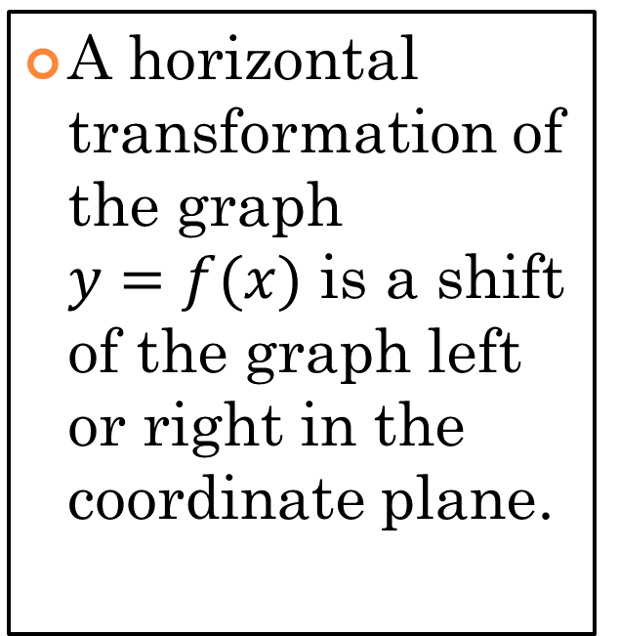
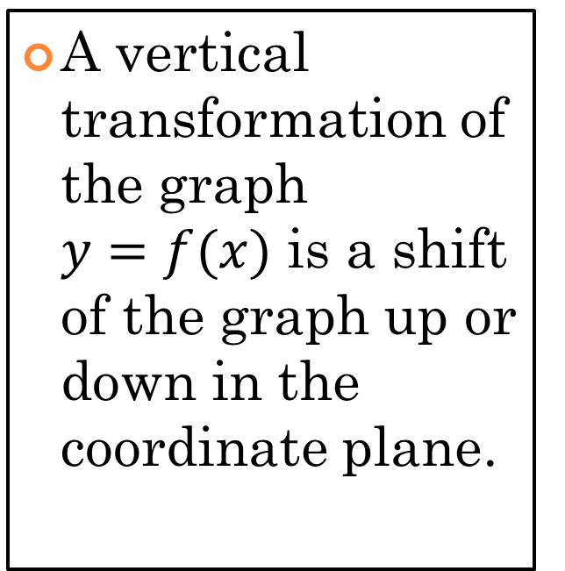
Shifts
Vertical
Horizontal
A vertical transformation of the graph $y=f(x)$ is a shift of the graph up or down in the coordinate plane.
A horizontal transformation of the graph $y=f(x)$ is a shift of the graph left or right in the coordinate plane.

Slide 3
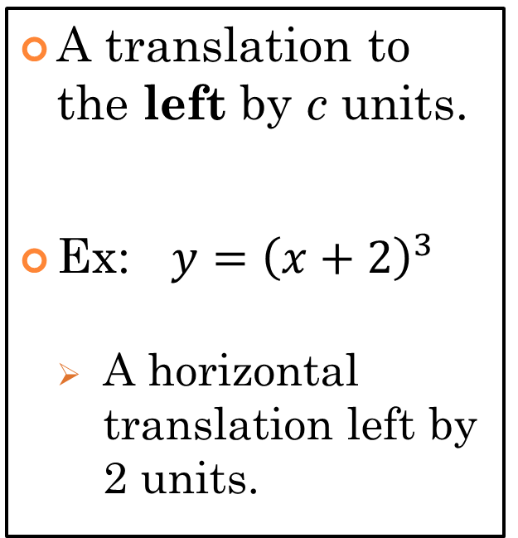
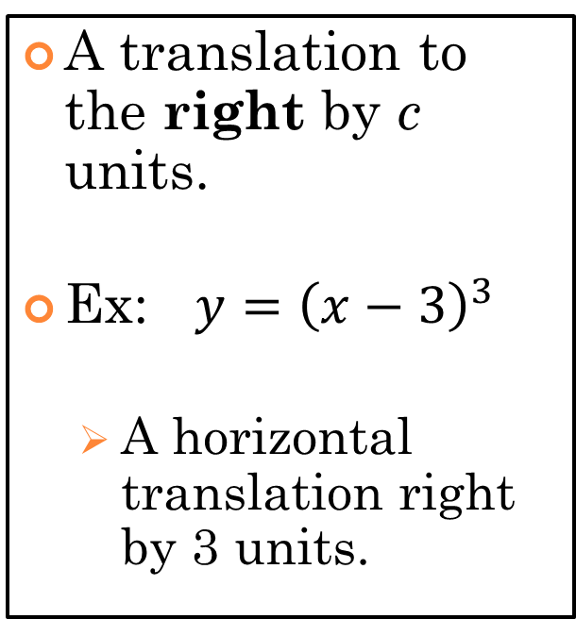


Horizontal Transformations
$$y=f(x−c)$$
$$y=f(x+c)$$
A translation to the right by c units.
Ex: $y={\left(x−3\right)}^{3}$
  A horizontal translation right by 3 units.
A translation to the left by c units.
Ex: $y={\left(x+2\right)}^{3}$
    A horizontal translation left by 2 units.

Slide 4
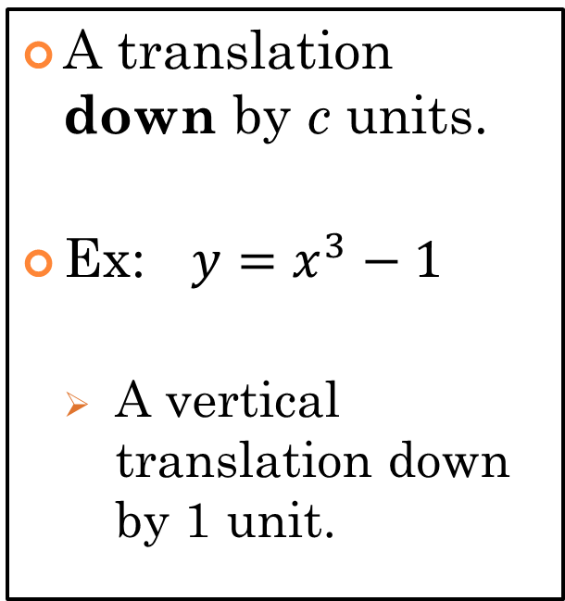
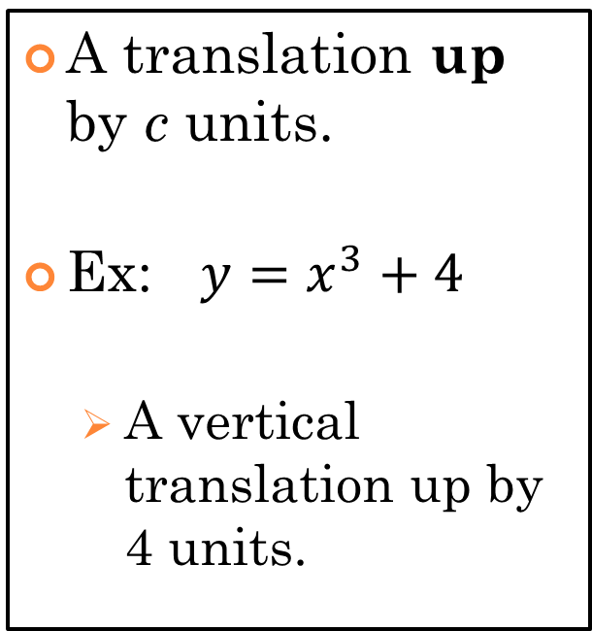


Vertical Transformations
$$y=f\left(x\right)+c$$
$$y=f\left(x\right)−c$$
A translation up by c units.
Ex: $y=x^{3}+4$
  A vertical translation up by 4 units.
A translation down by c units.
Ex: $y=x^{3}−1$
    A vertical translation down by 1 unit.

Slide 5
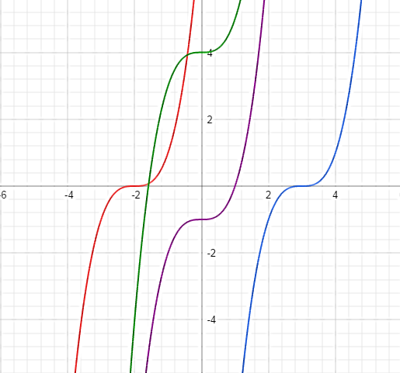
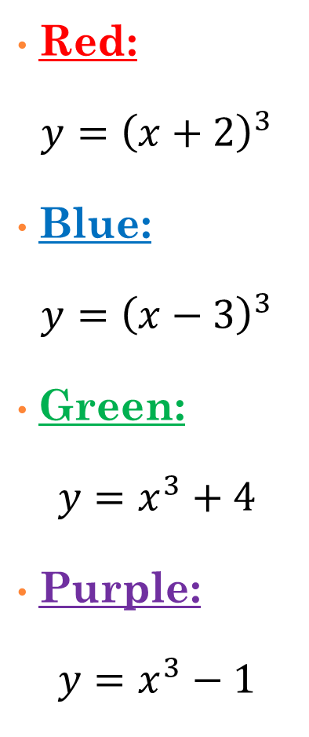
Horizontal and Vertical Shifts
Red:
$$y={\left(x+2\right)}^{3}$$
Blue:
$$y={\left(x−3\right)}^{3}$$
Green:
$$y=x^{3}+4$$
Purple:
$$y=x^{3}−1$$

Slide 6
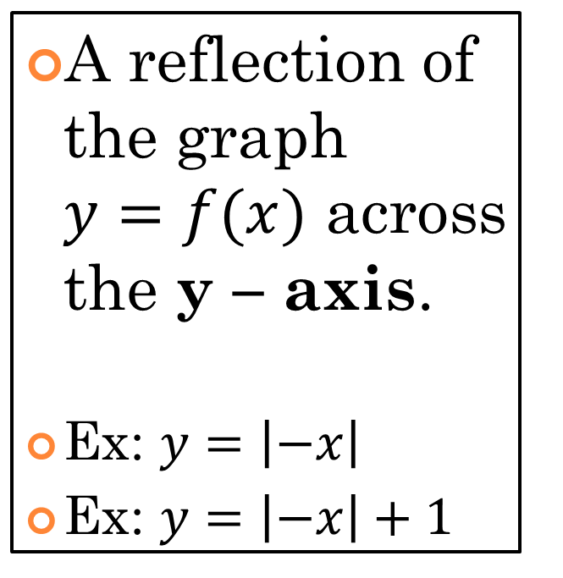
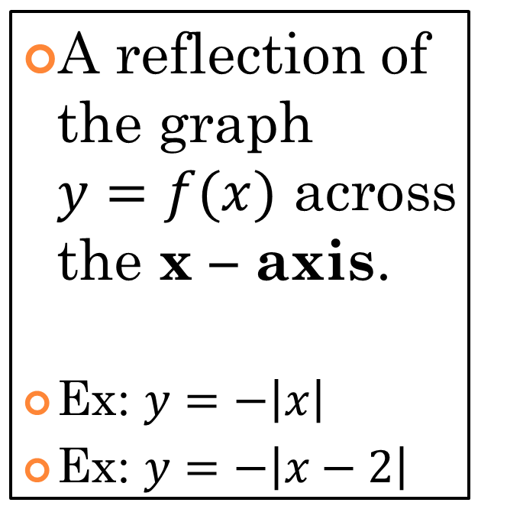


Reflections
$$y=−f(x)$$
$$y=f(−x)$$
A reflection of the graph $y=f(x)$ across the x – axis.
Ex: $y=−\left|x\right|$
Ex: $y=−\left|x−2\right|$
A reflection of the graph $y=f(x)$ across the y – axis.
Ex: $y=\left|−x\right|$
Ex: $y=\left|−x\right|+1$

Slide 7
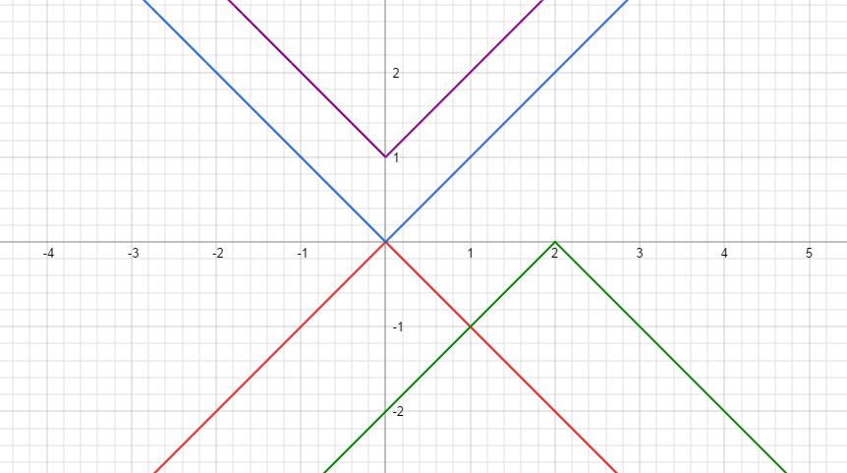
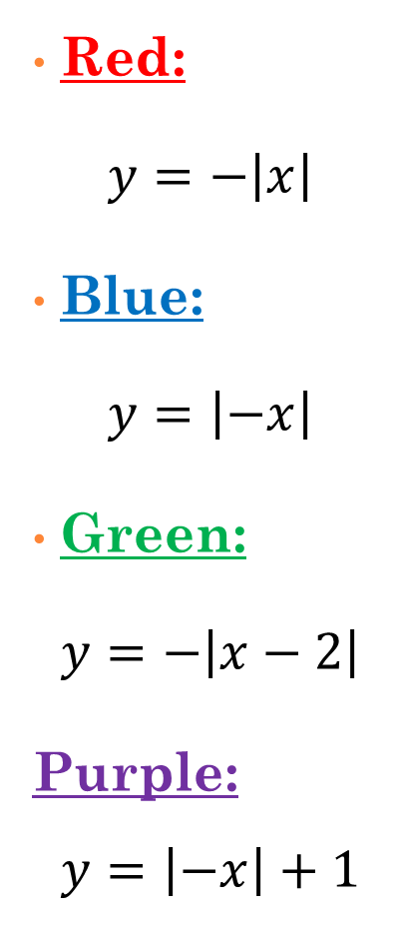
Reflections over the X-Axis and Y-Axis
Red:
$$y=−\left|x\right|$$
Blue:
$$y=\left|−x\right|$$
Green:
$$y=−\left|x−2\right|$$
Purple:
$$y=\left|−x\right|+1$$

Slide 8
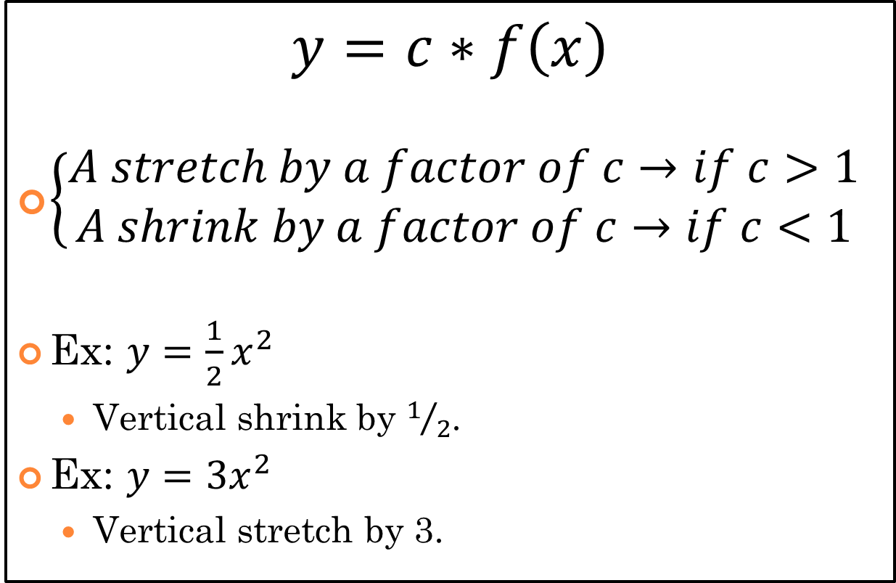
Vertical Stretch of Shrink
$$y=c∗f\left(x\right)$$
$\left\{\begin{aligned}A stretch by a factor of c→if c>1 \\ A shrink by a factor of c→if c<1\end{aligned}\right.$
Ex: $y=\frac{1}{2}x^{2}$
  Vertical shrink by $1/2$.
Ex: $y=3x^{2}$
  Vertical stretch by 3.

Slide 9
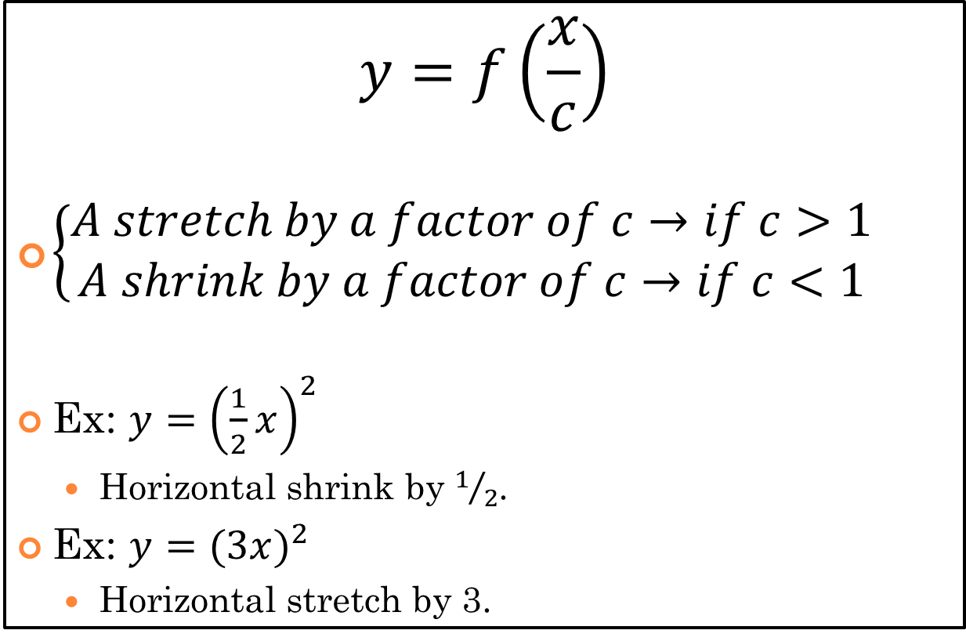
Horizontal Stretch of Shrink
$$y=f\left(\frac{x}{c}\right)$$
$\left\{\begin{aligned}A stretch by a factor of c→if c>1 \\ A shrink by a factor of c→if c<1\end{aligned}\right.$
Ex: $y={\left(\frac{1}{2}x\right)}^{2}$
  Horizontal shrink by $1/2$.
Ex: $y=(3{x)}^{2}$
  Horizontal stretch by 3.

Slide 10
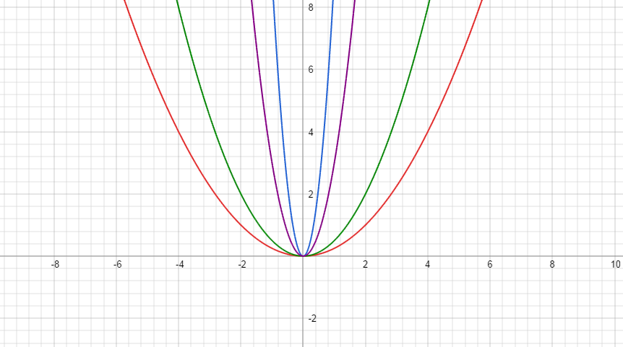
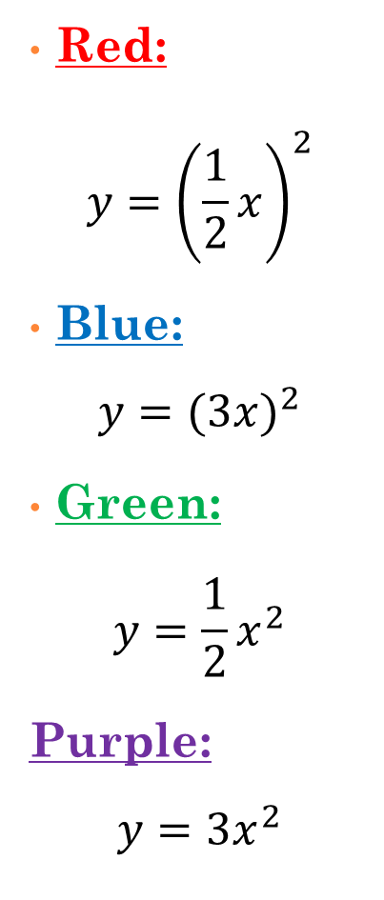
Stretching and Shrinking Horizontally and Vertically
Red:
$$y={\left(\frac{1}{2}x\right)}^{2}$$
Blue:
$$y=(3{x)}^{2}$$
Green:
$$y=\frac{1}{2}x^{2}$$
Purple:
$$y=3x^{2}$$

Slide 11

$$f\left(x\right)={(−3x)}^{2}−1$$

Slide 12

$$f\left(x\right)=−2\sqrt{x+5}$$

Slide 13

$$f\left(x\right)=\left|−\frac{1}{2}x\right|+4$$

