Slide 1
Functions
Linear, Quadratic, Absolute Value, Radical and Rational

Slide 2
Function
Definition: A function, sometimes called a mapping, is a relation in which no two different ordered pairs have the same x-coordinate or first member.
One value of the Domain is assigned to a unique element in Range.
Vertical Line Test: a graph defines y as a function of x if and only if no vertical line intersect the graph in more than one point.

Slide 3
Linear Equations
A function that can be written in the form $f\left(x\right)=mx+b$, where $m≠0$ and b are real numbers.
Vertical Line: $x=a$
Horizontal Line:$y=b$

Slide 4
Domain and Range
Domain
Range
The set of all input values (x-values) for a function.
$\left\{x_{1},x_{2},x_{3},x_{4}, x_{5},…\right\}$
The set of all output values (y-values) corresponding to elements in the domain.
$\left\{y_{1},y_{2},y_{3},y_{4}, y_{5},…\right\}$

Slide 5

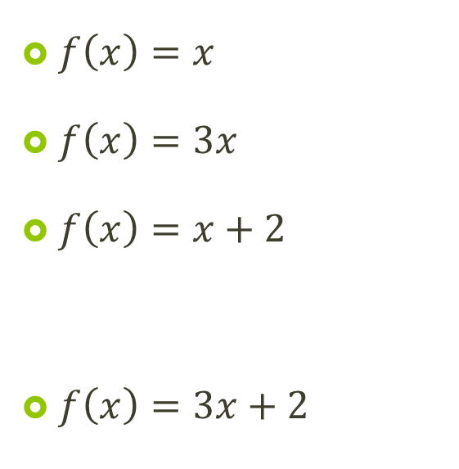
Examples:
$f\left(x\right)=x$
$f\left(x\right)=3x$
$f\left(x\right)=x+2$
$f\left(x\right)=3x+2$
$f\left(x\right)=−x$
$f\left(x\right)=−x−5$
$y=−4$
$x=6$

Slide 6
Worksheet
Add two problems to back of worksheet:
$y=6$
$x=−2$
Fill in the values of the table, graph the equation and then state the domain and range for each problem.
State the slope and y-intercept for each equation.

