Slide 1
Section 2.3: End Behavior of Polynomial Functions

Slide 2
Polynomial Function
Definition: Let n be a nonnegative integer and let $a_{0},a_{1},a_{2},…, a_{n−1},a_{n}$be real numbers with $a_{n}≠0.$ The function given by
$$f\left(x\right)=a_{n}x^{n}+a_{n−1}x^{n−1}+…+a_{2}x^{2}+a_{1}x+a_{0}$$
is a polynomial function of degree n. The leading coefficient is $a_{n}$.

Slide 3
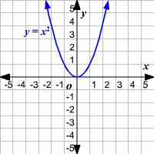
Even Degree Positive Coefficient
$$x→−∞$$ $$f\left(x\right)→+∞$$ | $$x→+∞,$$ $$f\left(x\right)→+∞$$

Slide 4
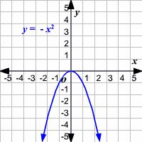
Even Degree negative Coefficient
$$x→−∞$$ $$f\left(x\right)→−∞$$ | $$x→+∞,$$ $$f\left(x\right)→−∞$$

Slide 5
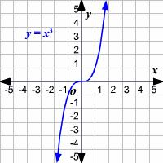
Odd Degree Positive Coefficient
$$x→−∞$$ $$f\left(x\right)→−∞$$ | $$x→+∞,$$ $$f\left(x\right)→+∞$$

Slide 6
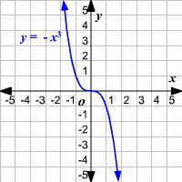
Odd Degree Negative Coefficient
$$x→−∞$$ $$f\left(x\right)→+∞$$ | $$x→+∞,$$ $$f\left(x\right)→−∞$$

Slide 7
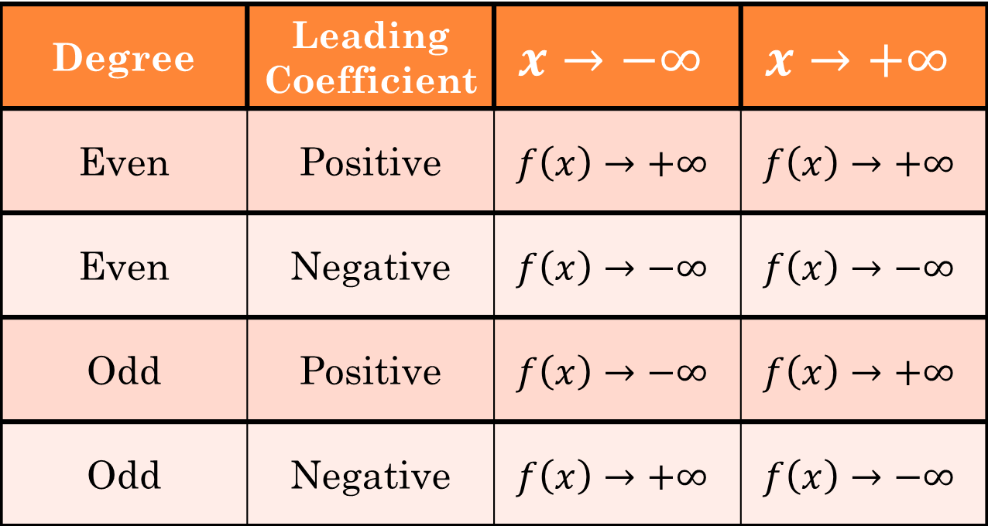
Summary:
Degree | Leading Coefficient | $$x→−∞$$ | $$x→+∞$$
Even | Positive | $$f\left(x\right)→+∞$$ | $$f\left(x\right)→+∞$$
Even | Negative | $$f\left(x\right)→−∞$$ | $$f\left(x\right)→−∞$$
Odd | Positive | $$f\left(x\right)→−∞$$ | $$f\left(x\right)→+∞$$
Odd | Negative | $$f\left(x\right)→+∞$$ | $$f\left(x\right)→−∞$$

Slide 8
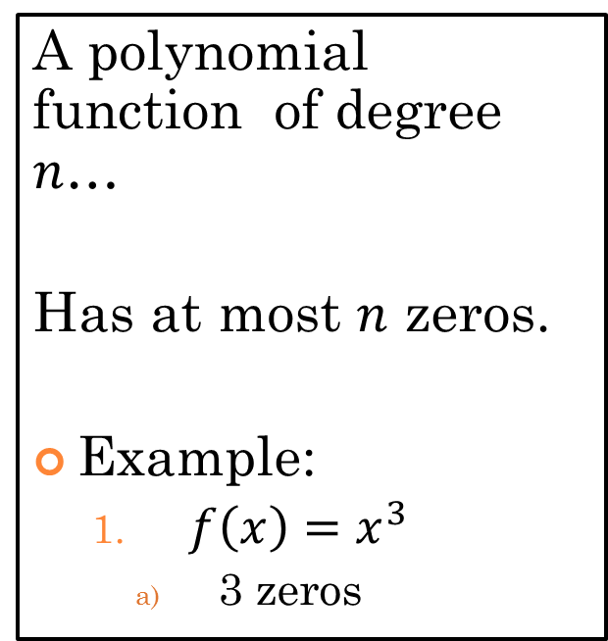
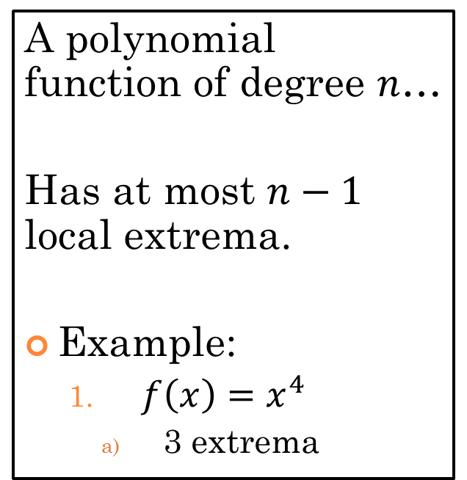
Local Extrema and Zeros of a Polynomial Function
Local Extrema
Zeros
A polynomial function of degree $n$…
Has at most $n−1$ local extrema.
Example:
$f\left(x\right)=x^{4}$
3 extrema
A polynomial function of degree $n$…
Has at most $n$ zeros.
Example:
$f\left(x\right)=x^{3}$
3 zeros

Slide 9
Multiplicity of a Zero
If $f$ is a polynomial function and ${\left(x−c\right)}^{m}$ is a factor of f but ${\left(x−c\right)}^{m+1}$ is not, then $c$ is a zero of multiplicity $m$ of $f$.
Odd: The graph crosses the axis at $(c,0)$.
Even: The graph kisses the axis $(c,0)$.
Example:
${\left(x−2\right)}^{3}{\left(x+1\right)}^{2}=0$
$x=2→multiplicity of 3→odd→crosses$
$x=−1→multiplicity of 2→even→kisses$

Slide 10
Graph of: ${f\left(x\right)=\left(x−2\right)}^{3}{\left(x+1\right)}^{2}$

