Slide 1
Agenda – Tentative
11/5: Section 2.5
11/6 – 11/7: Section 2.6
11/10: Review 2.6
11/11: Finish Section 2.6
11/12: Pass the Problem Activity
11/13: Review 2.5 and 2.6
11/14: Test on 2.5–2.6

Slide 2
Complex Numbers
Section 2.5

Slide 3
Complex Number
A complex number is any number than can be written in the form:
$$a+bi$$
where $a$ and $b$ are real numbers. The real number $a$ is the real part, the real number $b$ is the imaginary part, and $a+bi$ is the standard form.

Slide 4
Let’s Talk About $i$
What is $i$?
It is the imaginary number that is used to denote $\sqrt{−1}$.
What is $i^{2}?$
$i^{2}=\sqrt{−1}∙\sqrt{−1}=−1$
What is $i^{3}?$
$i^{3}=i^{2}∙i=−1∙\sqrt{−1}=−\sqrt{−1} or −i$
What is $i^{4}?$
$i^{4}=i^{2}{∙i}^{2}=−1∙−1=1$
Summary:
$i=\sqrt{−1}$
$i^{2}=−1$
$i^{3}=−\sqrt{−1} or−i$
$i^{4}=1$

Slide 5
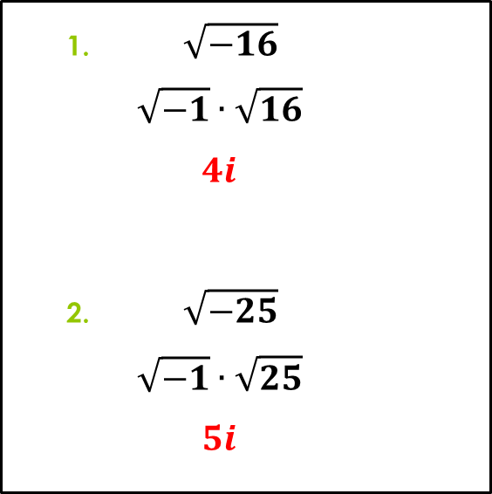
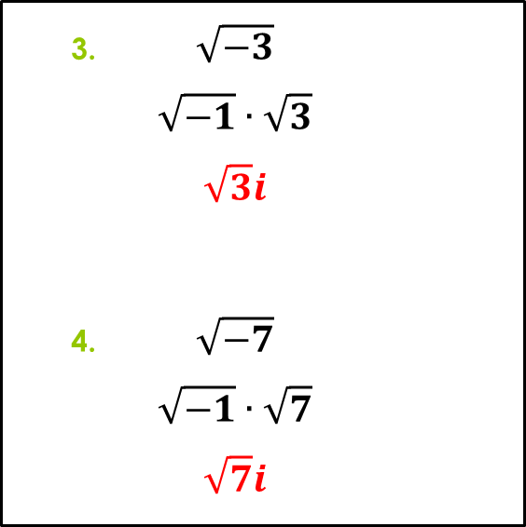
Simplifying Radicals
Directions: Write the expression in the form $bi$, where $b$ is a real number.
$\sqrt{−16}$
$$\sqrt{−1}∙\sqrt{16}$$
$$4i$$
$\sqrt{−25}$
$$\sqrt{−1}∙\sqrt{25}$$
$$5i$$
$\sqrt{−3}$
$$\sqrt{−1}∙\sqrt{3}$$
$$\sqrt{3}i$$
$\sqrt{−7}$
$$\sqrt{−1}∙\sqrt{7}$$
$$\sqrt{7}i$$

Slide 6
Addition: #1, 2, 3 and 6
$$\left(a+bi\right)+\left(c+di\right)=\left(a+c\right)+\left(b+d\right)i$$
Ex: Write the sum in standard form.
$$\left(7−3i\right)+\left(4+5i\right)$$
$$\left(7+4\right)+\left(−3+5\right)i$$
$$11+2i$$

Slide 7
Subtraction: #4 and 7
$$\left(a+bi\right)−\left(c+di\right)=\left(a−c\right)+\left(b−d\right)i$$
Ex: Write the difference in standard form.
$$\left(2−i\right)−\left(8+3i\right)$$
$$\left(2−8\right)+\left(−1−3\right)i$$
$$−6−4i$$

Slide 8
Multiplication: 9–15 (Odd)
$$\left(a+bi\right)∙\left(c+di\right)=a\left(c+di\right)+bi\left(c+di\right)$$
Ex: Write the product in standard form.
$$\left(2+3i\right)∙\left(5−i\right)$$
$$2\left(5−i\right)+3i(5−i)$$
$$10−2i+15i−3i^{2}$$
$$10+13i−3\left(−1\right)$$
$$13+13i$$
$$i^{2}=−1$$

Slide 9
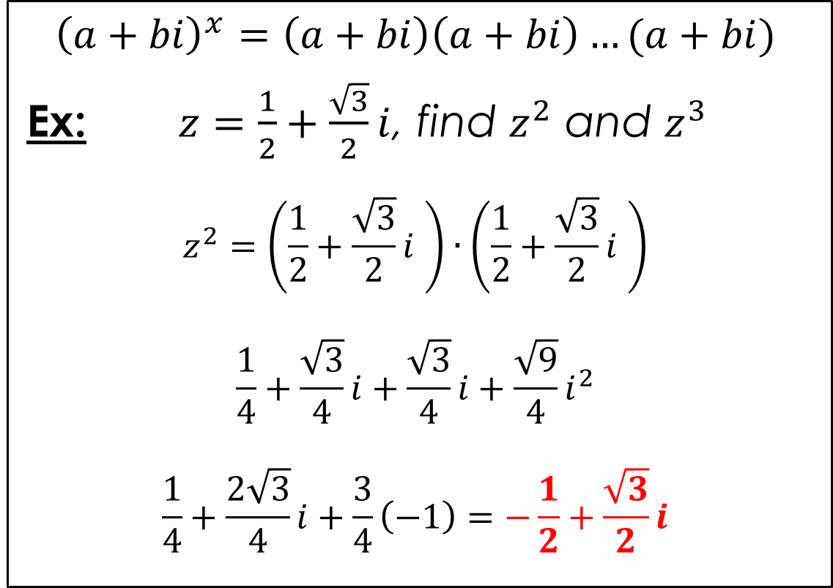
Raising to a Power: #25–27
$${\left(a+bi\right)}^{x}=\left(a+bi\right)\left(a+bi\right)…(a+bi)$$
Ex: $z=\frac{1}{2}+\frac{\sqrt{3}}{2}i$, find $z^{2}$ and $z^{3}$
$$z^{2}=\left(\frac{1}{2}+\frac{\sqrt{3}}{2}i \right)∙\left(\frac{1}{2}+\frac{\sqrt{3}}{2}i \right)$$
$$\frac{1}{4}+\frac{\sqrt{3}}{4}i+\frac{\sqrt{3}}{4}i+\frac{\sqrt{9}}{4}i^{2}$$
$$\frac{1}{4}+\frac{2\sqrt{3}}{4}i+\frac{3}{4}\left(−1\right)=−\frac{1}{2}+\frac{\sqrt{3}}{2}i$$

Slide 10
Raising to a Power
Now find $z^{3}$ when you already have $z^{2}$.
Ex: $z=\frac{1}{2}+\frac{\sqrt{3}}{2}i$ and $z^{2}=−\frac{1}{2}+\frac{\sqrt{3}}{2}i$
$$z^{3}=z∙z^{2}=\left(\frac{1}{2}+\frac{\sqrt{3}}{2}i \right)∙\left(−\frac{1}{2}+\frac{\sqrt{3}}{2}i \right)$$
$$−\frac{1}{4}+\frac{\sqrt{3}}{4}i−\frac{\sqrt{3}}{4}i+\frac{\sqrt{9}}{4}i^{2}$$
$$−\frac{1}{4}+0i+\frac{3}{4}\left(−1\right)=−1$$

Slide 11
Complex Conjugate: #29, 31
The complex conjugate of the complex number:
$z=a+bi$is $z=a−bi$
Use the complex conjugate to rationalize the denominator of rational functions:
$$z=\frac{1}{a+bi}=\frac{1}{a+bi}∙\frac{a−bi}{a−bi}$$
$$\frac{a−bi}{a^{2}−abi+abi−{\left(bi\right)}^{2}}=\frac{a−bi}{a^{2}+b^{2}}$$
$$\frac{a}{a^{2}+b^{2}}−\frac{b}{a^{2}+b^{2}}i$$

Slide 12
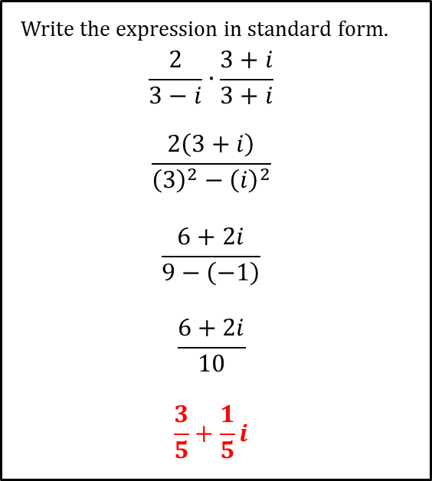
Dividing Complex Numbers 33, 35, 37 and 39
$$\frac{2}{3−i}$$
$$\frac{5+i}{2−3i}$$
Write the expression in standard form.
$$\frac{2}{3−i}∙\frac{3+i}{3+i}$$
$$\frac{2\left(3+i\right)}{{\left(3\right)}^{2}−{\left(i\right)}^{2}}$$
$$\frac{6+2i}{9−\left(−1\right)}$$
$$\frac{6+2i}{10}$$
$$\frac{3}{5}+\frac{1}{5}i$$
Write the expression in standard form.
$$\frac{5+i}{2−3i}∙\frac{2+3i}{2+3i}$$
$$\frac{5\left(2+3i\right)+i(2+3i)}{{\left(2\right)}^{2}−{\left(3i\right)}^{2}}$$
$$\frac{10+15i+2i+3i^{2}}{4−\left(−9\right)}$$
$$\frac{7+17i}{13}$$
$$\frac{7}{13}+\frac{17}{13}i$$

Slide 13
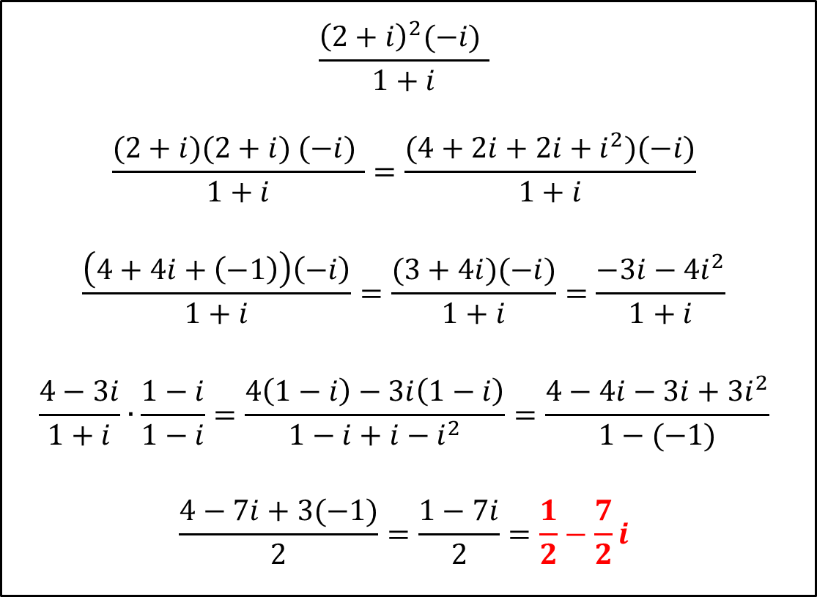
Dividing Complex Numbers
$$\frac{{\left(2+i\right)}^{2}(−i) }{1+i}$$
$$\frac{(2+i)(2+i) (−i) }{1+i}=\frac{(4+2i+2i+i^{2})(−i)}{1+i}$$
$$\frac{\left(4+4i+\left(−1\right)\right)\left(−i\right)}{1+i}=\frac{(3+4i)(−i)}{1+i}=\frac{−3i−4i^{2}}{1+i}$$
$$\frac{4−3i}{1+i}∙\frac{1−i}{1−i}=\frac{4\left(1−i\right)−3i\left(1−i\right)}{1−i+i−i^{2}}=\frac{4−4i−3i+3i^{2}}{1−(−1)}$$
$$\frac{4−7i+3(−1)}{2}=\frac{1−7i}{2}=\frac{1}{2}−\frac{7}{2}i$$

Slide 14
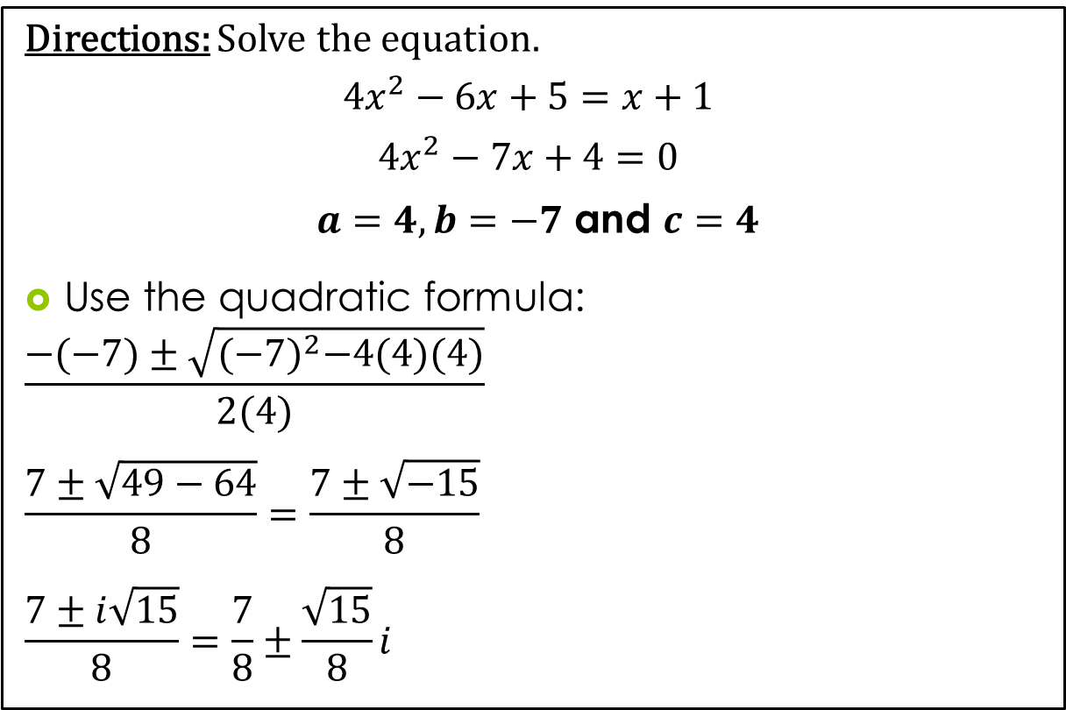
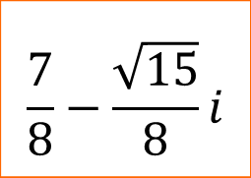
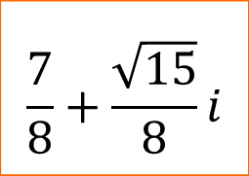
Solving a Quadratic Equation: 45, 46 and 48
Directions: Solve the equation.
$${4x}^{2}−6x+5=x+1$$
$$4x^{2}−7x+4=0$$
$a=4, b=−7$ and $c=4$
Use the quadratic formula:
$$\frac{−(−7)±\sqrt{{(−7)}^{2}−4(4)(4)}}{2(4)}$$
$$\frac{7±\sqrt{49−64}}{8}=\frac{7±\sqrt{−15}}{8}$$
$$\frac{7±i\sqrt{15}}{8}=\frac{7}{8}±\frac{\sqrt{15}}{8}i$$
$$\frac{7}{8}+\frac{\sqrt{15}}{8}i$$
$$\frac{7}{8}−\frac{\sqrt{15}}{8}i$$

Slide 15
Homework – Due 11/6
P. 218
1 – 7 (SKIP #5)
9 – 15 (Odd)
25 – 27 (27 is a challenge)
29 – 39 (Odd)
45, 46 and 48

