Slide 1
Combining Functions
Sum, Difference, Product, Quotient, Composition and Inverse

Slide 2
Warm Up: 10/7
$f\left(x\right)=3x^{2}+x−5$
Find $f(−2)$.
$f\left(x\right)=3{\left(−2\right)}^{2}+\left(−2\right)−5=5$
$g\left(x\right)=\sqrt{−2x+6}−4$
Find $g(1)$.
$g\left(x\right)=\sqrt{−2\left(1\right)+6}−1=2−4=−2$
When the transformation is on the inside it affects the...
When the transformation is on the outside it affects the…

Slide 3
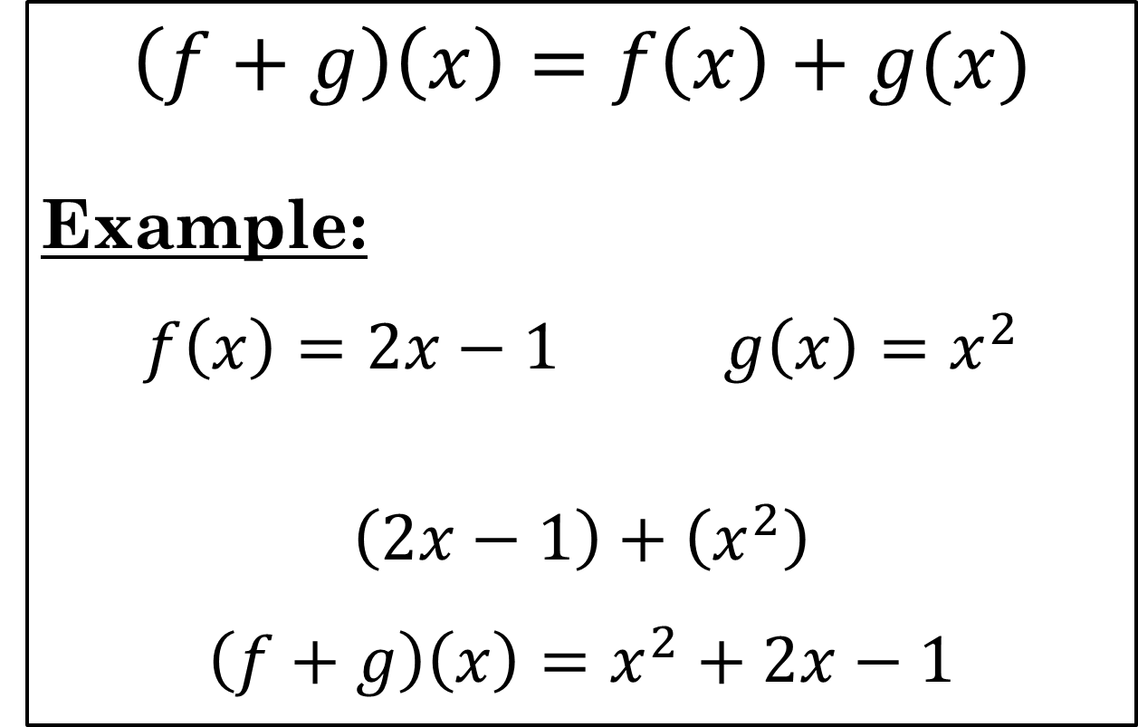
Sum
$$\left(f+g\right)\left(x\right)=f\left(x\right)+g(x)$$
Example:
$$f\left(x\right)=2x−1 g\left(x\right)=x^{2}$$
$$\left(2x−1\right)+\left(x^{2}\right)$$
$$\left(f+g\right)\left(x\right)=x^{2}+2x−1$$

Slide 4
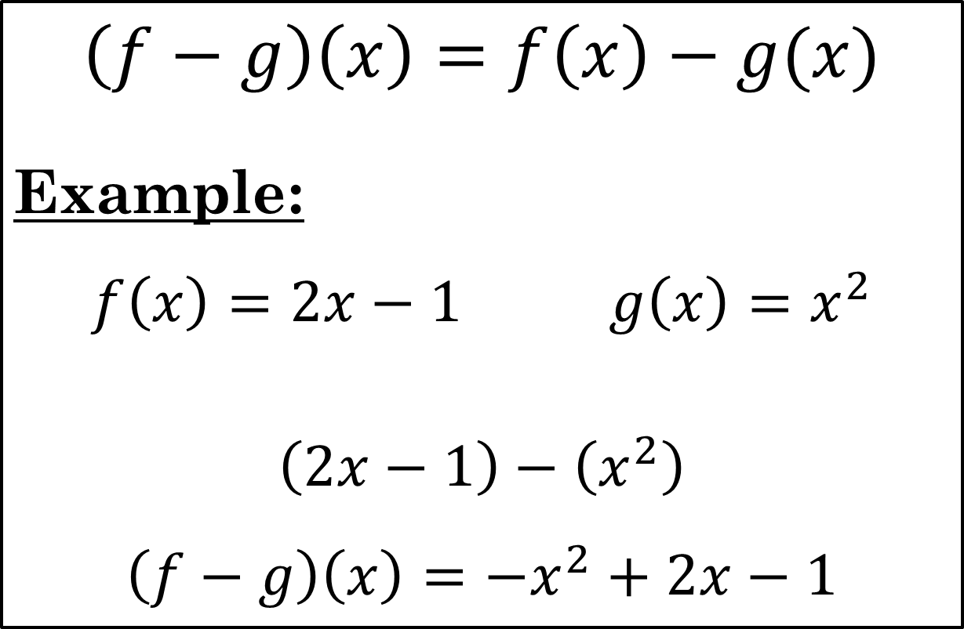
Difference
$$\left(f−g\right)\left(x\right)=f\left(x\right)−g(x)$$
$$\text{Example}\text{:}$$
$$f\left(x\right)=2x−1 g\left(x\right)=x^{2}$$
$$\left(2x−1\right)−\left(x^{2}\right)$$
$$\left(f−g\right)\left(x\right)={−x}^{2}+2x−1$$

Slide 5
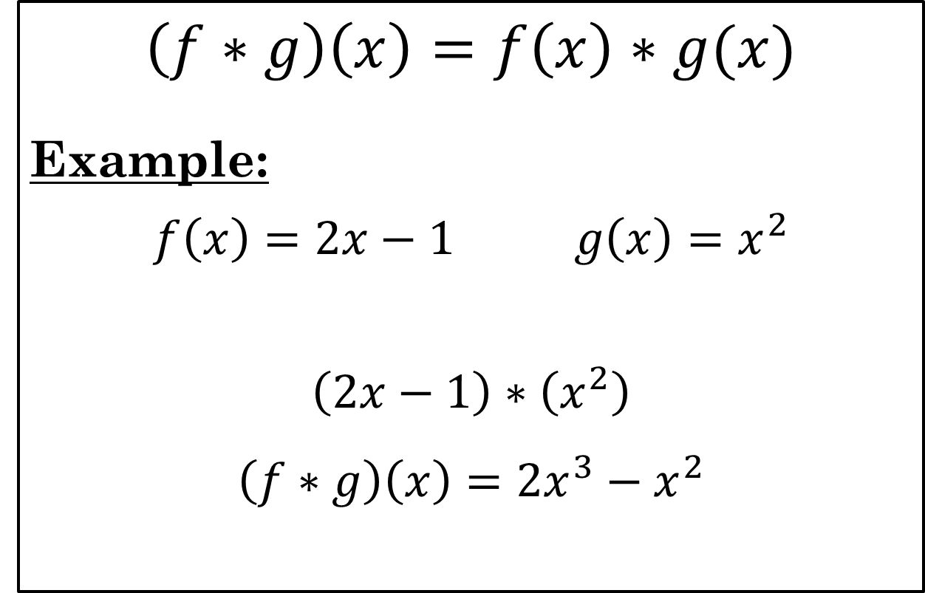
Product
$$\left(f∗g\right)\left(x\right)=f\left(x\right)∗g(x)$$
Example:
$$f\left(x\right)=2x−1 g\left(x\right)=x^{2}$$
$$\left(2x−1\right)∗\left(x^{2}\right)$$
$$\left(f∗g\right)\left(x\right)=2x^{3}−x^{2}$$

Slide 6
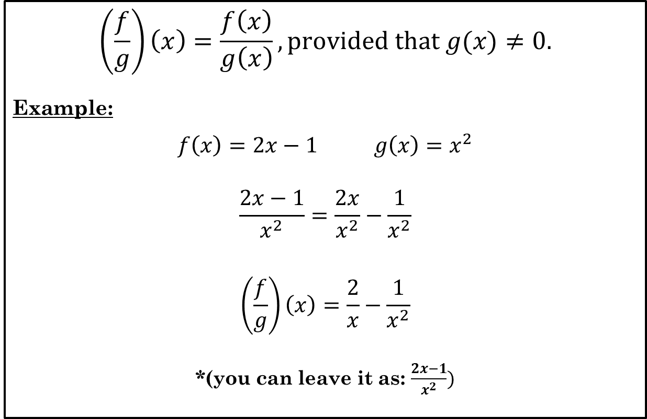
Quotient
$$\left(\frac{f}{g}\right)\left(x\right)=\frac{f\left(x\right)}{g\left(x\right)}, provided that g(x)≠0.$$
Example:
$$f\left(x\right)=2x−1 g\left(x\right)=x^{2}$$
$$\frac{2x−1}{x^{2}}=\frac{2x}{x^{2}}−\frac{1}{x^{2}}$$
$$\left(\frac{f}{g}\right)\left(x\right)=\frac{2}{x}−\frac{1}{x^{2}}$$
*(you can leave it as: $\frac{2x−1}{x^{2}})$

Slide 7
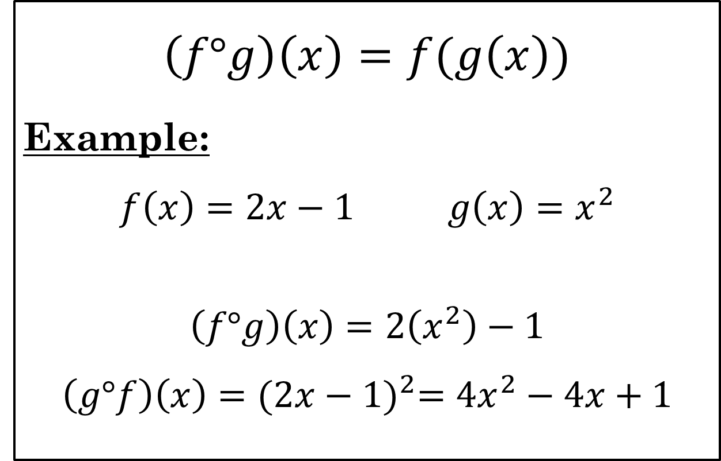
Composition of Functions
$$\left(f\text{°}g\right)\left(x\right)=f(g\left(x\right))$$
Example:
$$f\left(x\right)=2x−1 g\left(x\right)=x^{2}$$
$$\left(f°g\right)\left(x\right)=2\left(x^{2}\right)−1$$
$$\left(g°f\right)\left(x\right)={(2x−1)}^{2}=4x^{2}−4x+1$$

Slide 8
Inverse Function
If $f$ is a one-to-one function with domain $D$ and range $R$, then the inverse function of $f$, denoted $f^{−1}$, is the function with domain $R$ and range $D$ defined by:
$$f^{−1}\left(b\right)=a if and only if f\left(a\right)=b$$
One-to-one: A function in which each element of the range corresponds to exactly one element in the domain.

Slide 9
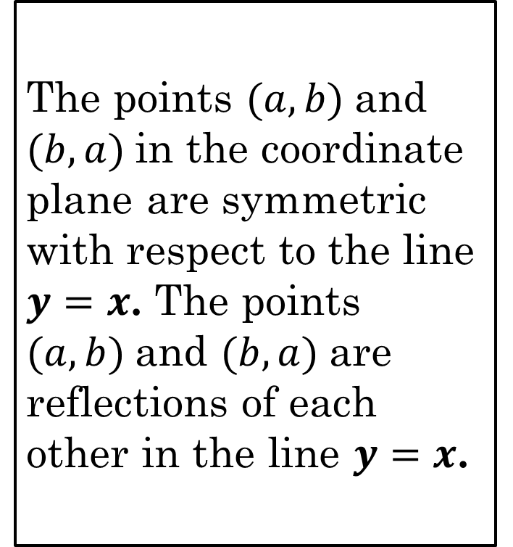
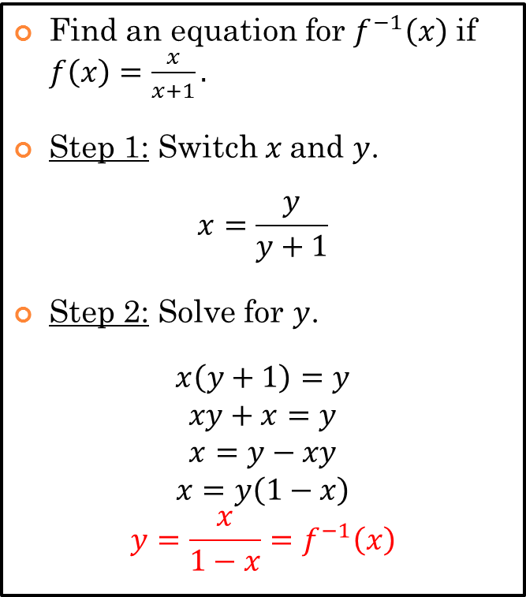
Inverses
Algebraically
Graphically
Find an equation for $f^{−1}\left(x\right)$ if $f\left(x\right)=\frac{x}{x+1}.$
Step 1: Switch $x$and $y$.
$$x=\frac{y}{y+1}$$
Step 2: Solve for $y$.
$$x\left(y+1\right)=y$$
$$xy+x=y$$
$$x=y−xy$$
$$x=y\left(1−x\right)$$
$$y=\frac{x}{1−x}=f^{−1}\left(x\right)$$
The points $(a,b)$and $(b,a)$in the coordinate plane are symmetric with respect to the line $y=x$. The points $(a,b)$and $(b,a)$are reflections of each other in the line $y=x$.

Slide 10
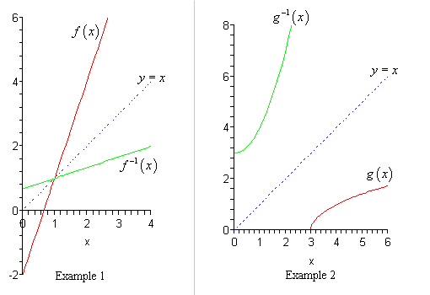
Looking at Inverses Graphically

Slide 11
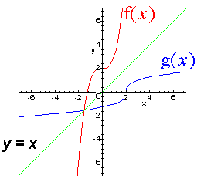
Looking at Inverses Graphically

Slide 12
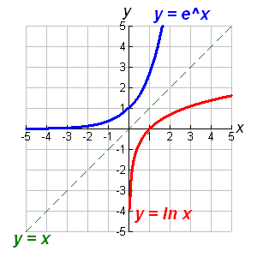
Inverses: reflected over the line $y=x.$
$y=e^{x}$ and $y=ln⁡(x)$

Slide 13
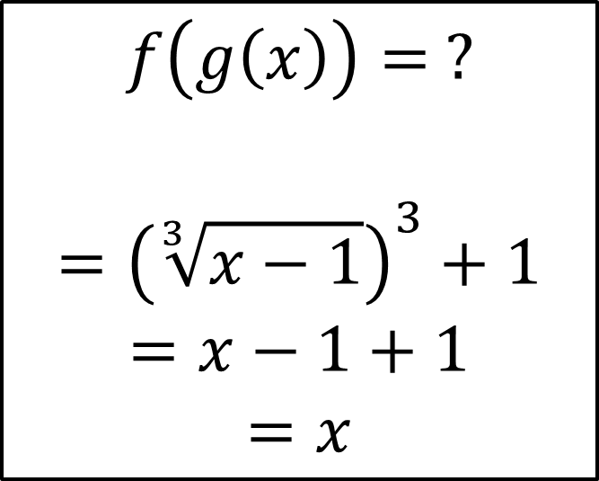
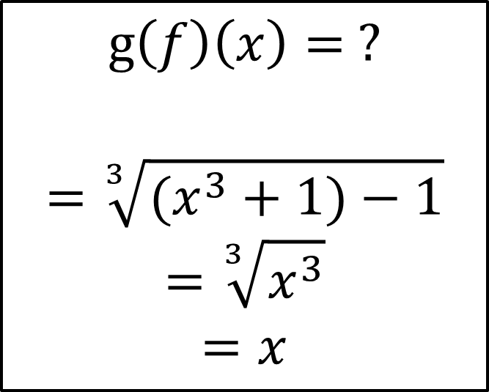
Inverses? $$f(g\left(x\right))=g(f\left(x\right))$$
$$f\left(x\right)=x^{3}+1$$
$$g\left(x\right)=\sqrt[3]{x−1}$$
$$f\left(g\left(x\right)\right)= ?$$
$$={\left(\sqrt[3]{x−1}\right)}^{3}+1$$
$$=x−1+1$$
$$=x$$
$$g\left(f\right)\left(x\right)= ?$$
$$=\sqrt[3]{(x^{3}+1)−1}$$
$$=\sqrt[3]{x^{3}}$$
$$=x$$
Thus, $f(x)$ and $g(x)$ are inverses.

