Slide 1
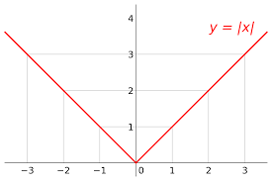
Absolute Value Function

Slide 2
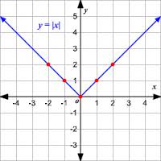

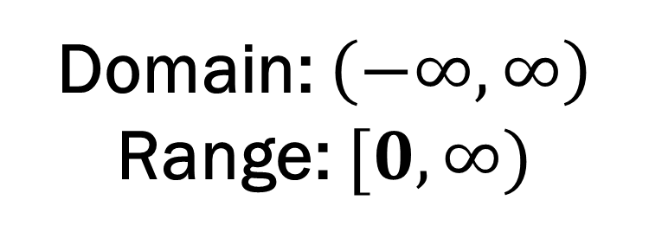
Absolute Value Function
$$y=\left|x\right|$$
Domain: $\left(−∞,∞\right)$ Range: $[0,∞)$

Slide 3
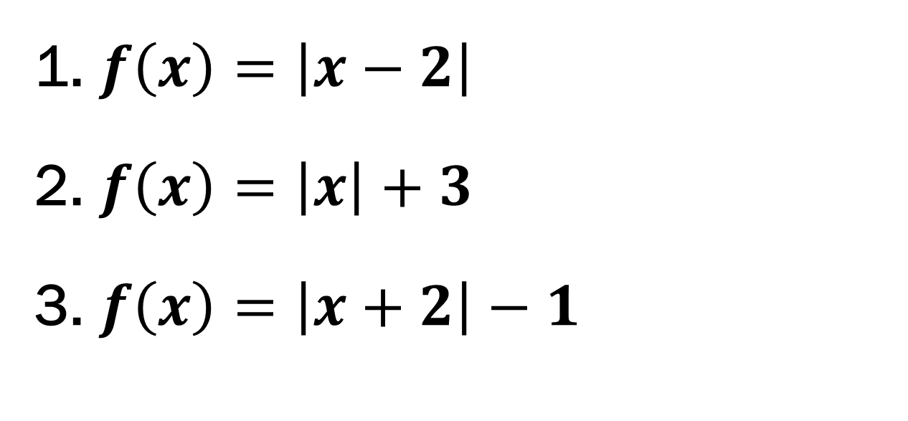
Examples
$f\left(x\right)=\left|x−2\right|$
$f\left(x\right)=\left|x\right|+3$
$f\left(x\right)=\left|x+2\right|−1$

Slide 4
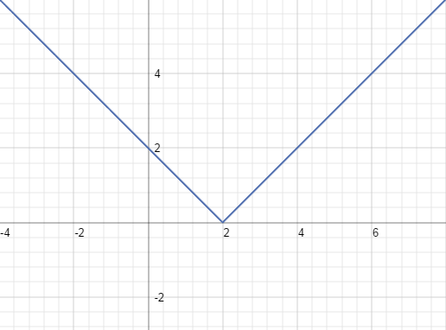
$$f\left(x\right)=\left|x−2\right|$$
X | Y
-2 | 4
-1 | 3
0 | 2
1 | 1
2 | 0
3 | 1
4 | 2
Domain: $\left(−∞,∞\right)$ Range: $[0,∞)$

Slide 5
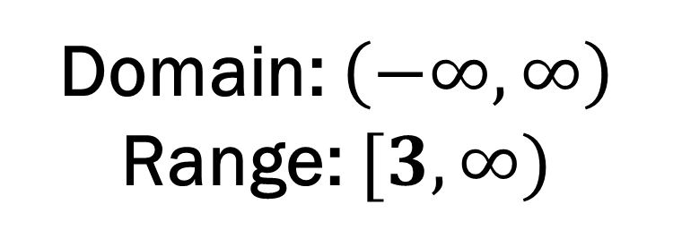
$$f\left(x\right)=\left|x\right|+3$$
X | Y
-3 | 6
-2 | 5
-1 | 4
0 | 3
1 | 4
2 | 5
3 | 6
Domain: $\left(−∞,∞\right)$ Range: $[3,∞)$
Notes:
3

Slide 6
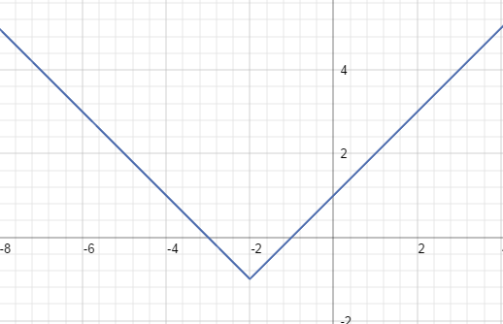
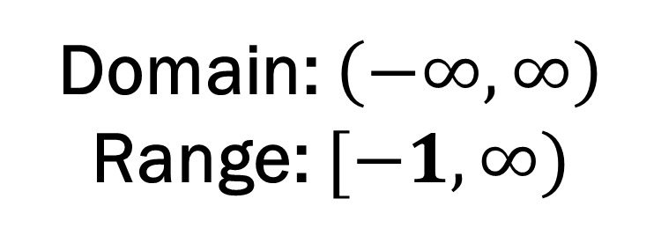
$$f\left(x\right)=\left|x+2\right|−1$$
X | Y
-5 | 2
-4 | 1
-3 | 0
-2 | -1
-1 | 0
0 | 1
1 | 2
Domain: $\left(−∞,∞\right)$ Range: $[−1,∞)$

