Slide 1
Proving Trigonometric Identities
Section 5.2 – Day 1

Slide 2
Exercises: #1 – 6
Directions: Tell whether or not $f\left(x\right)=\sin{x}$is an identity.
$f\left(x\right)=\frac{\tan{x}}{\sec{x}}$
$$\frac{\frac{\sin{x}}{\cos{x}}}{\frac{1}{\cos{x}}}=\frac{\sin{x}}{\cos{x}}∙\frac{\cos{x}}{1}=\sin{x}→YES!$$
$f\left(x\right)=\frac{\sin{2x}}{2}$
This can’t be simplified $→$ NO!

Slide 3
Exercises: #1 – 6
Directions: Tell whether or not $f\left(x\right)=\sin{x}$is an identity.
$f\left(x\right)=\cos\left(x−\frac{π}{2}\right)$
Note: $\cos\left(\frac{π}{2}−θ\right)=\sin{θ}$
$$\cos\left(\left(−1\right)\left(\frac{π}{2}−x\right)\right)=\sin{(−x)}$$
Note: $\sin{(−x)}=−\sin{(x)}$
$$−\sin{x}→NO!$$

Slide 4
Exercises: #7 – 19
Directions: Prove the identity.
$$\left(\sin{x}\right)\left(\cot{x}+\cos{x}\tan{x}\right)=\cos{x}+\sin^{2}{x} \\ (\sin{x)}\left(\frac{\cos{x}}{\sin{x}}+\cos{x}∙\frac{\sin{x}}{\cos{x}}\right)=\cos{x}+\sin^{2}{x} \\ \left(\sin{x}\right)\left(\frac{\cos{x}}{\sin{x}}+\sin{x}\right)=\cos{x}+\sin^{2}{x} \\ \cos{x}+\sin^{2}{x}=\cos{x}+\sin^{2}{x}$$

Slide 5
Exercises: #7 – 19
Directions: Prove the identity.
$${\left(\cos{x}−\sin{x}\right)}^{2}=1−2\sin{x}\cos{x} \\ \left(\cos{x}−\sin{x}\right)\left(\cos{x}−\sin{x}\right)=1−2\sin{x}\cos{x} \\ \cos^{2}{x}−\cos{x}\sin{x}−\cos{x}\sin{x}+\sin^{2}{x}=1−2\sin{x}\cos{x} \\ 1−2\sin{x}\cos{x}=1−2\sin{x}\cos{x}$$

Slide 6
Exercises: #7 – 19
Directions: Prove the identity.
$$\sec{x}+\tan{x}=\frac{\cos{x}}{1−\sin{x}} \\ \frac{1}{\cos{x}}+\frac{\sin{x}}{\cos{x}}=\frac{\cos{x}}{1−\sin{x}} \\ \frac{1+\sin{x}}{\cos{x}}∙\frac{1−\sin{x}}{1−\sin{x}}=\frac{\cos{x}}{1−\sin{x}} \\ \frac{1−\sin^{2}{x}}{\cos{x}(1−\sin{x})}=\frac{\cos{x}}{1−\sin{x}} \\ \frac{\cos^{2}{x}}{\cos{x}(1−\sin{x})}=\frac{\cos{x}}{1−\sin{x}} \\ \frac{\cos{x}}{1−\sin{x}}=\frac{\cos{x}}{1−\sin{x}}$$

Slide 7
Homework: Due 3/26
P. 437 – 438:
#1 – 19 (ODD)

Slide 8
Proving Trigonometric Identities
Section 5.2 – Day 2

Slide 9
Example #1
Directions: Prove the identity.
$$\frac{\sec{x}+1}{\tan{x}}=\frac{\tan{x}}{\sec{x}−1}$$

Slide 10
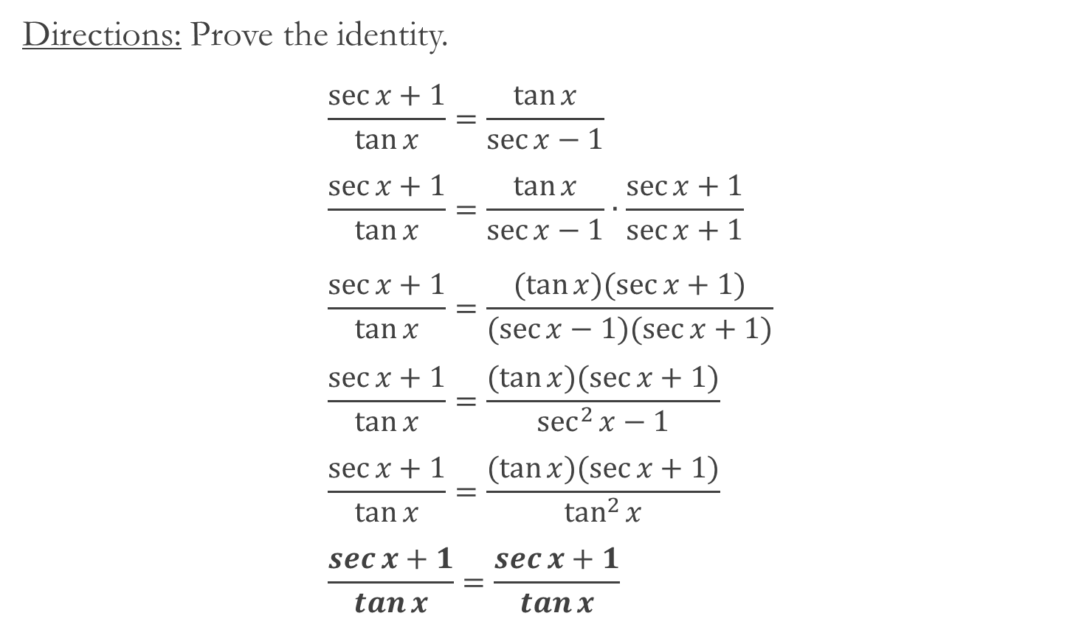
Example #1 – Solution
Directions: Prove the identity.
$$\frac{\sec{x}+1}{\tan{x}}=\frac{\tan{x}}{\sec{x}−1} \\ \frac{\sec{x}+1}{\tan{x}}=\frac{\tan{x}}{\sec{x}−1}∙\frac{\sec{x+1}}{\sec{x}+1} \\ \frac{\sec{x}+1}{\tan{x}}=\frac{(\tan{x})(\sec{x}+1)}{(\sec{x}−1)(\sec{x}+1)} \\ \frac{\sec{x}+1}{\tan{x}}=\frac{(\tan{x})(\sec{x}+1)}{\sec^{2}{x}−1} \\ \frac{\sec{x}+1}{\tan{x}}=\frac{(\tan{x})(\sec{x}+1)}{\tan^{2}{x}} \\ \frac{\sec{x}+1}{\tan{x}}=\frac{\sec{x}+1}{\tan{x}}$$

Slide 11
Example #2
Directions: Prove the identity.
$$\tan^{2}{x}−\sin^{2}{x}=\tan^{2}{x}\sin^{2}{x}$$

Slide 12

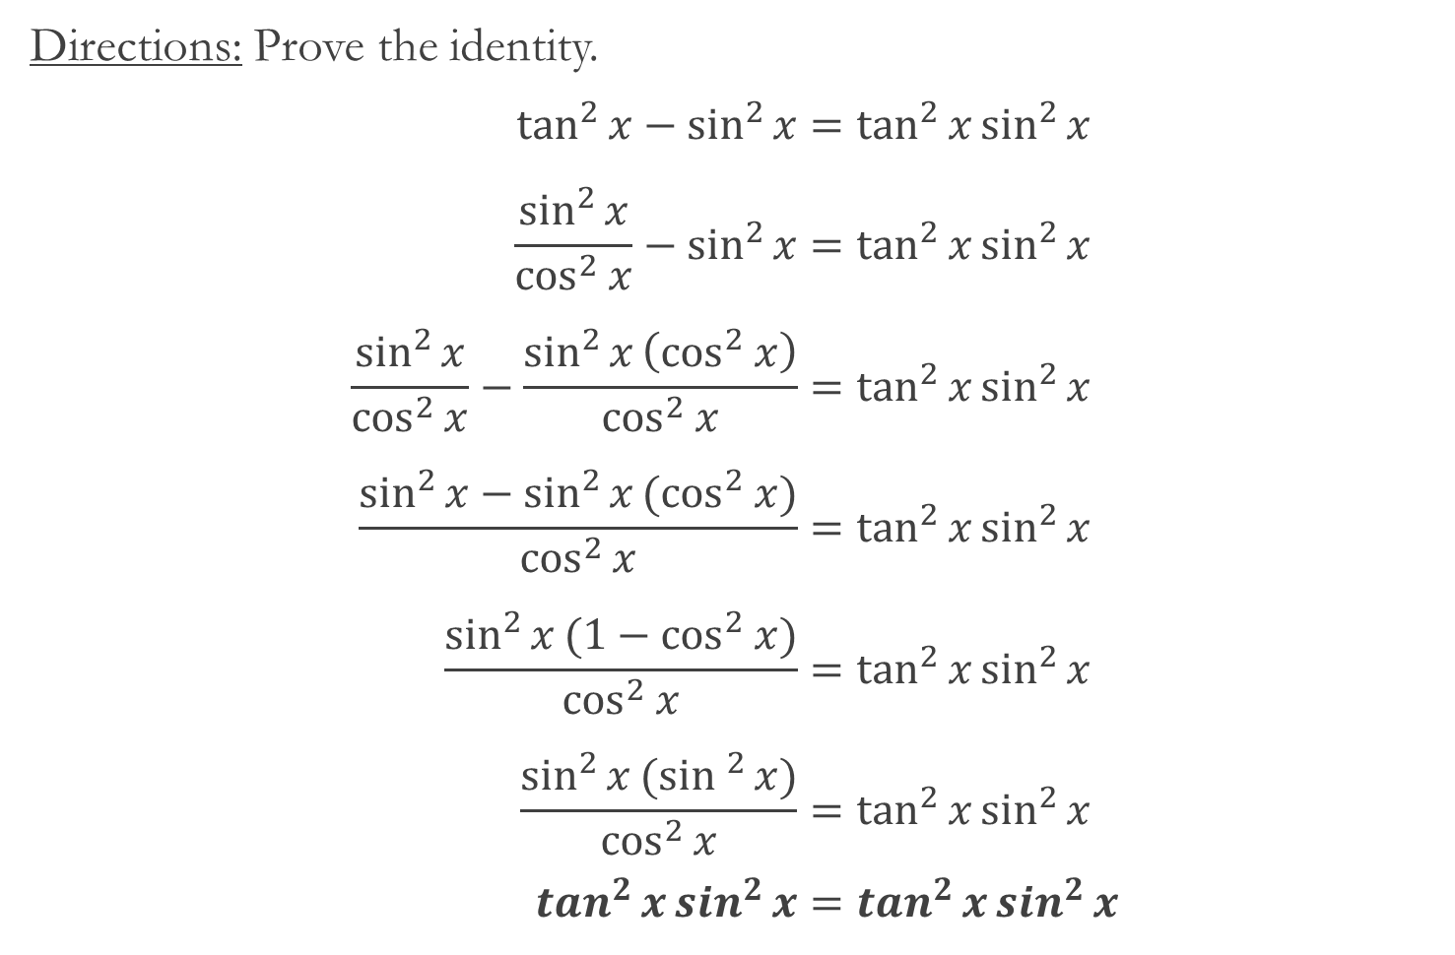
Example #2 – Solution
Directions: Prove the identity.
$$\tan^{2}{x}−\sin^{2}{x}=\tan^{2}{x}\sin^{2}{x} \\ \frac{\sin^{2}{x}}{\cos^{2}{x}}−\sin^{2}{x}=\tan^{2}{x}\sin^{2}{x} \\ \frac{\sin^{2}{x}}{\cos^{2}{x}}−\frac{\sin^{2}{x}\left(\cos^{2}{x}\right)}{\cos^{2}{x}}=\tan^{2}{x}\sin^{2}{x} \\ \frac{\sin^{2}{x}−\sin^{2}{x}(\cos^{2}{x})}{\cos^{2}{x}}=\tan^{2}{x}\sin^{2}{x} \\ \frac{\sin^{2}{x}(1−\cos^{2}{x})}{\cos^{2}{x}}=\tan^{2}{x}\sin^{2}{x} \\ \frac{\sin^{2}{x}(\sin^{2}{x})}{\cos^{2}{x}}=\tan^{2}{x}\sin^{2}{x} \\ \tan^{2}{x}\sin^{2}{x}=\tan^{2}{x}\sin^{2}{x}$$
$$\frac{\sin^{2}{x}}{\cos^{2}{x}}=\tan^{2}{x}$$

Slide 13

Example #3
Directions: Prove the identity.
$$\sin^{3}{x}\cos^{3}{x}=\left(\sin^{3}{x}−\sin^{5}{x}\right)(\cos{x})$$

Slide 14
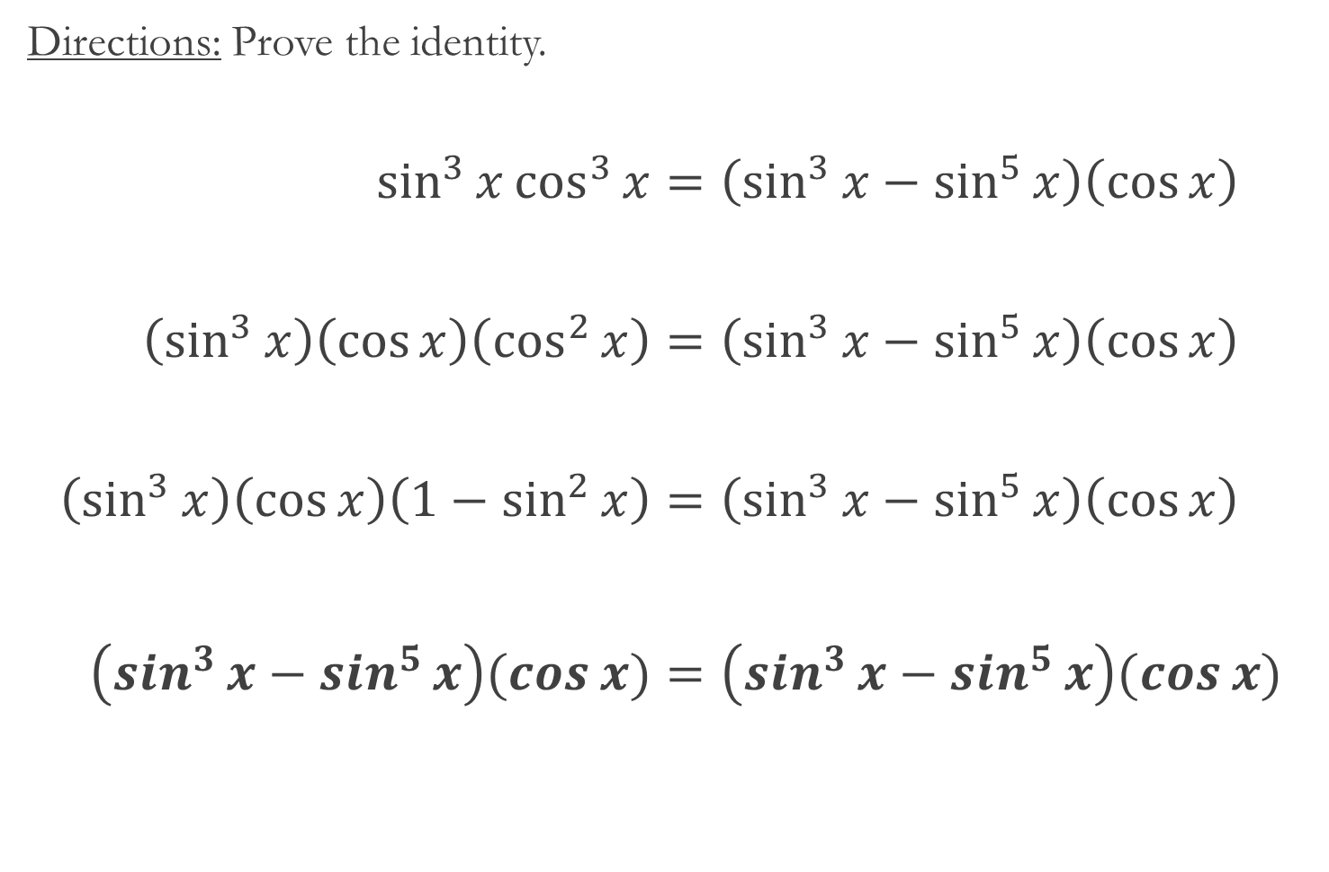
Example #3 – Solution
Directions: Prove the identity.
$$\sin^{3}{x}\cos^{3}{x}=\left(\sin^{3}{x}−\sin^{5}{x}\right)\left(\cos{x}\right) \\ \left(\sin^{3}{x}\right)\left(\cos{x}\right)\left(\cos^{2}{x}\right)=\left(\sin^{3}{x}−\sin^{5}{x}\right)\left(\cos{x}\right) \\ \left(\sin^{3}{x}\right)\left(\cos{x}\right)\left(1−\sin^{2}{x}\right)=\left(\sin^{3}{x}−\sin^{5}{x}\right)\left(\cos{x}\right) \\ \left(\sin^{3}{x}−\sin^{5}{x}\right)(\cos{x})=\left(\sin^{3}{x}−\sin^{5}{x}\right)(\cos{x})$$

Slide 15

Example #4
Directions: Prove the identity.
$$\sec^{4}{x}=\left(1+\tan^{2}{x}\right)(\sec^{2}{x})$$

Slide 16

Example #4 – Solution
Directions: Prove the identity.
$$\sec^{4}{x}=\left(1+\tan^{2}{x}\right)(\sec^{2}{x}) \\ \sec^{4}{x}=\left(\sec^{2}{x}\right)(\sec^{2}{x}) \\ \sec^{4}{x}=\sec^{4}{x}$$

Slide 17
Homework: Due 3/26
P. 437 – 438:
#21 – 27(ODD)
#31, 32, 37 and 39
#45 and #47

Slide 18
Proving Trigonometric Identities
Section 5.2 – Day 3

Slide 19

Warm – Up: 3/26
Prove the identity:
$$\frac{\sin{t}}{1−\cos{t}}+\frac{1+\cos{t}}{\sin{t}}=\frac{2(1+\cos{t})}{\sin{t}}$$

