Slide 1
Welcome Back!
Ms. Orban
Pre-Calculus
1st Hour

Slide 2
Agenda
Syllabus
Website
Remind101
Who Am I? (Getting to know Ms. Orban)
Who Are you?

Slide 3
Syllabus

Slide 4
Goals
Students will:
learn to graph and analyze functions using domain, range, continuity, zeros, asymptotes, maximums, minimums, and increasing and decreasing behavior.
be able to determine and interpret the limits of functions and sequences.
be able to understand and evaluate derivatives and know how to use them appropriately.
develop proficiency in the use of the graphic calculator.
be able to use appropriate formulas and identities from trigonometry.
be able to express solutions and ideas in written form with descriptions and presentations using correct notation, vocabulary, logic and concepts from this course content and that of previous courses.
develop problem-solving skills.

Slide 5
Grades
Grading Scale:
A 94 – 100 B+ 88 – 89 C+ 78 – 79 D+ 68 – 69
A- 90 – 93 B 84 – 87 C 74 – 77 D 64 – 67
B– 80 – 83 C– 70 – 73 D– 60 – 63
F 59 – 0
Marking Period Grade Criteria:
Tests 55%
Quizzes 20%
Homework/Class Work 25%

Slide 6
Student Responsibilities
In this course the study of mathematics intensifies and students will be expected:
To accept responsibility for their own learning.
To discuss solutions and explain their reasoning to others.
To keep a complete notebook which includes class assignments, homework, notes, tests, and quizzes.
To come to class prepared to participate and study.
All work assigned to individual students is expected to be their own product. In the event that collaboration took place when inappropriate, as in taking a test or quiz, a zero will be given to each student and the parents will be contacted for violation of this policy.
Class will begin each day following the tardy bell; therefore it is vital that students come to class on time to gain the most from each class.
Almost all students need help at one time or another; therefore students are encouraged to stay after school with their teacher for extra help. Please make appointments with individual teachers for extra help.
The Southfield Public Schools Board of Education Policy and High School Code of Conduct will be followed for dress code, electronic devices, hats, ID’s and planners.

Slide 7
Attendance Policy
Once students reach (5) unexcused tardies or (5) unexcused absences in one semester the student will receive zero points toward their grade point average. However, the students will receive credit for the class if satisfactory work has been completed despite the tardies or absences, or will not receive credit if satisfactory work has not been completed. Parents/Guardians must call within 24 hours to excuse an absence.

Slide 8
Additional Information
Recommended Materials:
Textbook, notebook, paper, pencil and a graphic calculator.
The mathematics department recommends the TI-83 or TI-84 Plus for all of our students.
Make up work:
Students are expected to make up all work missed due to absence from class for any reason. Students will be given the number of class periods missed plus one (1) to turn in missed assignments and class work. Extenuating circumstances may require teachers and student to negotiate reasonable time lines for making up work that both can accept.
Late work policy:
Late work in general is unacceptable for any reason other than absence from school.

Slide 9
Tips For Success!
Listen in class.
Take notes in class, keep these notes to study for the chapter test, mid-semester exam, and semester exam. They may even be helpful in future math classes.
Visit websites for worksheets, classwork/homework and helpful hints:
Orban: http://slhs-precalc-orban.weebly.com
Try every problem.
Give your best every day.
Bring your assignments and material to class every day.
Ask questions when you need clarification.
Review one day’s assignment before beginning a new one.

Slide 10
Website
Ms. Orban’s Class Page

Slide 11
http://slhs-precalc-orban.weebly.com/
Notes:
http://slhs-precalc-orban.weebly.com/

Slide 12
Remind101

Slide 13
Remind101
Email: https://www.remind.com/join/orban1
Text: (248) 918-0344 with the message: @orban1
Remind App: Enter class code: @orban1

Slide 14
Expectations

Slide 15
Classroom Expectations
Respect
For me and your classmates
Participation
OK to make mistakes
Mathematics Learning Community
Open to everyone’s ideas

Slide 16
WHO AM i?

Slide 17
Who Am I?
Graduated from Henry Ford II High School
Graduated from Michigan State University (2014)
Secondary Education Degree
Major: Mathematics
Minor: Chemistry
Played soccer for 15 years and played flute in marching band and symphonic band.
Likes: Traveling, reading, playing sports, and watching movies.

Slide 18
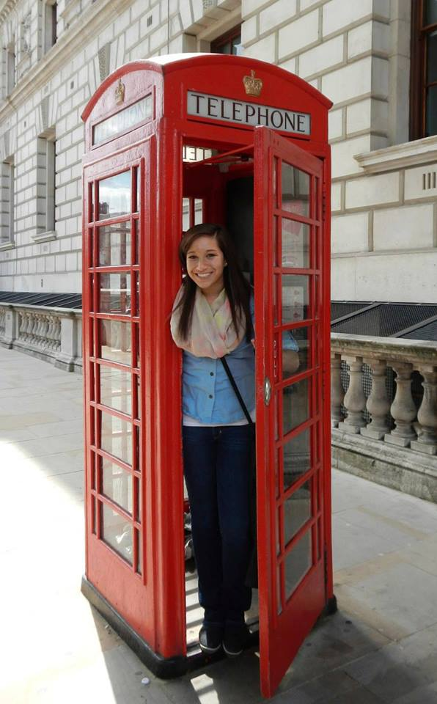
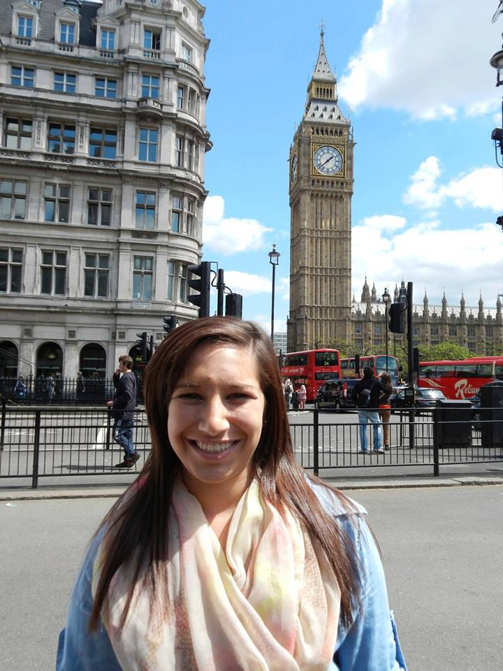
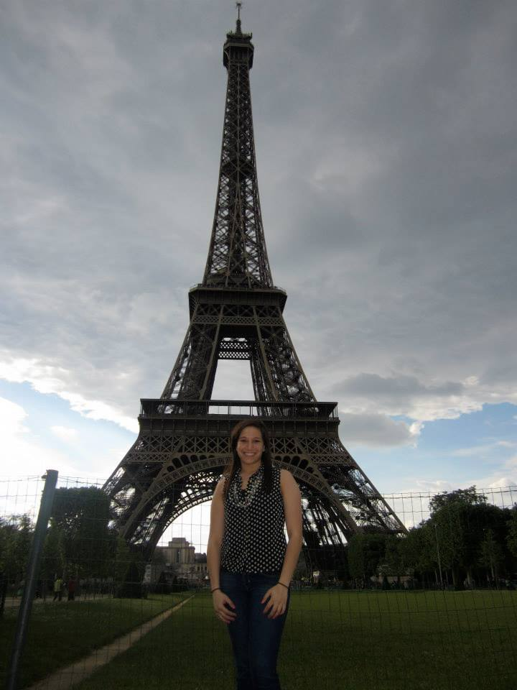
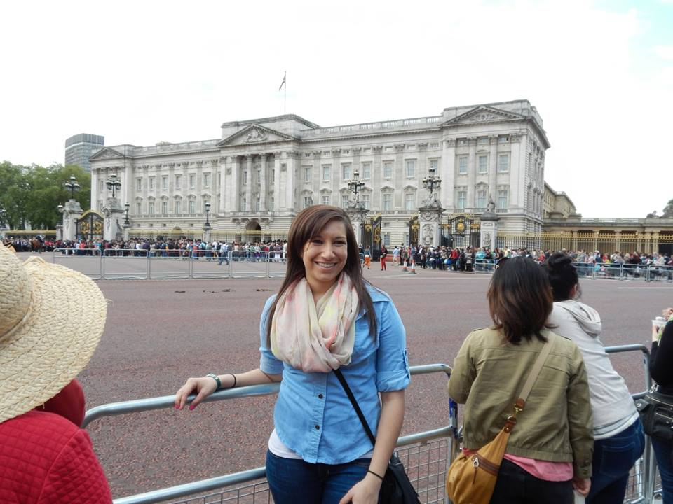
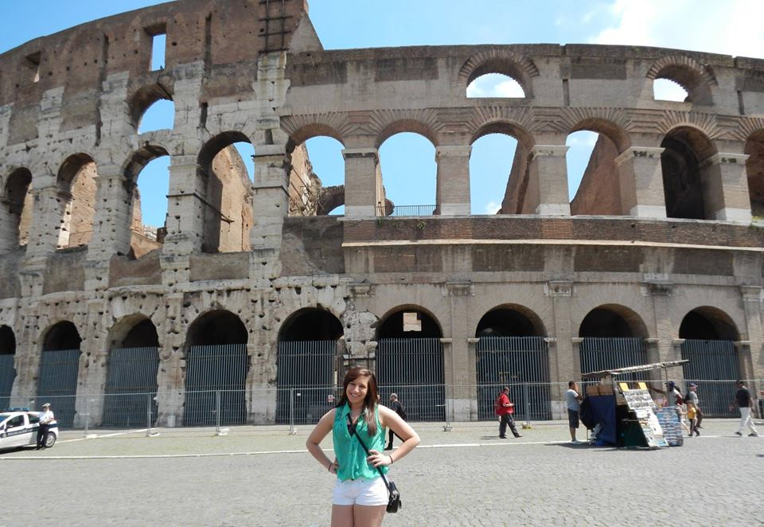
Traveling Around Europe
Maastricht, Netherlands
Amsterdam, Netherlands
Paris, France
Brussels, Belgium
Aachen, Germany
London, England
Rome, Italy
Vatican City, Italy

Slide 19
Who Are you?

Slide 20
Who Are You?
Did you travel anywhere this summer? If so, where?
What are some things you do for fun?
What is the best movie you’ve watched lately?
What is your favorite sport?
What is one thing you are looking forward to this year?
What is one word that describes you?

